Slide 1
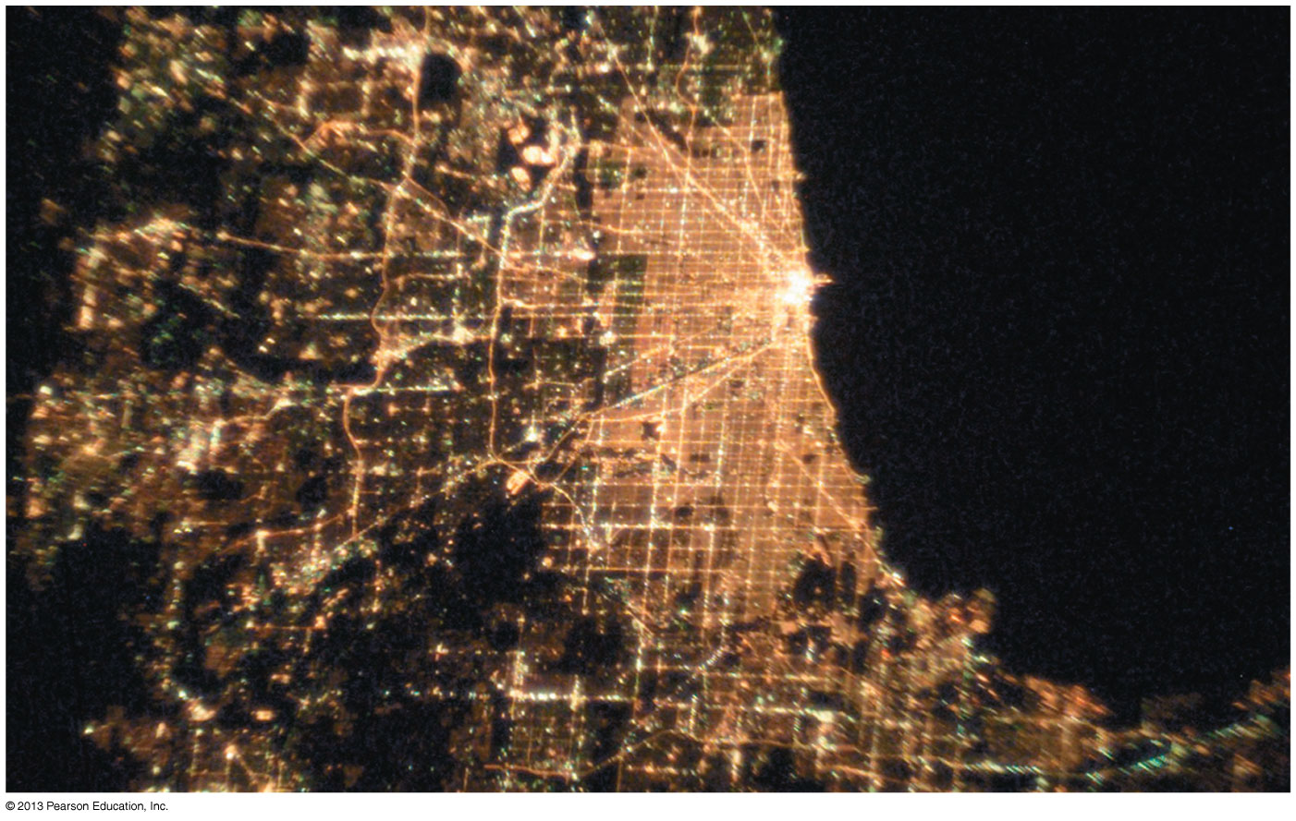
Chapter 28 The Electric Potential
Chapter Goal: To calculate and use the electric potential and electric potential energy.
Slide 28-2

Slide 2
Energy
The kinetic energy of a system, K, is the sum of the kinetic energies K_{i} = 1/2m_{i}v_{i}² of all the particles in the system.
The potential energy of a system, U, is the interaction energy of the system.
The change in potential energy, ΔU, is −1 times the work done by the interaction forces:
If all of the forces involved are conservative forces (such as gravity or the electric force) then the total energy K + U is conserved; it does not change with time.
Slide 28-21

Slide 3
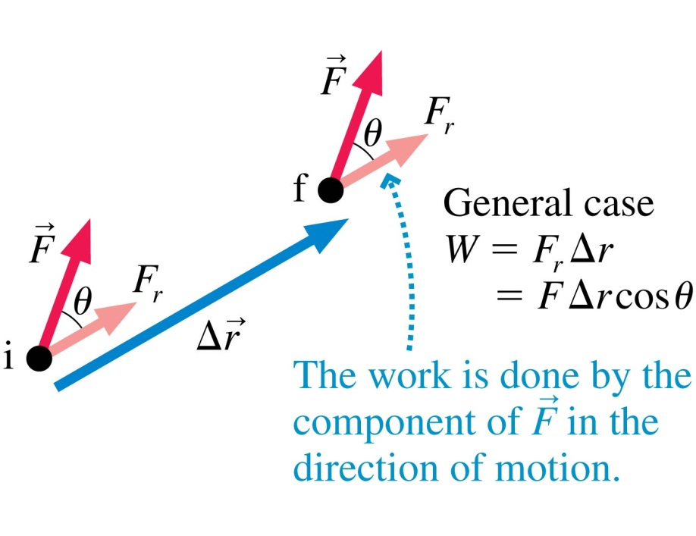
Work Done by a Constant Force
Recall that the work done by a constant force depends on the angle θ between the force F and the displacement Δr.
If θ = 0°, then W = FΔr.
If θ = 90°, then W = 0.
If θ = 180°, then W = −FΔr.
Slide 28-22

Slide 4
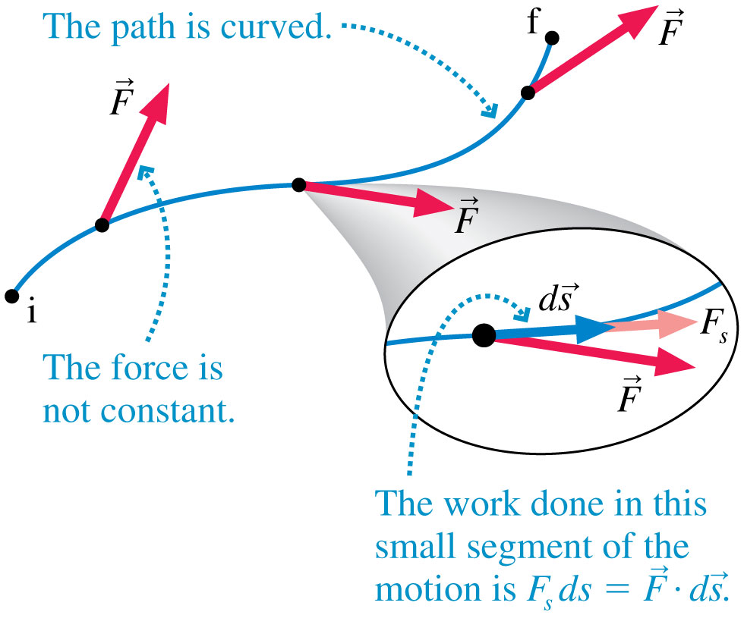
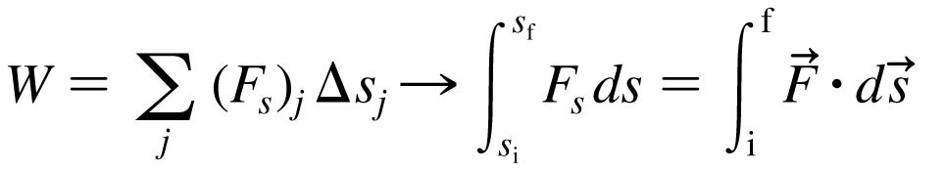
Work
If the force is not constant or the displacement is not along a linear path, we can calculate the work by dividing the path into many small segments.
Slide 28-23

Slide 5
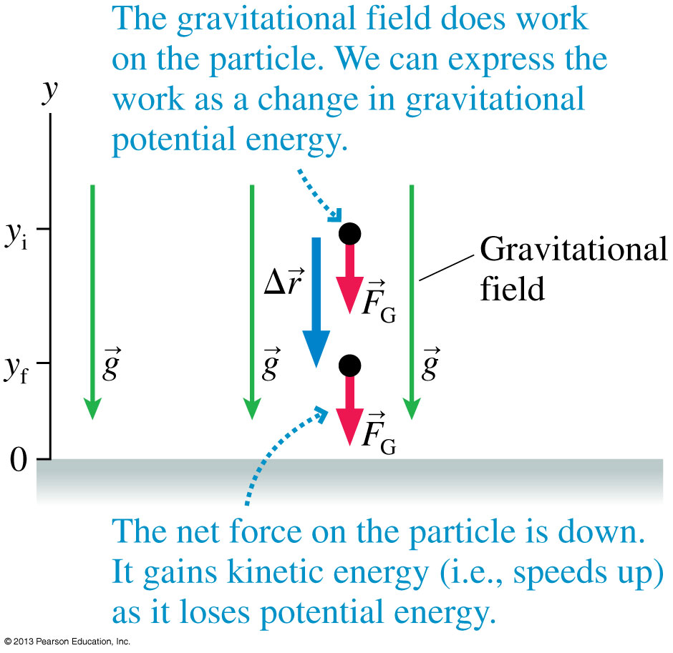
Gravitational Potential Energy
Every conservative force is associated with a potential energy.
In the case of gravity, the work done is:
W_{grav} = mgy_{i} − mgy_{f}
The change in gravitational potential energy is:
ΔU_{grav} = − W_{grav}
where
U_{grav} = U₀ + mgy
Slide 28-24

Slide 6
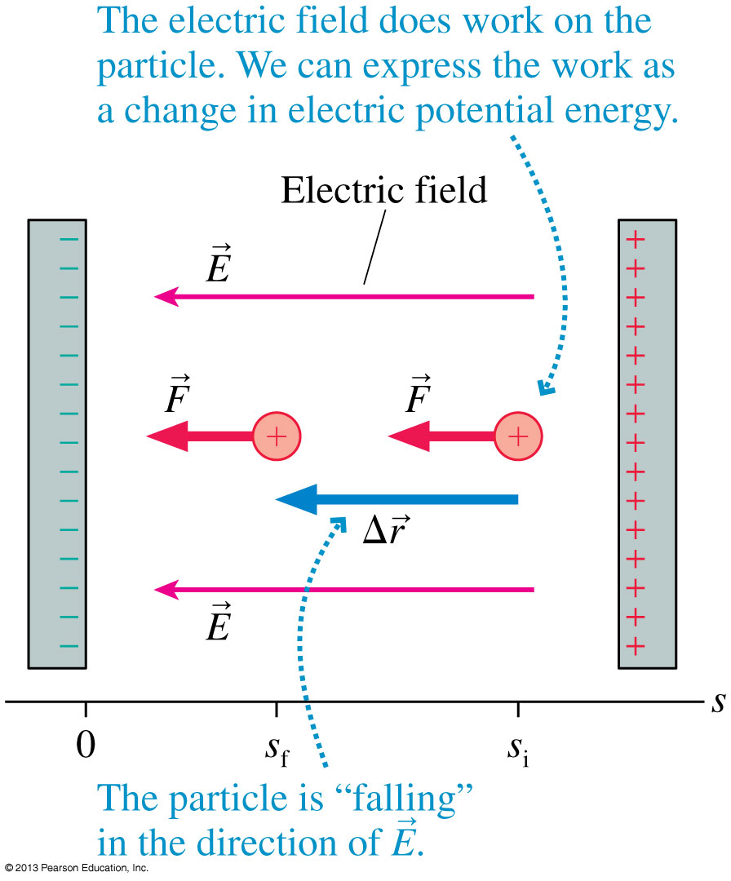
Electric Potential Energy in a Uniform Field
A positive charge q inside a capacitor speeds up as it “falls” toward the negative plate.
There is a constant force
F = qE in the direction of the displacement.
The work done is:
W_{elec} = qEs_{i} − qEs_{f}
The change in electric potential energy is:
ΔU_{elec} = −W_{elec}
where
U_{elec} = U₀ + qEs
Slide 28-27

Slide 7
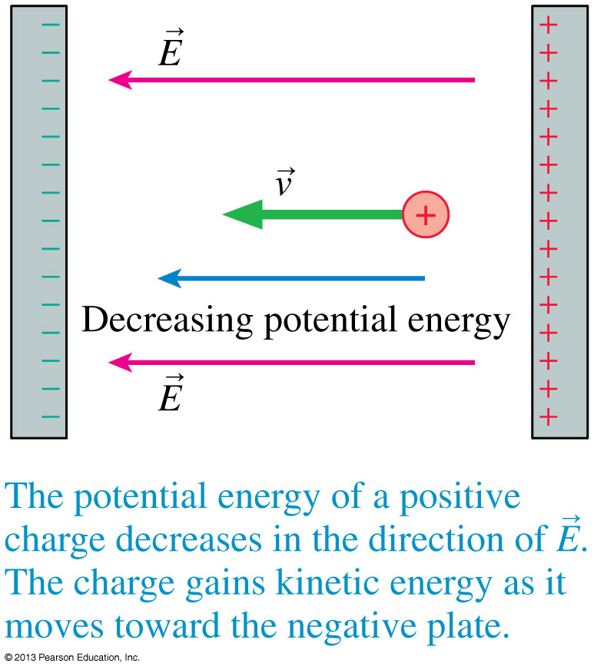
Electric Potential Energy in a Uniform Field
A positively charged particle gains kinetic energy as it moves in the direction of decreasing potential energy.
Slide 28-30

Slide 8
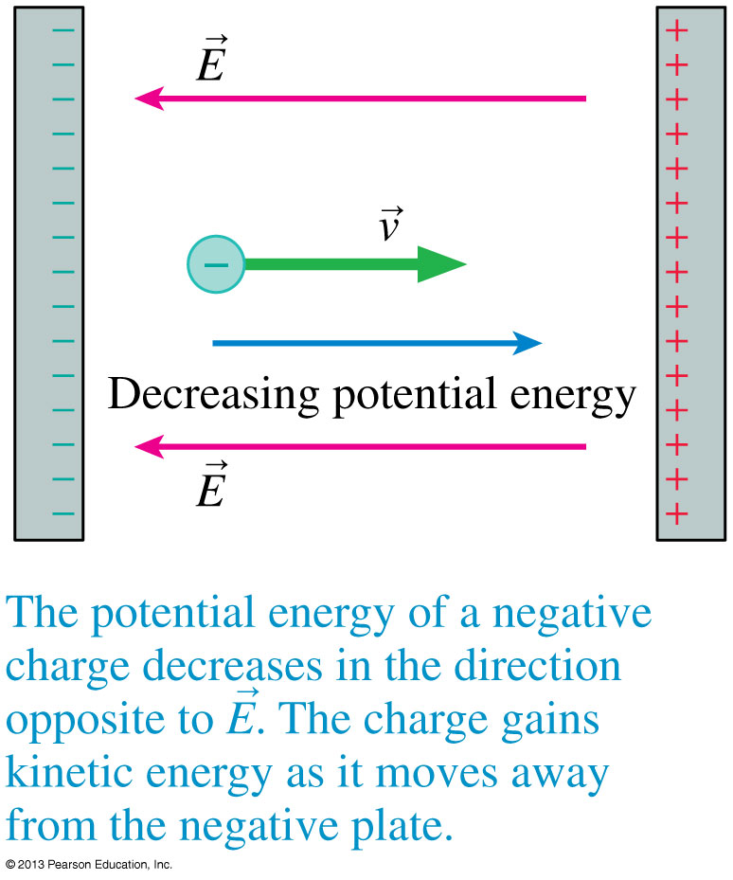
Electric Potential Energy in a Uniform Field
A negatively charged particle gains kinetic energy as it moves in the direction of decreasing potential energy.
Slide 28-31

Slide 9
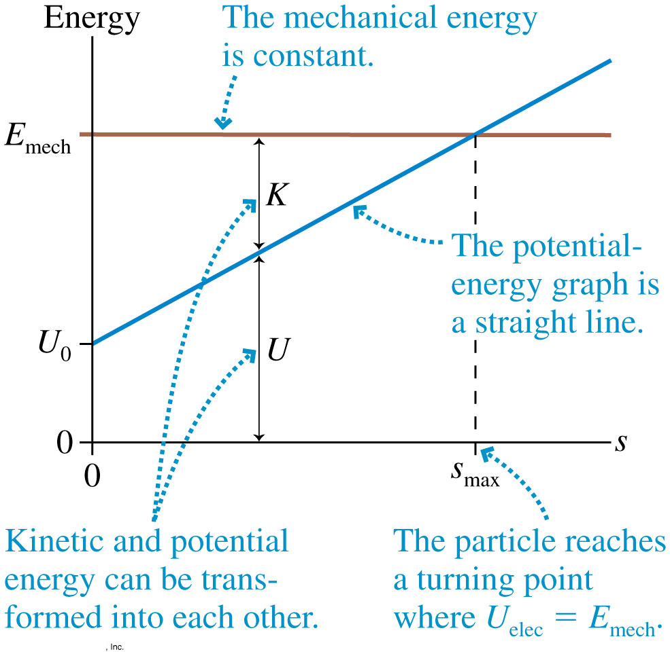
Electric Potential Energy in a Uniform Field
The figure shows the energy diagram for a positively charged particle in a uniform electric field.
The potential energy increases linearly with distance, but the total mechanical energy E_{mech} is fixed.
Slide 28-32

Slide 10
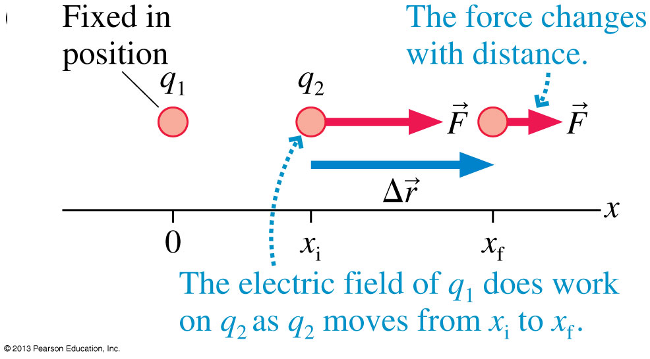
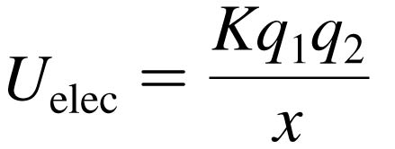
The Potential Energy of Two Point Charges
Consider two like charges q₁ and q₂.
The electric field of q₁ pushes q₂ as it moves from x_{i} to x_{f}.
The work done is:
The change in electric potential energy of the system is ΔU_{elec} = −W_{elec} if:
Slide 28-37

Slide 11

The Potential Energy of Point Charges
The Potential Energy of Two Point Charges
Consider two point charges, q₁ and q₂, separated by a distance r. The electric potential energy is
This is explicitly the energy of the system, not the energy of just q₁ or q₂.
Note that the potential energy of two charged particles approaches zero as r → ∞.
Slide 28-38

Slide 12
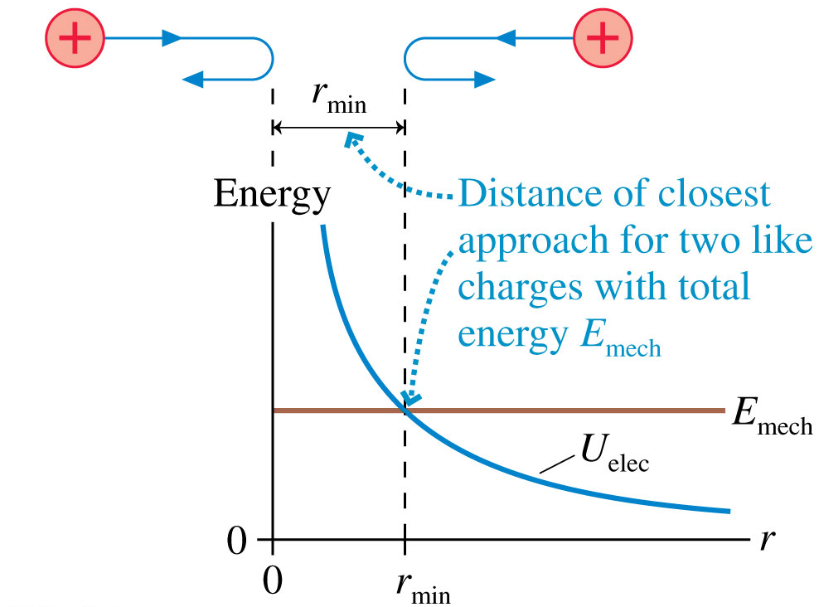
The Potential Energy of Two Point Charges
Two like charges approach each other.
Their total energy is E_{mech} > 0.
They gradually slow down until the distance separating them is r_{min}.
This is the distance of closest approach.
Slide 28-39

Slide 13
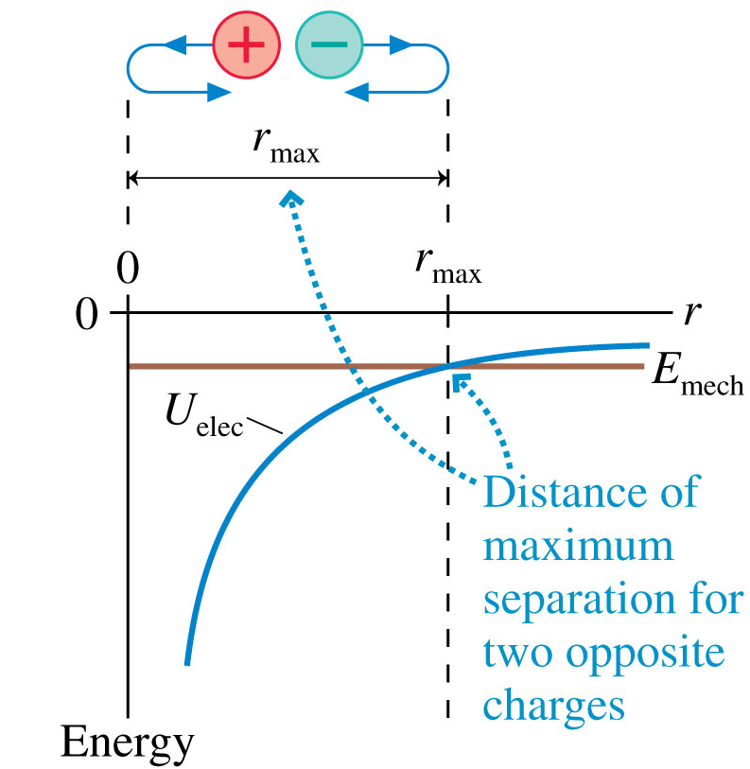
The Potential Energy of Two Point Charges
Two opposite charges are shot apart from one another with equal and opposite momenta.
Their total energy is
E_{mech} < 0.
They gradually slow down until the distance separating them is r_{max}.
This is their maximum separation.
Slide 28-40

Slide 14
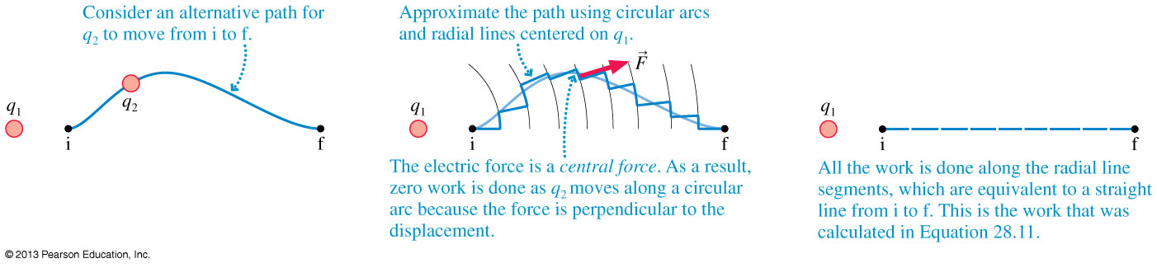
The Electric Force Is a Conservative Force
Any path away from q₁ can be approximated using circular arcs and radial lines.
All the work is done along the radial line segments, which is equivalent to a straight line from i to f.
Therefore the work done by the electric force depends only on initial and final position, not the path followed.
Slide 28-43

Slide 15
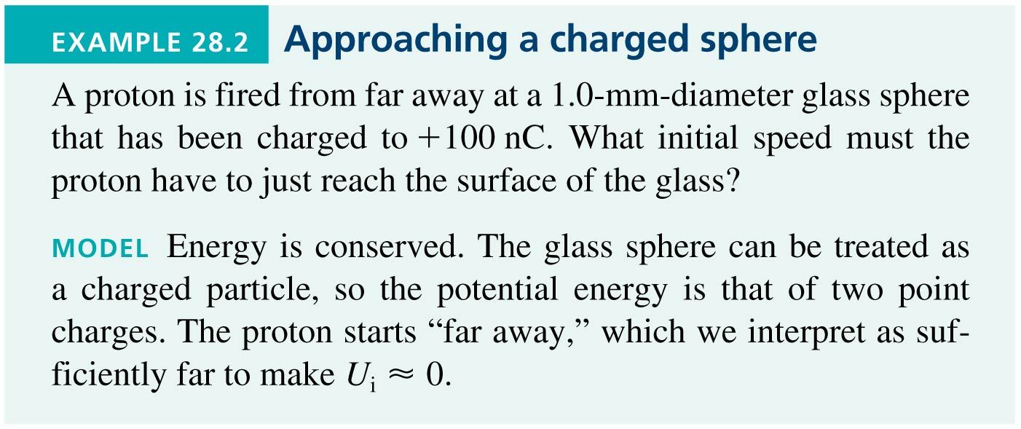
Example 28.2 Approaching a Charged Sphere
Slide 28-44

Slide 16
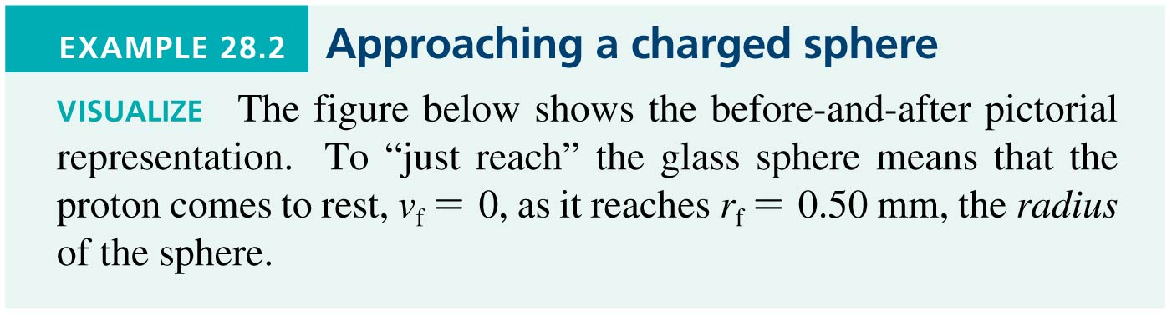
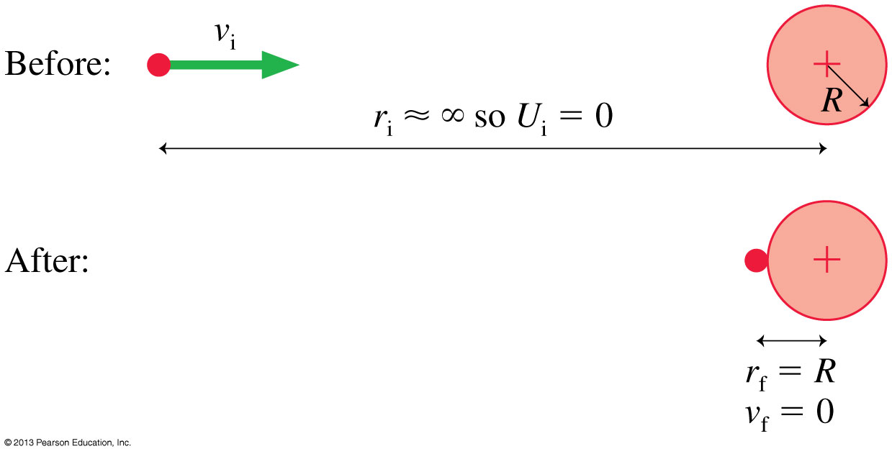
Example 28.2 Approaching a Charged Sphere
Slide 28-45

Slide 17
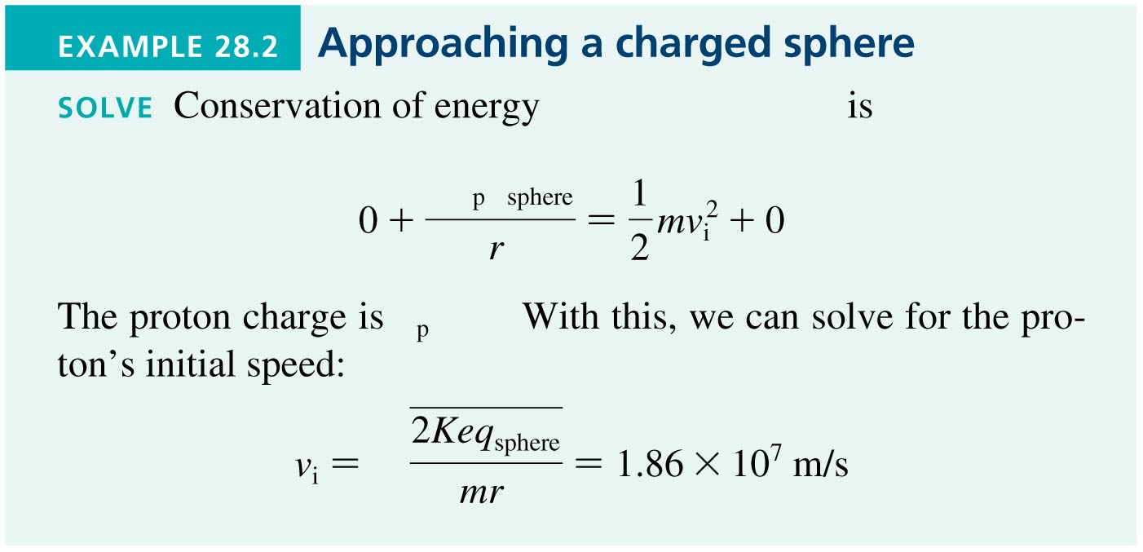
Example 28.2 Approaching a Charged Sphere
Slide 28-46

Slide 18
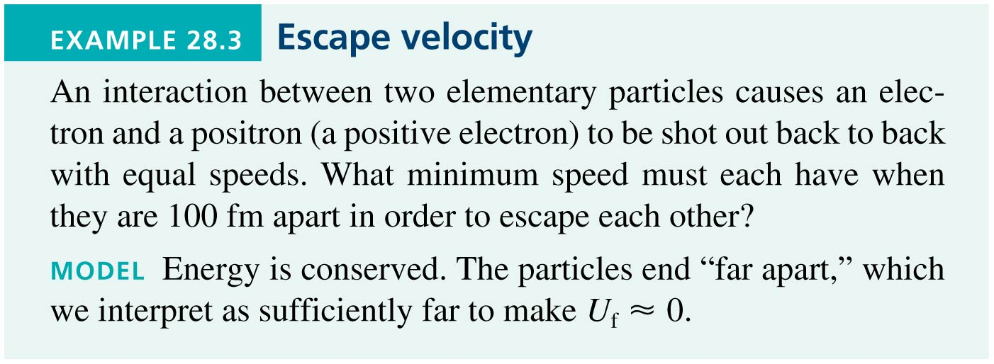
Example 28.3 Escape Velocity
Slide 28-47

Slide 19
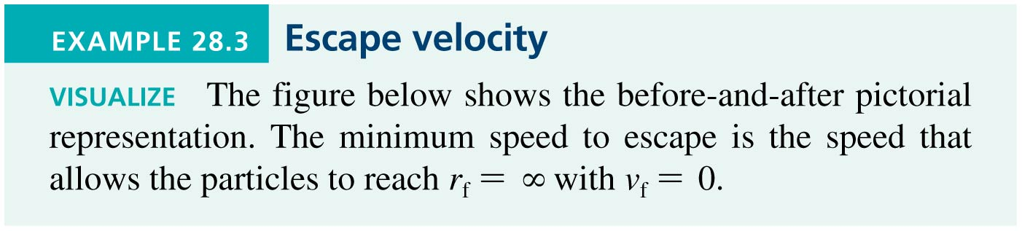
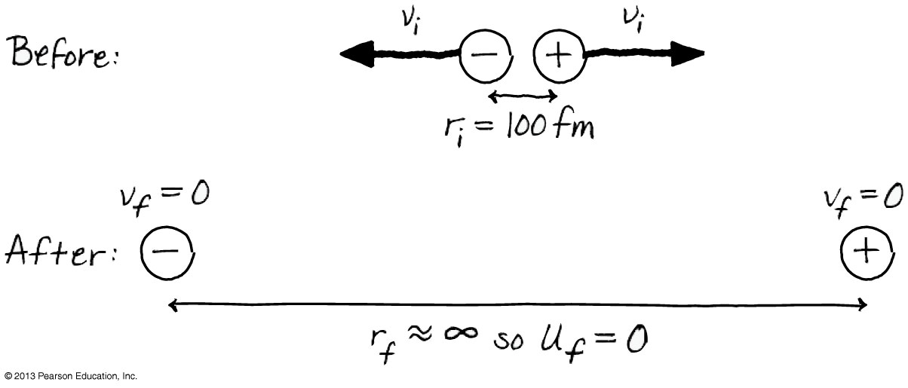
Example 28.3 Escape Velocity
Slide 28-48

Slide 20
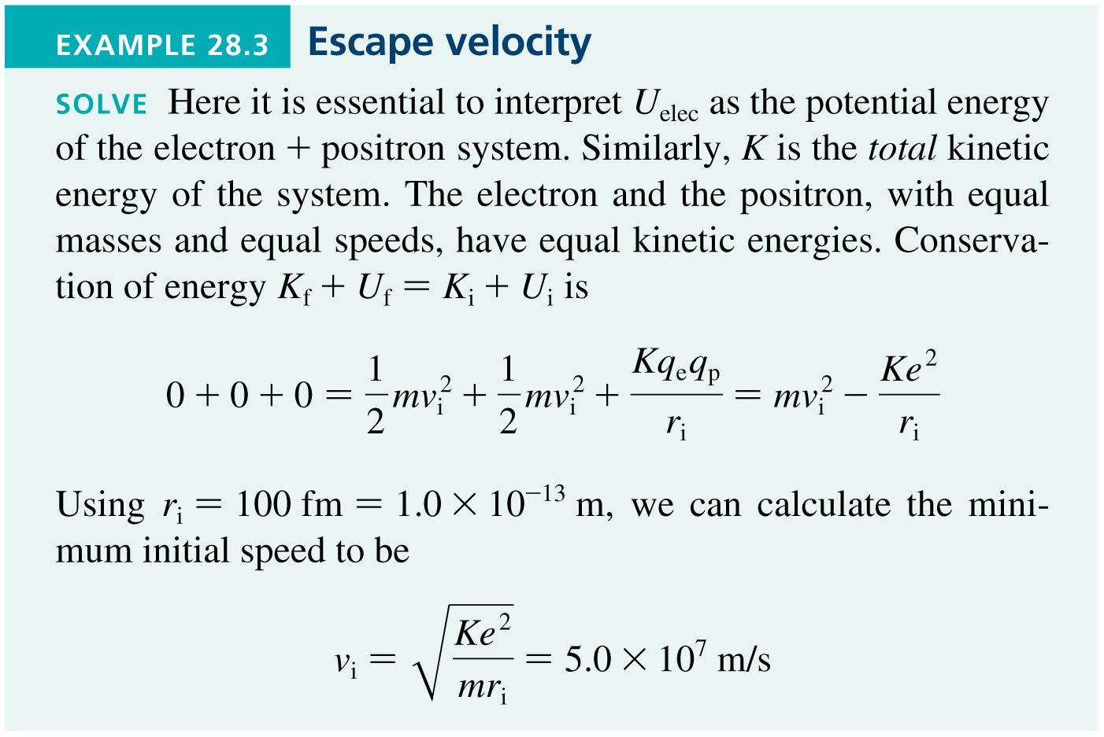
Example 28.3 Escape Velocity
Slide 28-49

Slide 21
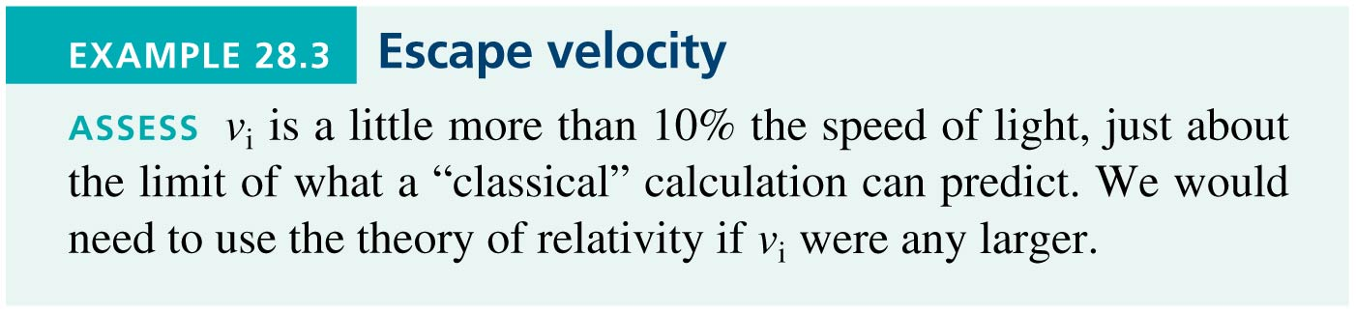
Example 28.3 Escape Velocity
Slide 28-50

Slide 22
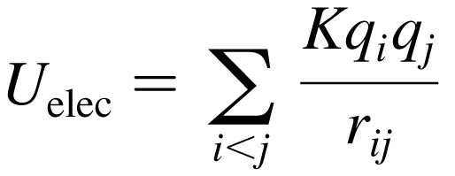
The Potential Energy of Multiple Point Charges
The Potential Energy of Multiple Point Charges
Consider more than two point charges, the potential energy is the sum of the potential energies due to all pairs of charges:
where r_{ij} is the distance between q_{i} and q_{j}.
The summation contains the i < j restriction to ensure that each pair of charges is counted only once.
Slide 28-51

Slide 23
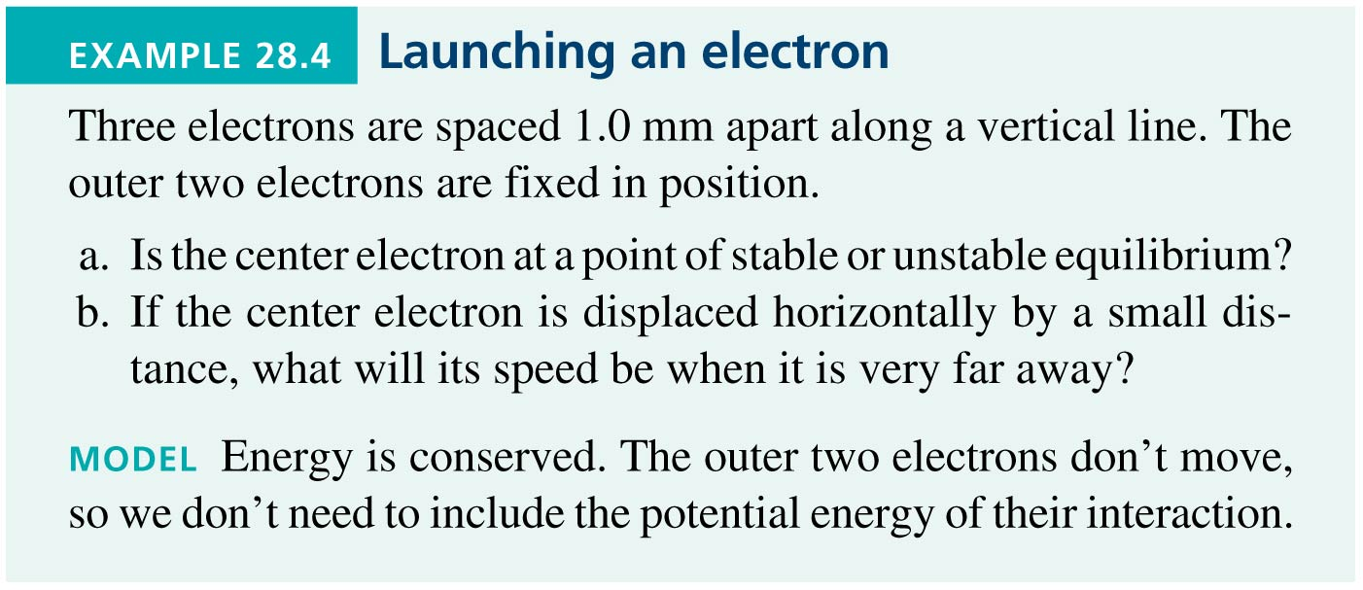
Example 28.4 Launching an Electron
Slide 28-52

Slide 24

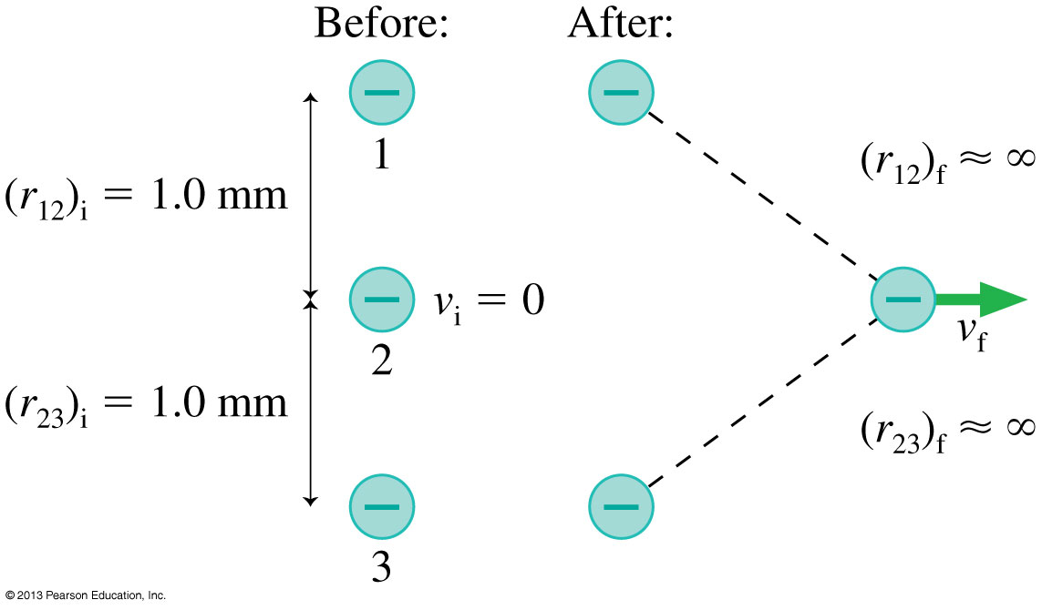
Example 28.4 Launching an Electron
Slide 28-53

Slide 25
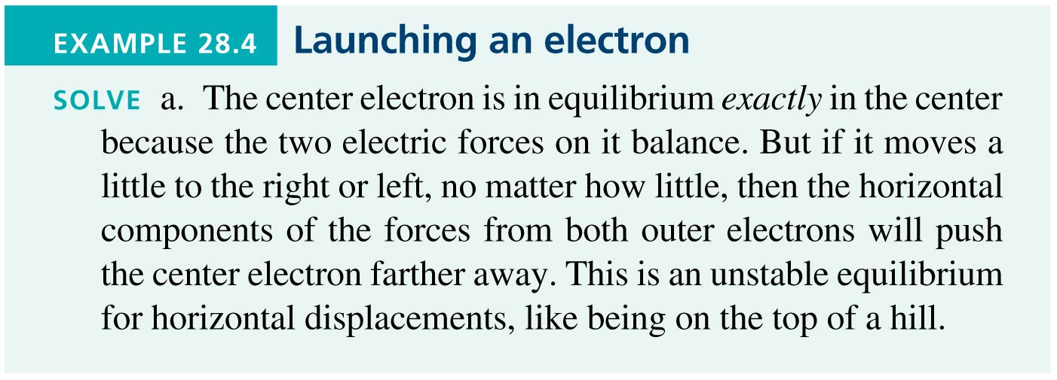
Example 28.4 Launching an Electron
Slide 28-54

Slide 26
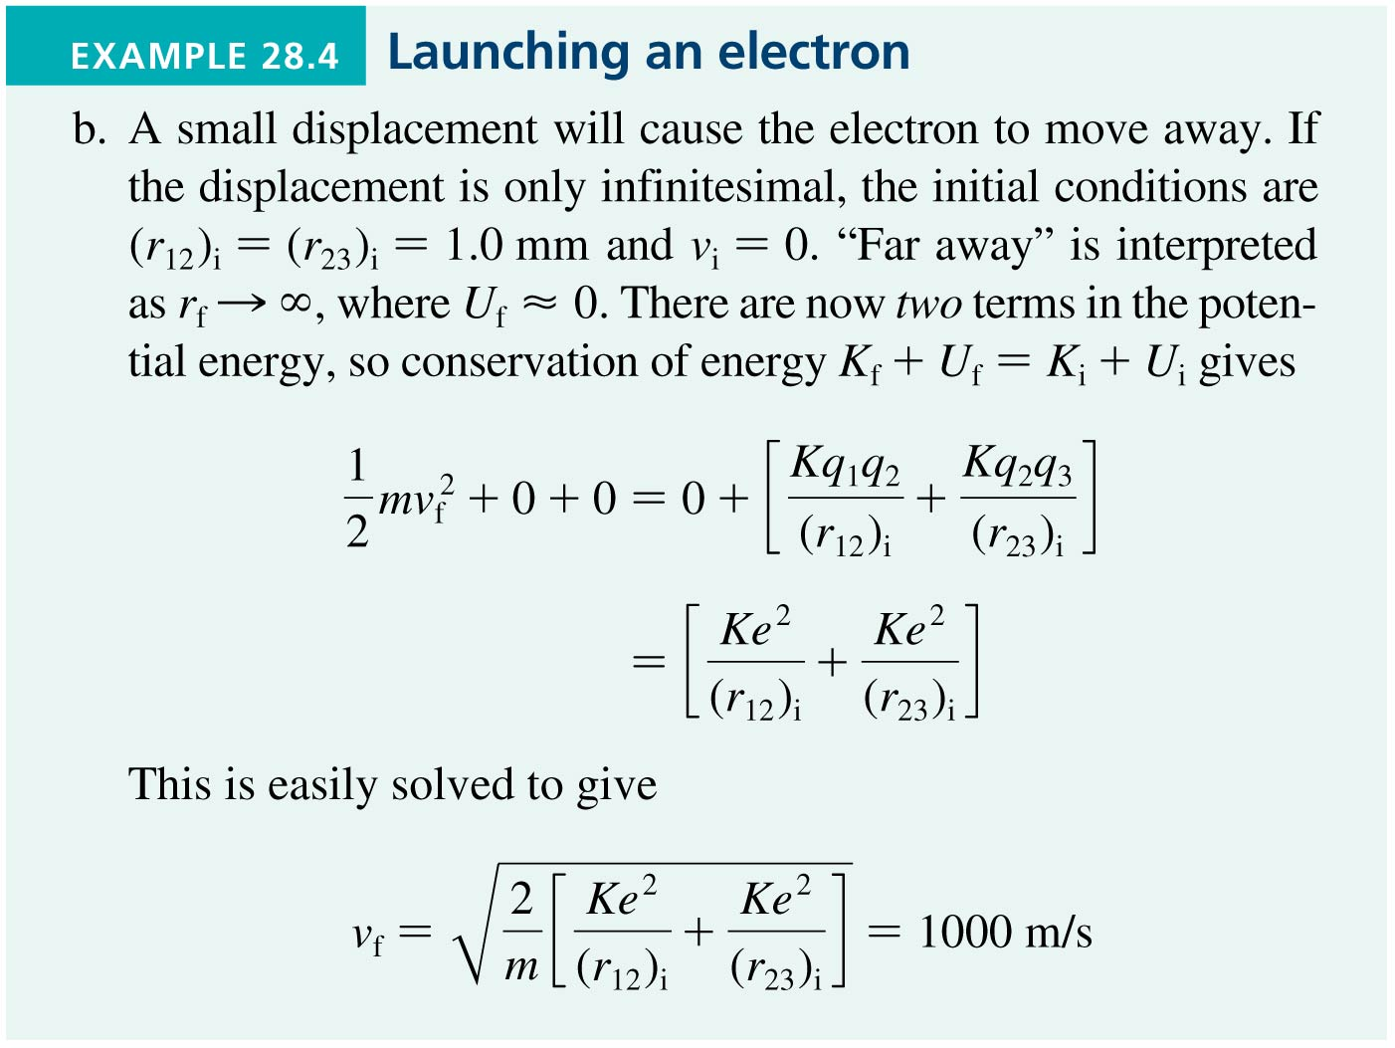
Example 28.4 Launching an Electron
Slide 28-55

Slide 27
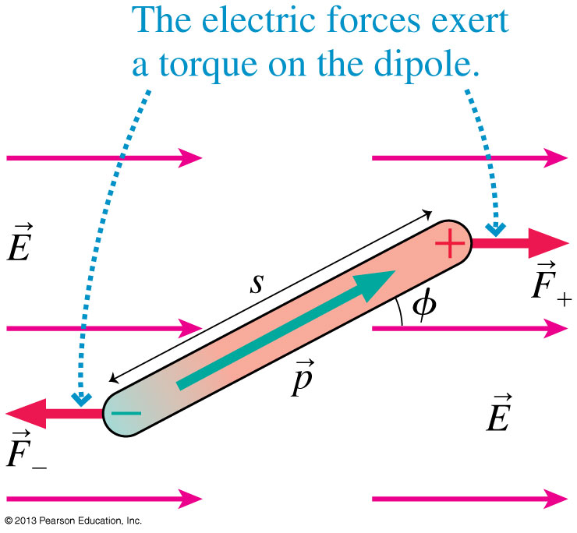
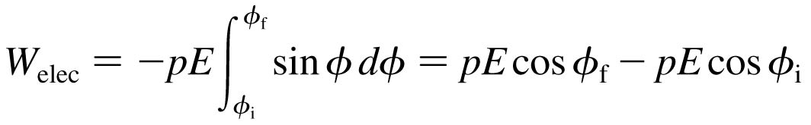
The Potential Energy of a Dipole
Consider a dipole in a uniform electric field.
The forces F₊ and F₋ exert a torque on the dipole.
The work done is:
The change in electric potential energy of the system is ΔU_{elec} = −W_{elec} if:
Slide 28-56

Slide 28
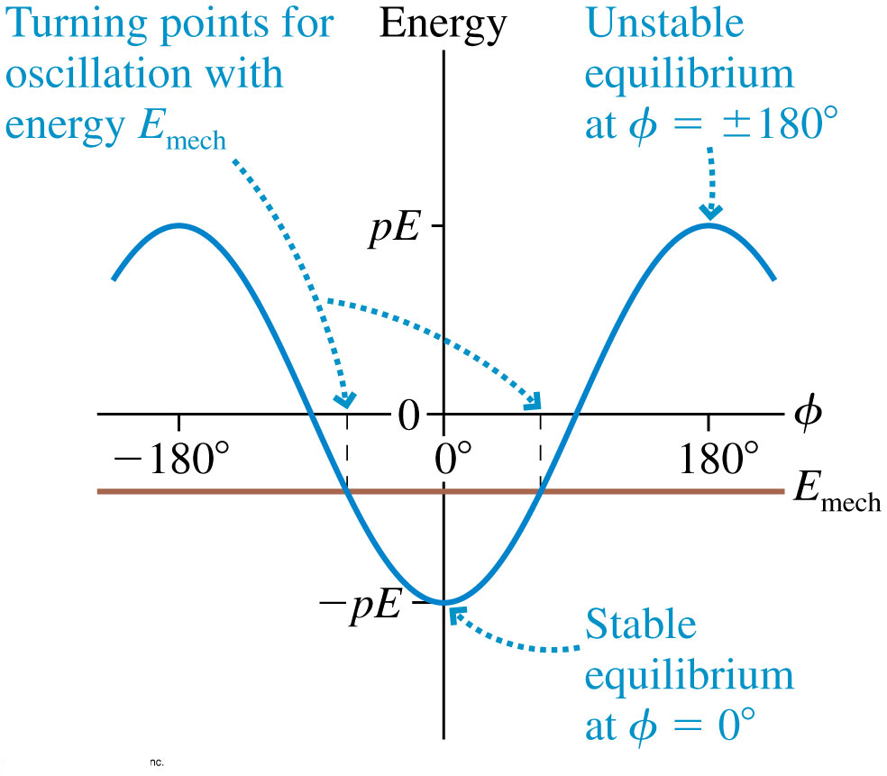
The Potential Energy of a Dipole
The potential energy of a dipole is φ = 0° minimum at where the dipole is aligned with the electric field.
A frictionless dipole with mechanical energy E_{mech} will oscillate back and forth between turning points on either side of φ = 0°.
Slide 28-57

Slide 29
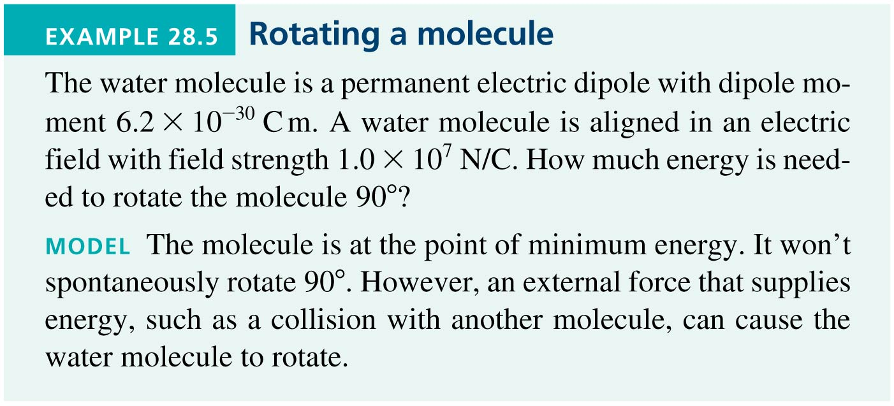
Example 28.5 Rotating a Molecule
Slide 28-58

Slide 30
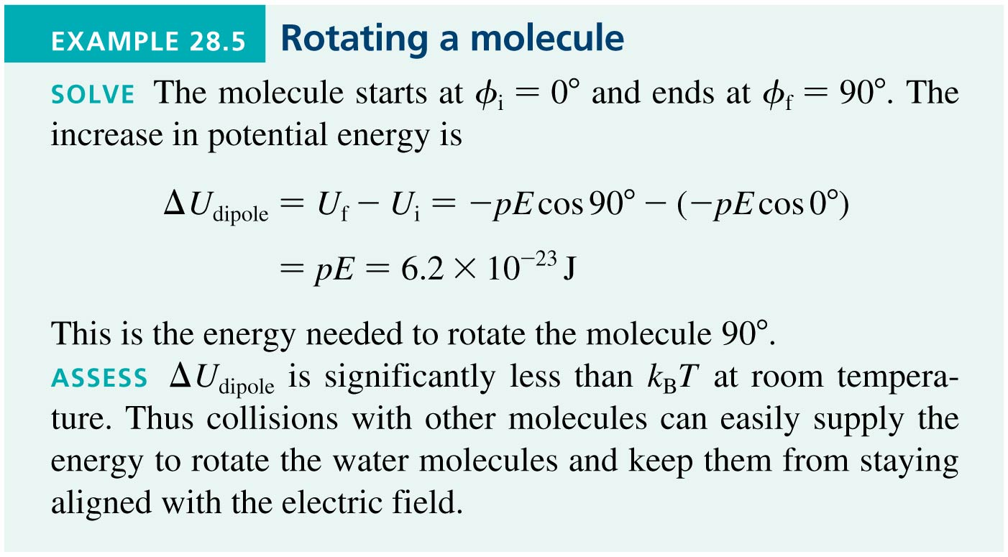
Example 28.5 Rotating a Molecule
Slide 28-59

Slide 31
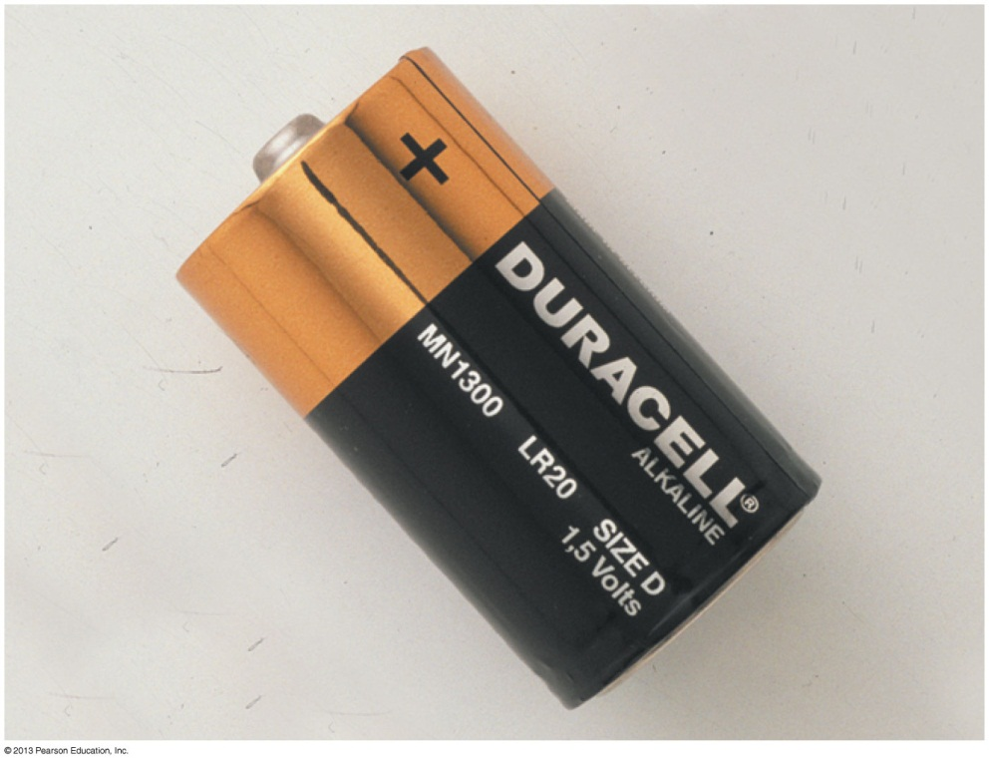
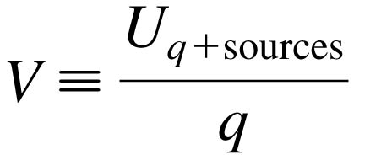

The Electric Potential
We define the electric potential V (or, for brevity, just the potential) as
The unit of electric potential is the joule per coulomb, which is called the volt V:
This battery is a source of electric potential. The electric potential difference between the + and − sides is 1.5 V.
Slide 28-60

Slide 32
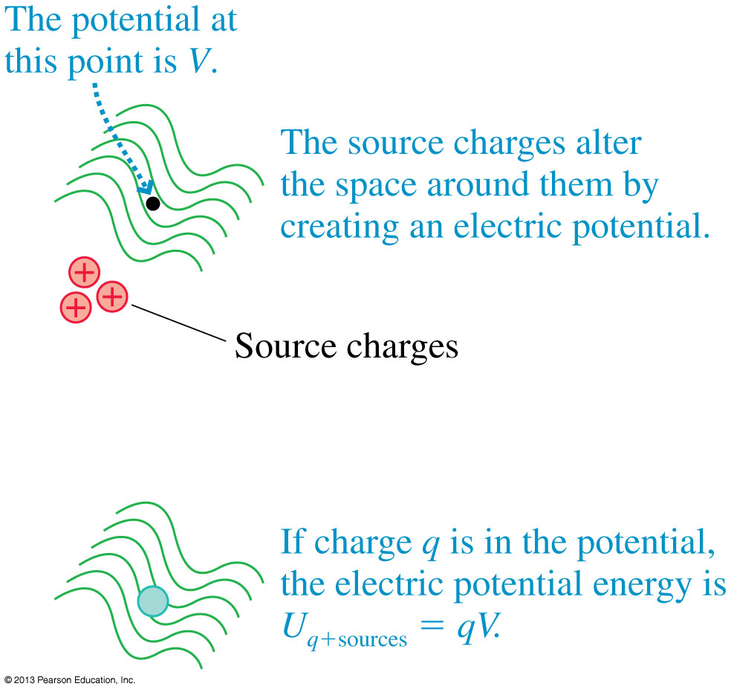
The Electric Potential
Test charge q is used as a probe to determine the electric potential, but the value of V is independent of q.
The electric potential, like the electric field, is a property of the source charges.
Slide 28-61

Slide 33
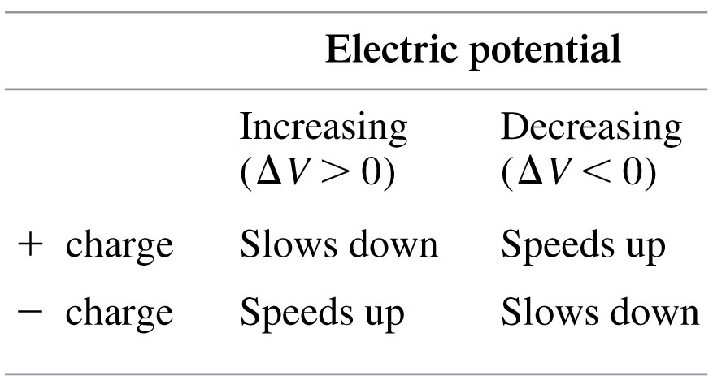
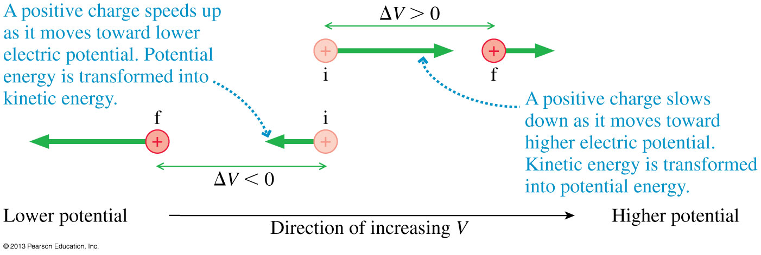
Using the Electric Potential
As a charged particle moves through a changing electric potential, energy is conserved:
Slide 28-62

Slide 34
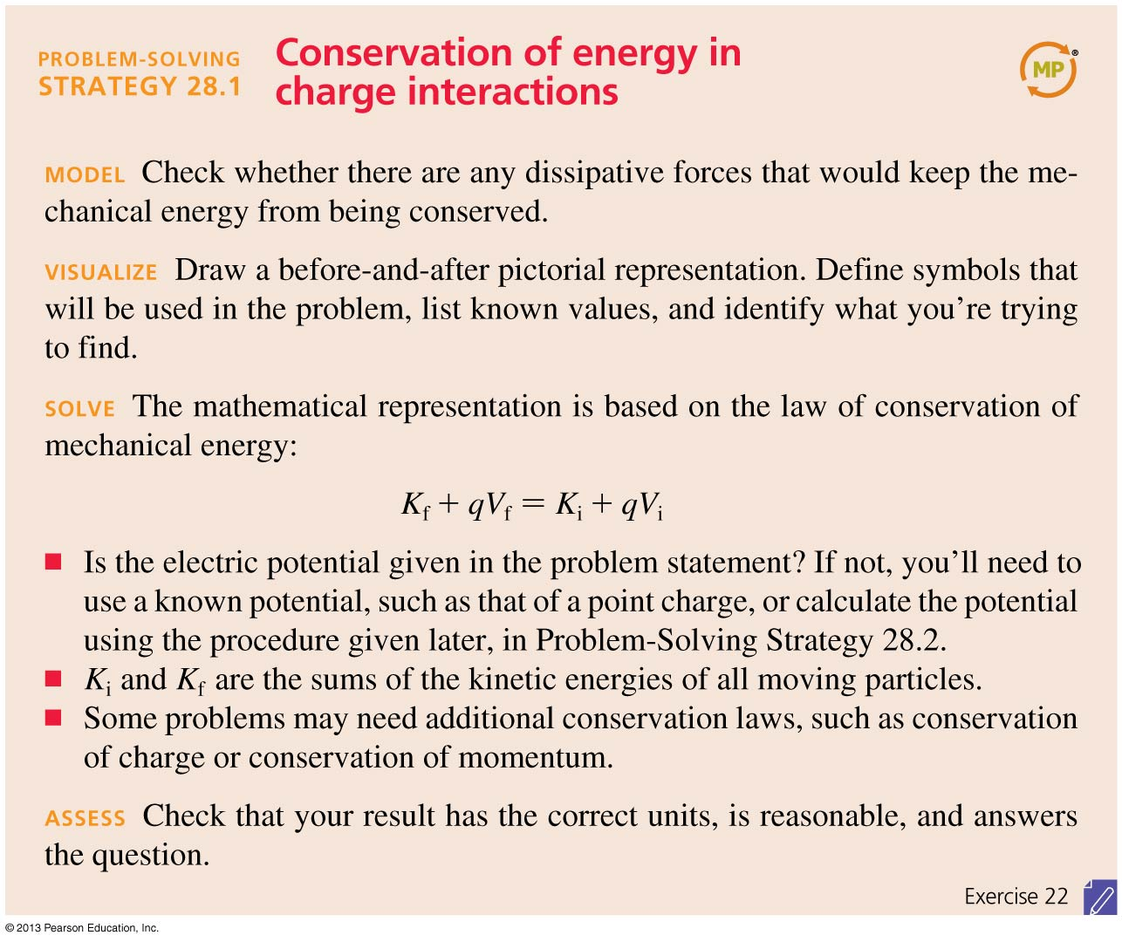
Problem-Solving Strategy: Conservation of Energy in Charge Interactions
Slide 28-67

Slide 35
Problem-Solving Strategy: Conservation of Energy in Charge Interactions
Slide 28-68

Slide 36
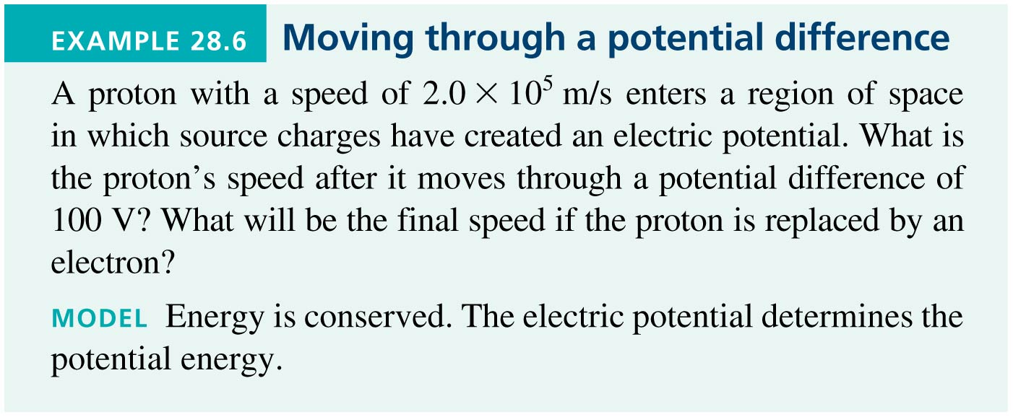
Example 28.6 Moving Through a Potential Difference
Slide 28-69

Slide 37
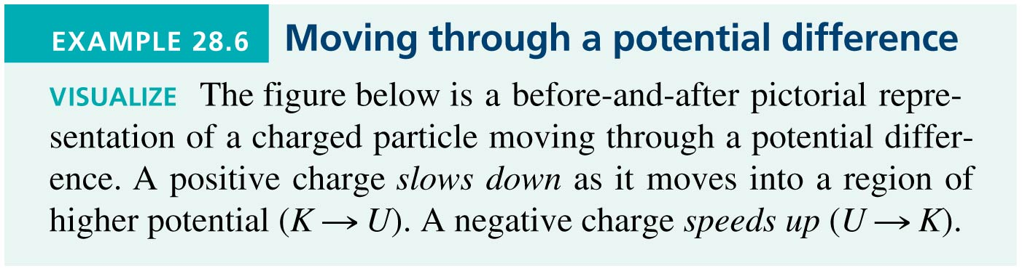
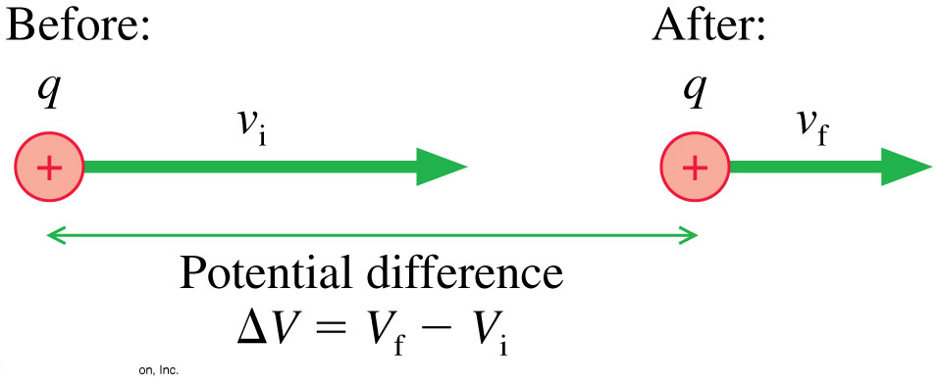
Example 28.6 Moving Through a Potential Difference
Slide 28-70

Slide 38
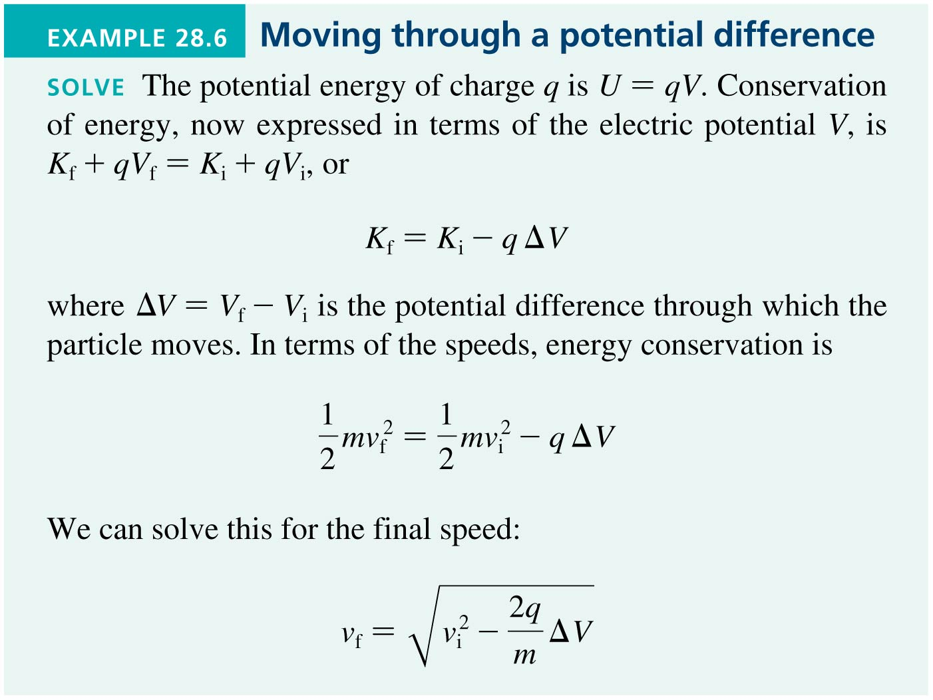
Example 28.6 Moving Through a Potential Difference
Slide 28-71

Slide 39
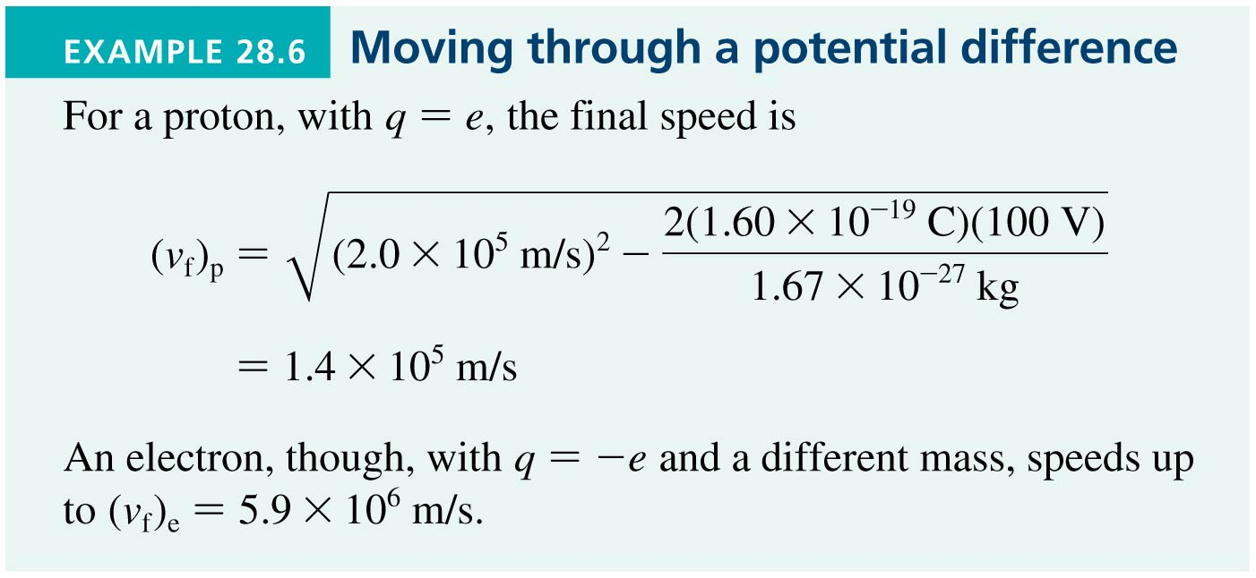
Example 28.6 Moving Through a Potential Difference
Slide 28-72

Slide 40
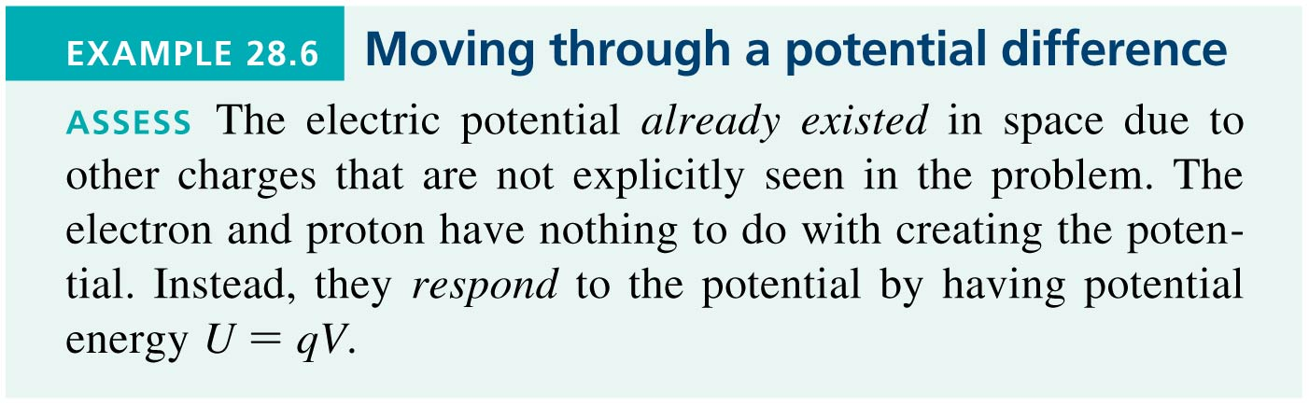
Example 28.6 Moving Through a Potential Difference
Slide 28-73

Slide 41
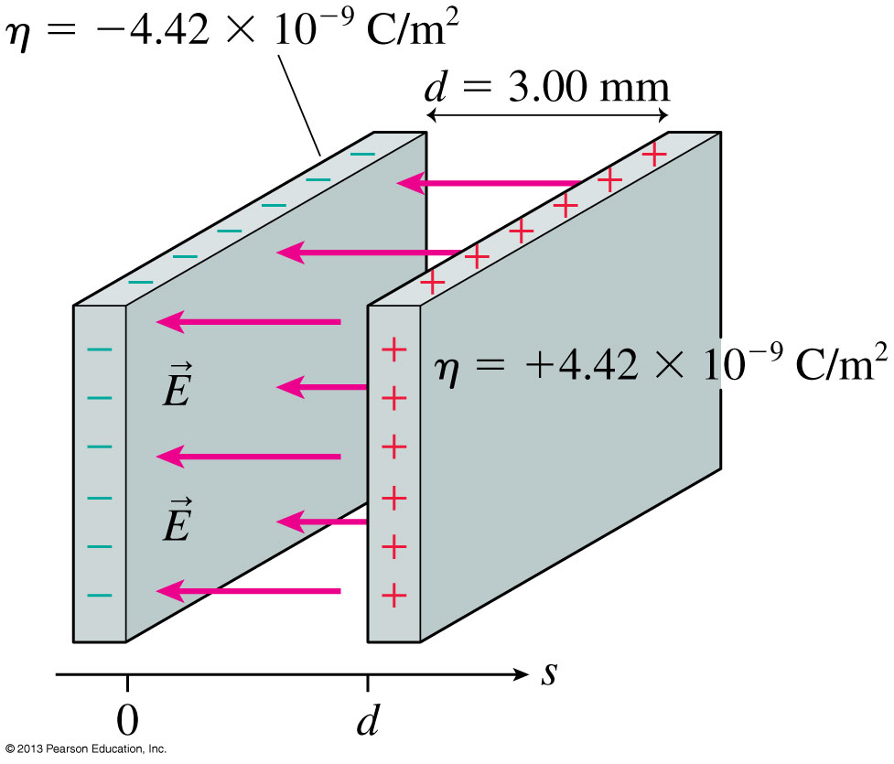
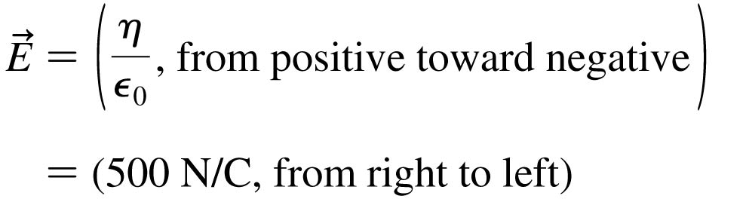
The Electric Field Inside a Parallel-Plate Capacitor
This is a review of Chapter 26.
Slide 28-74

Slide 42
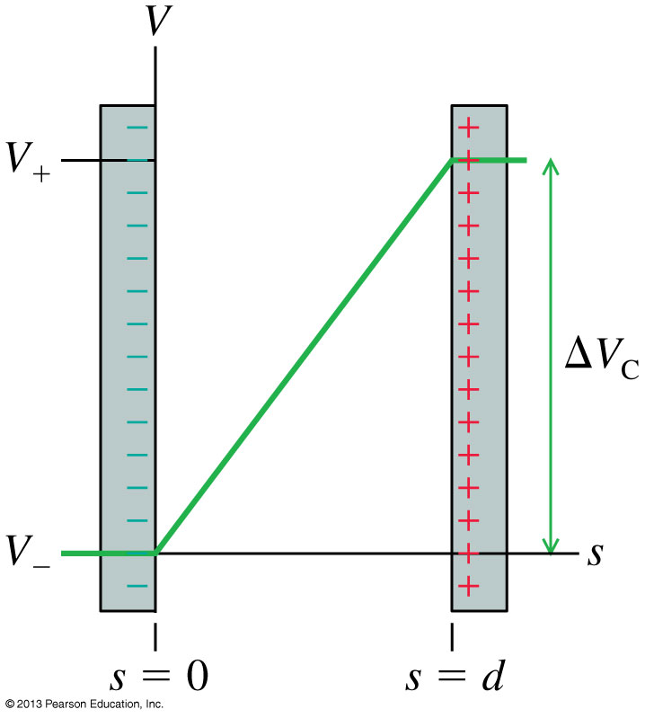
The Electric Potential Inside a Parallel-Plate Capacitor
The electric potential inside a parallel-plate capacitor is
where s is the distance from the negative electrode.
The potential difference ΔV_{C}, or “voltage” between the two capacitor plates is
Slide 28-75

Slide 43
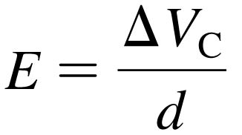
Units of Electric Field
If we know a capacitor’s voltage ΔV and the distance between the plates d, then the electric field strength within the capacitor is:
This implies that the units of electric field are volts per meter, or V/m.
Previously, we have been using electric field units of newtons per coulomb.
In fact, as you can show as a homework problem, these units are equivalent to each other:
1 N/C = 1 V/m
Slide 28-76

Slide 44
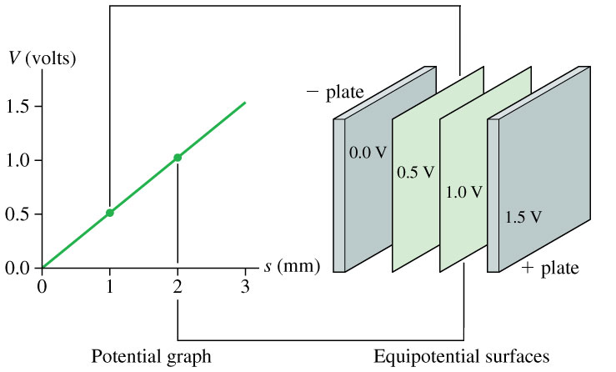
The Electric Potential Inside a Parallel-Plate Capacitor
Slide 28-77

Slide 45

The Electric Potential Inside a Parallel-Plate Capacitor
Slide 28-78

Slide 46

The Parallel-Plate Capacitor
The figure shows the contour lines of the electric potential and the electric field vectors inside a parallel-plate capacitor.
The electric field vectors are perpendicular to the equipotential surfaces.
The electric field points in the direction of decreasing potential.
Slide 28-81

Slide 47

The Zero Point of Electric Potential
Where you choose V = 0 is arbitrary. The three contour maps below represent the same physical situation.
Slide 28-82

Slide 48


The Electric Potential of a Point Charge
Let q in the figure be the source charge, and let a second charge q', a distance r away, probe the electric potential of q.
The potential energy of the two point charges is
Slide 28-87

Slide 49

The Electric Potential of a Point Charge
The electric potential due to a point charge q is
The potential extends through all of space, showing the influence of charge q, but it weakens with distance as 1/r.
This expression for V assumes that we have chosen V = 0 to be at r = ∞.
Slide 28-88

Slide 50

Example 28.9 Calculating the Potential of a Point Charge
Slide 28-91

Slide 51

Example 28.9 Calculating the Potential of a Point Charge
Slide 28-92

Slide 52

Example 28.9 Calculating the Potential of a Point Charge
Slide 28-93

Slide 53

The Electric Potential of a Point Charge
Slide 28-94

Slide 54

The Electric Potential of a Point Charge
Slide 28-95

Slide 55


The Electric Potential of a Charged Sphere
Outside a uniformly charged sphere of radius R, the electric potential is identical to that of a point charge Q at the center.
where r > R.
If the potential at the surface V₀ is known, then the potential at
r > R is:
A plasma ball consists of a small metal ball charged to a potential of about 2000 V inside a hollow glass sphere filled with low-pressure neon gas. The high voltage of the ball creates “lightning bolts” between the ball and the glass sphere.
Slide 28-96

Slide 56

Example 28.10 A Proton and a Charged Sphere
Slide 28-99

Slide 57


Example 28.10 A Proton and a Charged Sphere
VISUALIZE
Slide 28-100

Slide 58

Example 28.10 A Proton and a Charged Sphere
Slide 28-101

Slide 59

Example 28.10 A Proton and a Charged Sphere
Slide 28-102

Slide 60

The Electric Potential of Many Charges
The Electric Potential of Many Charges
The electric potential V at a point in space is the sum of the potentials due to each charge:
where r_{i} is the distance from charge q_{i} to the point in space where the potential is being calculated.
The electric potential, like the electric field, obeys the principle of superposition.
Slide 28-103

Slide 61

The Electric Potential of an Electric Dipole
The Electric Potential of an Electric Dipole
Slide 28-104

Slide 62

The Electric Potential of a Human Heart
The Electric Potential of a Human Heart
Electrical activity within the body can be monitored by measuring equipotential lines on the skin.
The equipotentials near the heart are a slightly distorted but recognizable electric dipole.
Slide 28-105

Slide 63


Example 28.11 The Potential of Two Charges
Slide 28-110

Slide 64

Example 28.11 The Potential of Two Charges
Slide 28-111

Slide 65

Example 28.11 The Potential of Two Charges
Slide 28-112

Slide 66

Problem-Solving Strategy: The Electric Potential of a Continuous Distribution of Charge
Slide 28-113

Slide 67
Problem-Solving Strategy: The Electric Potential of a Continuous Distribution of Charge
Slide 28-114

Slide 68

Example 28.12 The Potential of a Ring of Charge
Slide 28-115

Slide 69

Example 28.12 The Potential of a Ring of Charge
Slide 28-116

Slide 70

Example 28.12 The Potential of a Ring of Charge
Slide 28-117

Slide 71

Example 28.12 The Potential of a Ring of Charge
Slide 28-118

Slide 72

Example 28.12 The Potential of a Ring of Charge
Slide 28-119

Slide 73
Chapter 28 Summary Slides
Slide 28-120

Slide 74

General Principles
General Principles
Slide 28-121

Slide 75
General Principles
Slide 28-122

Slide 76
General Principles

Slide 77
General Principles
Slide 28-124

