Slide 1
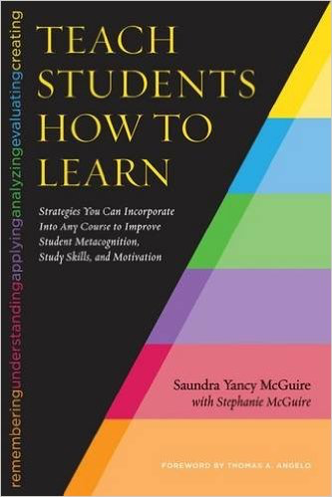
Prioritize metacognition in your STEM course
Ted M. Clark
Department of Chemistry and Biochemistry
The Ohio State University
Clark.789@osu.edu
“I can’t believe how poorly I did on the midterm. I never struggled on a test in high school, and this exam crushed me. I didn’t even recognize many of the questions. I am lost and don’t know what to do next. This makes me think I am just not good at Chemistry.”

Slide 2
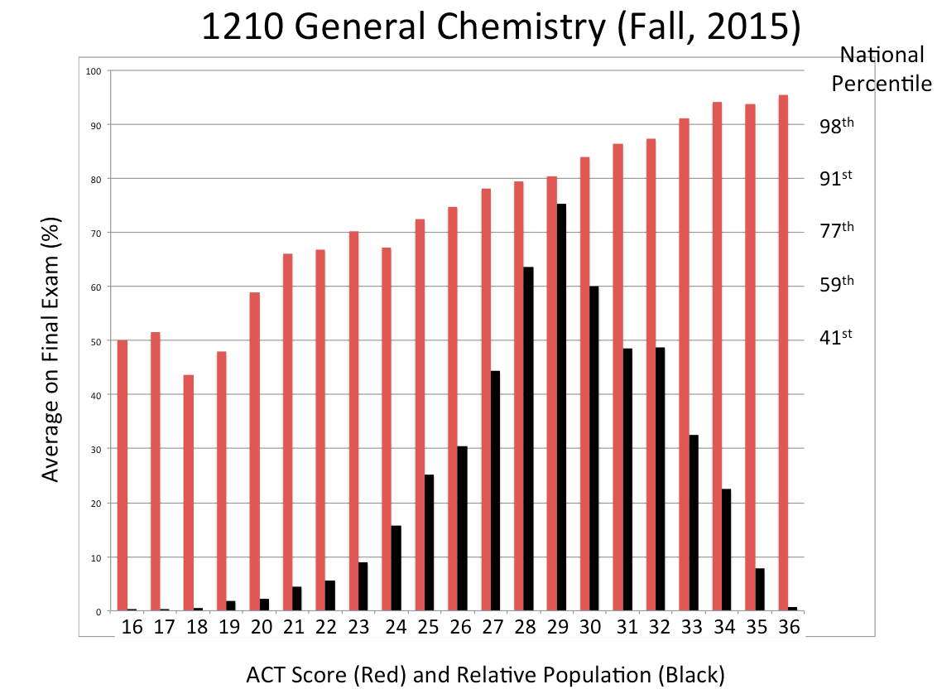
Final exam percentile
In General Chemistry, average ACT scores at ~90th percentile.
Performance on nationally normed ACS final exam also averages ~ 90th percentile.
Avg. final exam performance
Student population
ACT Scores
Setting:
Large-Enrollment (lecture >300 students) General Chemistry Course

Slide 3
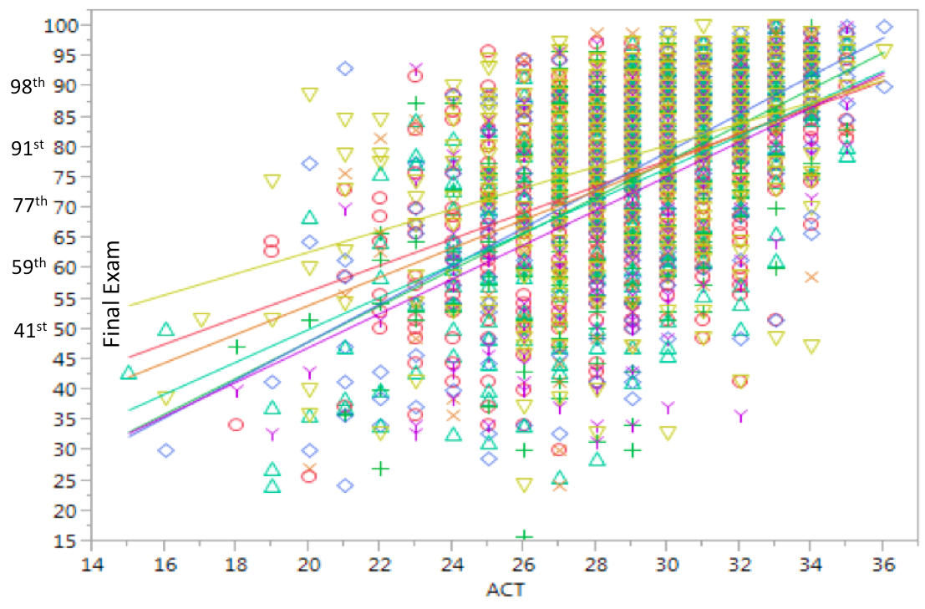
Final exam percentile
In General Chemistry, average ACT scores at ~90th percentile.
Performance on nationally normed ACS final exam also averages ~ 90th percentile.
ACT Scores
Incoming ACT score is correlated with success in the class…
But variability occurs for all but the highest scoring incoming students.

Slide 4
Pre-Assessment of Chemistry Content Understanding
On-sequence
Avg. = 4.1, s.d. = 2.1
Off-sequence
Avg. = 4.3, s.d. = 2.1
X
% of students
X
X
X
Number Correct

Slide 5
12 Question Pre-Test
PRE-DATA
Lower 1/3 of class
identified
Email encouraging them to attend evening session on “Success in Chemistry”
Day of session, announcement made to entire class for evening session.
PARTICIPANTS
INTERVENTION
Control group (n~450)
45 minute “Metacognition” presentation in the 2nd week
Intervention (n~150)
At OSU, a “metacognition talk” is now given in every General Chemistry class, usually after the 1st midterm exam.

Slide 6
Using Metacognition to Become an Expert Learner in Chemistry
(and other classes too)
Dr. Clark
OSU Chemistry & Biochemistry

Slide 7
SCIENTISTS USE DATA
Understanding on Mid-Term
MT1 Score
Pre-Assessment
Understanding to begin the class

Slide 8
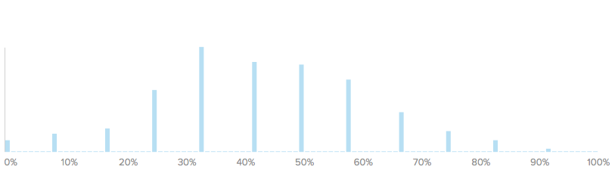
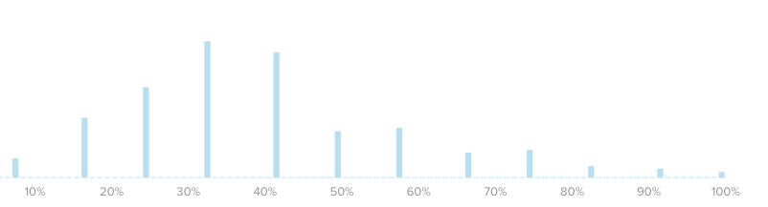
SCIENTISTS USE DATA
Understanding on Mid-Term
MT1 Score
Your pre-class assessment
Pre-Assessment

Slide 9
SCIENTISTS USE DATA
Understanding on Mid-Term
MT1 Score
Your pre-class assessment
Pre-Assessment

Slide 10
SCIENTISTS USE DATA
Understanding on Mid-Term
MT1 Score
Your pre-class assessment
Pre-Assessment

Slide 11
SCIENTISTS USE DATA
Understanding on Mid-Term
MT1 Score
Your pre-class assessment
Pre-Assessment

Slide 12
SCIENTISTS USE DATA
Understanding on Mid-Term
MT1 Score
Your pre-class assessment
Pre-Assessment

Slide 13
Did not attend session on Metacognitive Learning Strategies
Attended session on Metacognitive Learning Strategies
MT1
My Night Class
My Afternoon Class
Pre-Assessment

Slide 14
Did not attend session on Metacognitive Learning Strategies
Attended session on Metacognitive Learning Strategies
MT1
MT1
Pre-Assessment
Pre-Assessment

Slide 15
Did not attend session on Metacognitive Learning Strategies
Attended session on Metacognitive Learning Strategies
MT1
MT1
Pre-Assessment
Pre-Assessment

Slide 16
My Usual Class (the “control”)
MT1
Pre-Assessment

Slide 17
Intervention > control
Intervention
MT1
Control
Pre-Assessment

Slide 18
Reflection Questions
Is there a difference between studying for a chemistry test and learning chemistry for a test?
For which task would you work harder?
A. Make an A on a test
B. Teach the material to the class

Slide 19
Reflection Questions
Is there a difference between studying for a chemistry test and learning chemistry for a test?
For which task would you work harder?
A. Make an A on a test
B. Teach the material to the class
Success in this class depends on understanding, not simply completing assignments.

Slide 20
Reflection Questions
Is there a difference between studying for a chemistry test and learning chemistry for a test?
For which task would you work harder?
A. Make an A on a test
B. Teach the material to the class
Success in this class depends on understanding, not simply completing assignments.
Know the material well enough to teach it, and this will result in an A on the test.

Slide 21
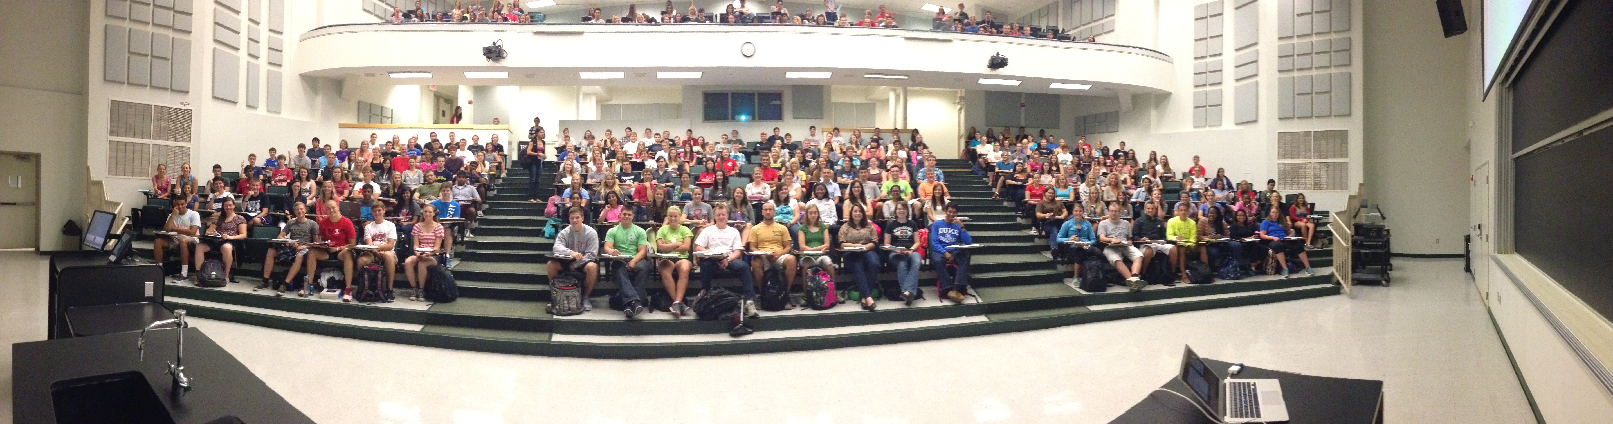
Reading
Teaching Others
Discussion Group
Lecture
Audio visual
Demonstration
Practice by doing
There are different ways of communicating and processing information.
Which ones “work best” in terms of retaining information or skills?

Slide 22
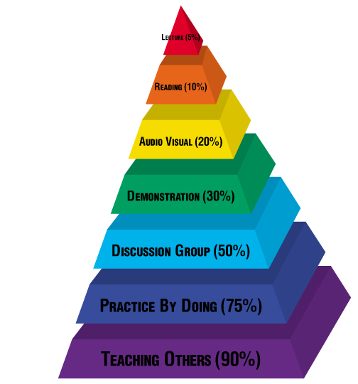

Retention of information after 24 hours
Teaching Others
Lecture
Discussion Group
??

Slide 23
Retention of information after 24 hours

Slide 24
Retention of information after 24 hours
“I go to class.”
“I read the book.”
“I don’t understand why I am struggling in your class.”

Slide 25
This pyramid depicts the different levels of thinking we use when learning.
Each level builds on the foundation that precedes it.
Bloom’s Taxonomy
Evaluation
Graduate School
Synthesis
Analysis
Undergraduate
Application
Comprehension
High School
Knowledge
Louisiana State University  Center for Academic Success  B-31 Coates Hall  225-578-2872  www.cas.lsu.edu

Slide 26
This pyramid depicts the different levels of thinking we use when learning.
Each level builds on the foundation that precedes it.
Bloom’s Taxonomy
Evaluation
Graduate School
Synthesis
Analysis
Undergraduate
Application
Comprehension
Memorizing verbatim information. Being able to remember, but not necessarily fully understanding the material.
High School
Knowledge
Louisiana State University  Center for Academic Success  B-31 Coates Hall  225-578-2872  www.cas.lsu.edu

Slide 27
This pyramid depicts the different levels of thinking we use when learning.
Each level builds on the foundation that precedes it.
Bloom’s Taxonomy
Evaluation
Graduate School
Synthesis
Analysis
Undergraduate
Application
Restating in your own words; paraphrasing, summarizing, translating.
Comprehension
Memorizing verbatim information. Being able to remember, but not necessarily fully understanding the material.
High School
Knowledge
Louisiana State University  Center for Academic Success  B-31 Coates Hall  225-578-2872  www.cas.lsu.edu

Slide 28
This pyramid depicts the different levels of thinking we use when learning.
Each level builds on the foundation that precedes it.
Bloom’s Taxonomy
Evaluation
Graduate School
Synthesis
Analysis
Undergraduate
Using information to solve problems; transferring abstract or theoretical ideas to practical situations. Identifying connections and relationships and how they apply.
Application
Restating in your own words; paraphrasing, summarizing, translating.
Comprehension
High School
Memorizing verbatim information. Being able to remember, but not necessarily fully understanding the material.
Knowledge
Louisiana State University  Center for Academic Success  B-31 Coates Hall  225-578-2872  www.cas.lsu.edu

Slide 29
This pyramid depicts the different levels of thinking we use when learning.
Each level builds on the foundation that precedes it.
Bloom’s Taxonomy
Evaluation
Graduate School
Synthesis
Analysis
Undergraduate
Using information to solve problems; transferring abstract or theoretical ideas to practical situations. Identifying connections and relationships and how they apply.
Application
Restating in your own words; paraphrasing, summarizing, translating.
Comprehension
High School
Memorizing verbatim information. Being able to remember, but not necessarily fully understanding the material.
About 15% of a MT.
Students do Great!
Scores ~95%
Knowledge
Louisiana State University  Center for Academic Success  B-31 Coates Hall  225-578-2872  www.cas.lsu.edu

Slide 30
This pyramid depicts the different levels of thinking we use when learning.
Each level builds on the foundation that precedes it.
Bloom’s Taxonomy
Evaluation
Graduate School
Synthesis
Analysis
Undergraduate
Using information to solve problems; transferring abstract or theoretical ideas to practical situations. Identifying connections and relationships and how they apply.
Application
Restating in your own words; paraphrasing, summarizing, translating.
About 65% of a MT.
More difficult
Scores 50-75%
Comprehension
High School
Memorizing verbatim information. Being able to remember, but not necessarily fully understanding the material.
About 15% of a MT.
Students do Great!
Scores ~95%
Knowledge
Louisiana State University  Center for Academic Success  B-31 Coates Hall  225-578-2872  www.cas.lsu.edu

Slide 31
This pyramid depicts the different levels of thinking we use when learning.
Each level builds on the foundation that precedes it.
Bloom’s Taxonomy
Evaluation
Graduate School
Synthesis
Analysis
Undergraduate
Using information to solve problems; transferring abstract or theoretical ideas to practical situations. Identifying connections and relationships and how they apply.
About 20% of a MT.
Scores <50%
Application
Restating in your own words; paraphrasing, summarizing, translating.
About 65% of a MT.
More difficult
Scores 50-75%
Comprehension
High School
Memorizing verbatim information. Being able to remember, but not necessarily fully understanding the material.
About 15% of a MT.
Students do Great!
Scores ~95%
Knowledge
Louisiana State University  Center for Academic Success  B-31 Coates Hall  225-578-2872  www.cas.lsu.edu

Slide 32
How do you move yourself higher on Bloom’s Taxonomy?

Slide 33
What is metacognition?

Slide 34
What is metacognition?
The ability to…
Think about your own thinking.
Be aware of yourself as a problem solver.
Monitor, plan, and control your learning.
Assess your understanding.

Slide 35
Effective Metacognitive Strategies
Using the textbook
Previewing
Paraphrasing, reading actively
Going to class, participating, then reviewing
Taking notes by hand
Doing homework as assessment
Learning from mistakes on homework
Consolidate and review information
Authentically test yourself
Aim for 100% mastery, not 90%!
Before class
In class
After class
Preparing for tests & quizzes

Slide 36
Effective Metacognitive Strategies
Using the textbook
Previewing
Paraphrasing, reading actively
Going to class, participating, then reviewing
Taking notes by hand
Doing homework as assessment
Learning from mistakes on homework
Consolidate and review information
Authentically test yourself
Aim for 100% mastery, not 90%!
Before class
In class
After class
Preparing for tests & quizzes

Slide 37
Effective Metacognitive Strategies
Using the textbook
Previewing
Paraphrasing, reading actively
Going to class, participating, then reviewing
Taking notes by hand
Doing homework as assessment
Learning from mistakes on homework
Consolidate and review information
Authentically test yourself
Aim for 100% mastery, not 90%!
Before class
In class
After class
Preparing for tests & quizzes

Slide 38
Effective Metacognitive Strategies
Using the textbook
Previewing
Paraphrasing, reading actively
Going to class, participating, then reviewing
Taking notes by hand
Doing homework as assessment
Learning from mistakes on homework
Consolidate and review information
Authentically test yourself
Aim for 100% mastery, not 90%!
Before class
In class
After class
Preparing for tests & quizzes

Slide 39
Effective Metacognitive Strategies
Using the textbook
Previewing
Paraphrasing, reading actively
Going to class, participating, then reviewing
Taking notes by hand
Doing homework as assessment
Learning from mistakes on homework
Consolidate and review information
Authentically test yourself
Aim for 100% mastery, not 90%!
Before class
In class
After class
Preparing for tests

Slide 40
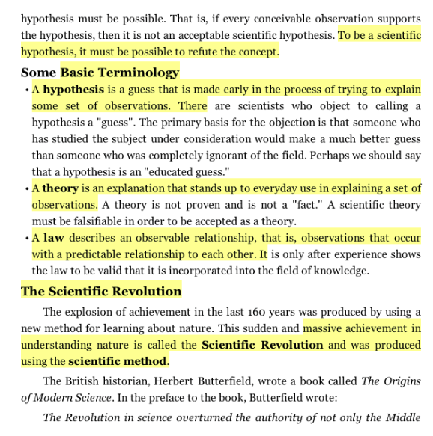
Using the Textbook

Slide 41

Using the Textbook
Highlighting a textbook is close to useless

Slide 42
Using the Textbook
Highlighting a textbook doesn’t require any input.
Taking notes requires understanding what you are writing to a much greater degree.
Highlighting a textbook is close to useless

Slide 43
Using the Textbook
Highlighting a textbook doesn’t require any input.
Taking notes requires understanding what you are writing to a much greater degree.
Highlighting a textbook doesn’t provide a useful output.
Your notes are useful to study from. A highlighted textbook is not.
Highlighting takes up time &
it doesn’t increase retention.
Highlighting a textbook is close to useless

Slide 44
Using the Textbook
Highlighting a textbook doesn’t require any input.
Taking notes requires understanding what you are writing to a much greater degree.
Highlighting a textbook doesn’t provide a useful output.
Your notes are useful to study from. A highlighted textbook is not.
Highlighting takes up time &
it doesn’t increase retention.
Highlighting a textbook is close to useless

Slide 45
Preview the Chapter and Make a Map
Title of Chapter
Primary Headings
Subheadings
Secondary Subheadings

Slide 46
Preview the Chapter and Make a Map
Title of Chapter
Primary Headings
Subheadings
Secondary Subheadings
It is really difficult to…
Hear new information,
Process it, and
Connect it to other information.

Slide 47
Active Reading
Read a paragraph. Stop.
Put the information into your own words. This can be done mentally or (even better) written down.
Read the next paragraph. Stop.
Paraphrase, but now combine both paragraphs.
Go on to the next paragraph.

Slide 48
Active Reading
Read a paragraph. Stop.
Put the information into your own words. This can be done mentally or (even better) written down.
Read the next paragraph. Stop.
Paraphrase, but now combine both paragraphs.
Go on to the next paragraph.
“But this will take too much time…”

Slide 49
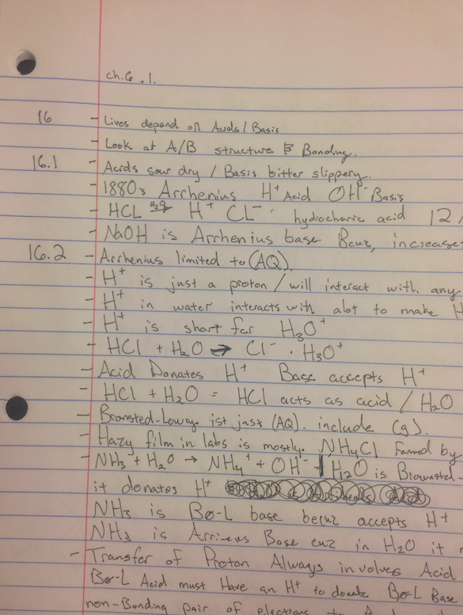
Active Reading
Read a paragraph. Stop.
Put the information into your own words. This can be done mentally or (even better) written down.
Read the next paragraph. Stop.
Paraphrase, but now combine both paragraphs.
Go on to the next paragraph.
This is the first time a science textbook has ever been helpful. I used to ‘read it’, but now I am finding information I actually use.

Slide 50
Active Reading
Read a paragraph. Stop.
Put the information into your own words. This can be done mentally or (even better) written down.
Read the next paragraph. Stop.
Paraphrase, but now combine both paragraphs.
Go on to the next paragraph.
If you REALLY want to highlight something, return to your own notes after class.
Make connections between things you understand & what the instructor prioritized.

Slide 51
What is your plan for success?
Active reading
Active
Outline chapter.
Complete any Pre-Class homework.
Passive
Wait and go to lecture.
Before Class

Slide 52
Effective Metacognitive Strategies
Using the textbook
Previewing
Paraphrasing, reading actively
Going to class, participating, then reviewing
Taking notes by hand
Doing homework as assessment
Learning from mistakes on homework
Working in pairs or groups
Creating practice exams and study material
Aim for 100% mastery, not 90%!
Before class
In class

Slide 53

In-Class…Mentally Participate
A chemistry class is often a progression of ideas.

Slide 54
In-Class…Mentally Participate
Does class move too fast for you?
A chemistry class is often a progression of ideas.

Slide 55
In-Class…Mentally Participate
Does class move too fast for you?
Are you able to answer the questions in class?
A chemistry class is often a progression of ideas.

Slide 56

In-Class…Mentally Participate
Does class move too fast for you?
Are you able to answer the questions in class?
A chemistry class is often a progression of ideas.

Slide 57
In-Class…Mentally Participate
Does class move too fast for you?
Are you able to answer the questions in class?
Can you identify the learning objectives and typical exam questions?
A chemistry class is often a progression of ideas.

Slide 58
In-Class…Mentally Participate
Does class move too fast for you?
Are you able to answer the questions in class?
Can you identify the learning objectives and typical exam questions?
Do you remember what you learned in class?
A chemistry class is often a progression of ideas.

Slide 59


Rehearsal:
Repeating info. again and again.
Thinking about the meaning, making connections to other info.

Slide 60
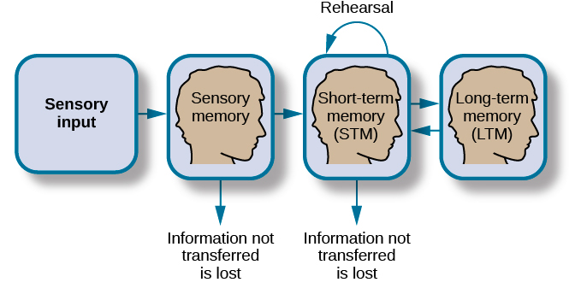
Rehearsal:
Repeating info. again and again.
Thinking about the meaning, making connections to other info.
Making Memories

Slide 61
Rehearsal:
Repeating info. again and again.
Thinking about the meaning, making connections to other info.
Making Memories

Slide 62
Rehearsal:
Repeating info. again and again.
Thinking about the meaning, making connections to other info.
Making Memories

Slide 63
Rehearsal:
Repeating info. again and again.
Thinking about the meaning, making connections to other info.
Making Memories

Slide 64
In-Class
Rehearsal:
Repeating info. again and again.
Thinking about the meaning, making connections to other info.
Making Memories

Slide 65
Rehearsal:
Repeating info. again and again.
Thinking about the meaning, making connections to other info.
Making Memories

Slide 66
Rehearsal:
Repeating info. again and again.
Thinking about the meaning, making connections to other info.
Making Memories
Mentally review & recall class information, without looking at your notes, later in the day.

Slide 67
What is your plan for success?
Mental Review.
Coordinate class
notes & book.
Active
Active reading
Treat class as a
self-test.
Get feedback.
Address
Weaknesses.
Outline chapter.
Complete any Pre-Class homework.
Passive
Wait and go to lecture.
Attend every class
Before Class Class

Slide 68
Effective Metacognitive Strategies
Using the textbook
Previewing
Paraphrasing, reading actively
Going to class, participating, then reviewing
Taking notes by hand
Doing homework as assessment
Learning from mistakes on homework
Consolidate and review information
Authentically test yourself
Aim for 100% mastery, not 90%!
Before class
In class
After class
Preparing for tests & quizzes

Slide 69
Doing Homework as Assessment
Most students do their homework by…
Looking at example problems in the textbook, or in their notes, and trying to copy the steps (or look for a pattern) laid out there to arrive at the correct answer.

Slide 70
Doing Homework as Assessment
Most students do their homework by…
Looking at example problems in the textbook, or in their notes, and trying to copy the steps (or look for a pattern) laid out there to arrive at the correct answer.
This is exactly the wrong way to do homework problems

Slide 71
Doing Homework as Assessment
Most students do their homework by…
Looking at example problems in the textbook, or in their notes, and trying to copy the steps (or look for a pattern) laid out there to arrive at the correct answer.
This is exactly the wrong way to do homework problems
Homework and example problems in the textbook or class notes
are an opportunity to test yourself.

Slide 72
Doing Homework as Assessment
Most students do their homework by…
Looking at example problems in the textbook, or in their notes, and trying to copy the steps (or look for a pattern) laid out there to arrive at the correct answer.
This is exactly the wrong way to do homework problems
Homework and example problems in the textbook or class notes
are an opportunity to test yourself.
Before looking at the homework actively study the material.
You will never have notes or other resources to use on a test.
Most insidious…you will tell yourself you know how to answer questions on a test without notes, but you have never actually done so!

Slide 73
A Plan for Learning
Review material
Try to answer questions

Slide 74
A Plan for Learning
Review material
Try to answer questions
Honest
evaluation
The topic is easy. I can teach it.
I can prepare my own questions

Slide 75
A Plan for Learning
Review material
Try to answer questions
Honest
evaluation
The topic is easy. I can teach it.
I can prepare my own questions
I have not mastered the material
Must learn more.
Class notes or Textbook.
Classmates or TA.
Office hours.
Recitation
Online videos (Drfus.com)

Slide 76
A Plan for Learning
Review material
Try to answer questions
Honest
evaluation
The topic is easy. I can teach it.
I can prepare my own questions
Re-test yourself
Must learn more.
Class notes or Textbook.
Classmates or TA.
Office hours.
Recitation
Online videos (Drfus.com)
End of chapter questions
Online homework.
Practice exams

Slide 77
A Plan for Learning
Review material
Try to answer questions
Honest
evaluation
The topic is easy**. I can teach it.
I can prepare my own questions
**I have identified and learned from my mistakes.
Re-test yourself
Must learn more.
Class notes or Textbook.
Classmates or TA.
Office hours.
Recitation
Online videos (Drfus.com)
End of chapter questions
Online homework.
Practice exams

Slide 78

A Plan for Learning
Review material
Try to answer questions
Honest
evaluation
The topic is easy**. I can teach it.
I can prepare my own questions
.

Slide 79
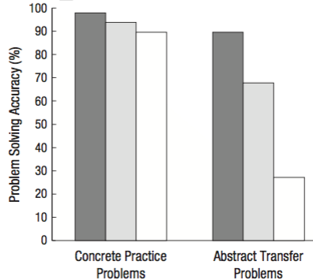

A Plan for Learning
Review material
Try to answer questions
Honest
evaluation
The topic is easy**. I can teach it.
I can prepare my own questions
.

Slide 80
A Plan for Learning
Review material
Try to answer questions
Honest
evaluation
The topic is easy**. I can teach it.
I can prepare my own questions
.

Slide 81
Learning from Homework
Number of submissions
3 2 1 midnight
Days before deadline

Slide 82
Learning from Homework
Number of submissions
3 2 1 midnight
Days before deadline

Slide 83
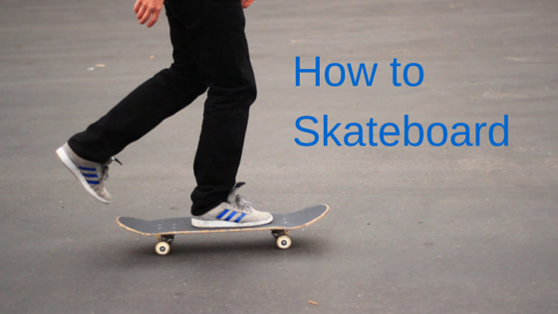
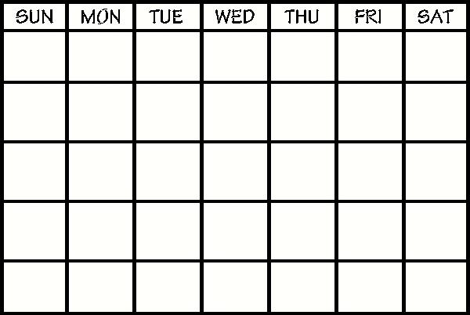
Put Yourself First &
Schedule Your Learning
Class 1 Class 2 Class 3
Class 4 Class 5 Class 6
Class 7 Class 8 Class 9
Event

Slide 84
Put Yourself First &
Schedule Your Learning
Class 1 Class 2 Class 3
Class 4 Class 5 Class 6
Class 7 Class 8 Class 9
Equip.
Starting,
Stopping
Turning
Event

Slide 85
Put Yourself First &
Schedule Your Learning
Class 1 Class 2 Class 3
Class 4 Class 5 Class 6
Class 7 Class 8 Class 9
Equip.
Starting,
Stopping
Turning
Event

Slide 86
Put Yourself First &
Schedule Your Learning
Class 1 Class 2 Class 3
Class 4 Class 5 Class 6
Class 7 Class 8 Class 9
Equip.
Starting,
Stopping
Turning
Ramps
Drop in
Ollie
Kick flip
Shuvit
360 flip
Boardside lipside
5-0 grind
Routine
Event

Slide 87
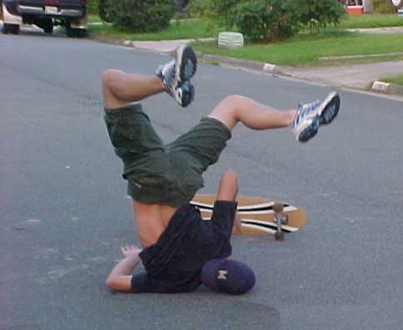
Excellent metacognition

Slide 88

High on Bloom’s Taxonomy

Slide 89
What is your plan for success?
Mental Review.
Coordinate class
notes & book.
Active reading
EXPLAIN the material.
Active
Review first, then use homework as a self-test
Get feedback.
Address Weaknesses.
Treat class as a
self-test.
Get feedback.
Address
Weaknesses.
Outline chapter.
Complete any Pre-Class homework.
Passive
Wait and go to lecture.
Attend every class
Complete homework
(the last day)
Before Class Class After Class

Slide 90
Effective Metacognitive Strategies
Using the textbook
Previewing
Paraphrasing, reading actively
Going to class, participating, then reviewing
Taking notes by hand
Doing homework as assessment
Learning from mistakes on homework
Consolidate and review information
Authentically test yourself
Aim for 100% mastery, not 90%!
Before class
In class
After class
Preparing for tests.

Slide 91
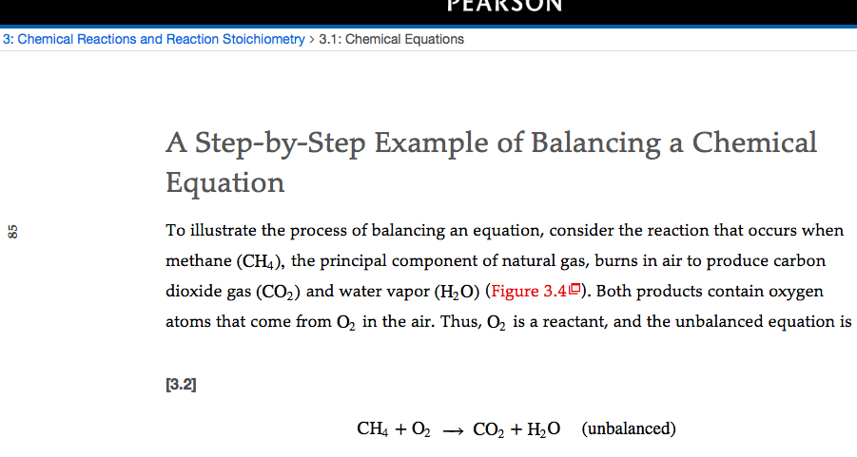
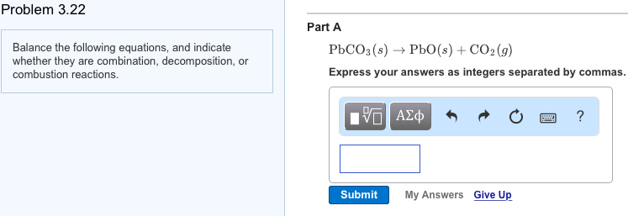
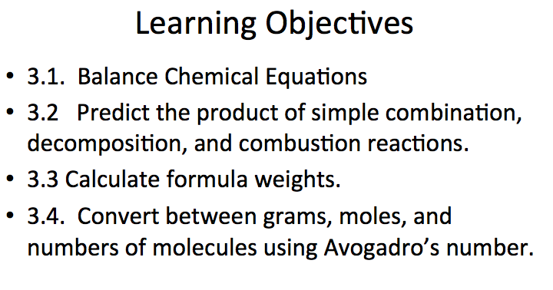
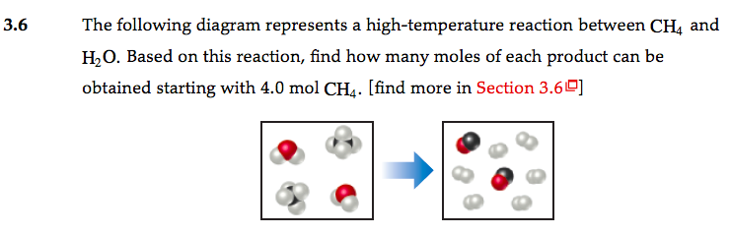
Consolidate Your Study Material
Textbook and notes
Online Homework
Class slides and class notes
End of chapter problems and notes

Slide 92
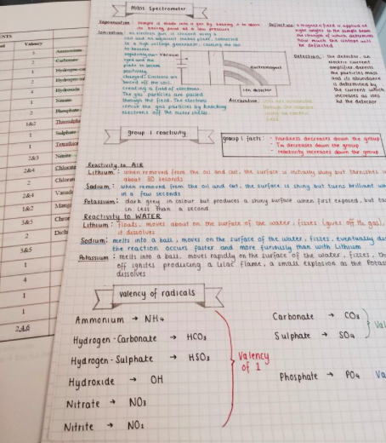
Consolidate Your Study Material
Textbook and notes
Online Homework
Class slides and class notes
Concisely summarize this information in a way most meaningful for you.
You can do this now
End of chapter problems and notes

Slide 93
What is your plan for success?
Teach and EXPLAIN the material.
Mental Review.
Coordinate class
notes & book
Write and share exam questions.
EXPLAIN!
Active reading
Active
Treat class as a
self-test.
Get feedback.
Address
Weaknesses.
Review first, then use homework a self-test.
Get feedback.
Address weaknesses
Consolidate and review notes.
Use practice tests as self-test.
Get feedback
.
Outline chapter.
Complete any Pre-Class homework.
Passive
Wait and go to lecture.
Complete homework
(the last day)
Read class slides, Look at homework problems.
Attend every class
Before Class Class After Class Preparing for Exams

Slide 94
If you don’t try it within the next 48 hours...
… you probably never will.

Slide 95
Your Final Grade will be C- to C+
Teach and EXPLAIN the material.
Mental Review.
Coordinate class
notes & book
Write and share exam questions.
EXPLAIN!
Active reading
Active
Treat class as a
self-test.
Get feedback.
Address
Weaknesses.
Review first, then use homework a self-test.
Get feedback.
Address weaknesses
Consolidate and review notes.
Use practice tests as self-test.
Get feedback
.
Outline chapter.
Complete any Pre-Class homework.
Passive
Wait and go to lecture.
Complete homework
(the last day)
Read class slides, Look at homework problems.
Attend every class
Before Class Class After Class Preparing for Exams

Slide 96
These strategies WORK and take very little time.
Teach and EXPLAIN the material.
Mental Review.
Coordinate class
notes & book
Write and share exam questions.
EXPLAIN!
Active reading
Active
Treat class as a
self-test.
Get feedback.
Address
Weaknesses.
Review first, then use homework a self-test.
Get feedback.
Address weaknesses
Consolidate and review notes.
Use practice tests as self-test.
Get feedback
.
Outline chapter.
Complete any Pre-Class homework.
Passive
Wait and go to lecture.
Complete homework
(the last day)
Read class slides, Look at homework problems.
Attend every class
Before Class Class After Class Preparing for Exams

Slide 97
All of the ACTIVE strategies reinforce each other.
Teach and EXPLAIN the material.
Mental Review.
Coordinate class
notes & book
Write and share exam questions.
EXPLAIN!
Active reading
Active
Treat class as a
self-test.
Get feedback.
Address
Weaknesses.
Review first, then use homework a self-test.
Get feedback.
Address weaknesses
Consolidate and review notes.
Use practice tests as self-test.
Get feedback
.
Outline chapter.
Complete any Pre-Class homework.
Passive
Wait and go to lecture.
Complete homework
(the last day)
Read class slides, Look at homework problems.
Attend every class
Before Class Class After Class Preparing for Exams

Slide 98
Post-class homework that includes earlier material, prompting recall of information.
Pre-class questions as homework
Frequent in-class questions & discussions
Multiple timed practice exams with feedback
Teach and EXPLAIN the material.
Mental Review.
Coordinate class
notes & book
Write and share exam questions.
EXPLAIN!
Active reading
Active
Treat class as a
self-test.
Get feedback.
Address
Weaknesses.
Review first, then use homework a self-test.
Get feedback.
Address weaknesses
Consolidate and review notes.
Use practice tests as self-test.
Get feedback
.
Outline chapter.
Complete any Pre-Class homework.
Passive
Wait and go to lecture.
Complete homework
(the last day)
Read class slides, Look at homework problems.
Attend every class
Before Class Class After Class Preparing for Exams
The Class Format Can Support the Best Practices

Slide 99

Work Together!

