Slide 1
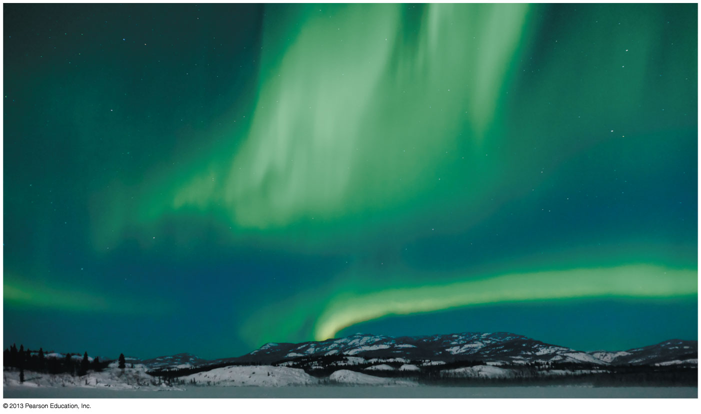
Chapter 32 The Magnetic Field
Chapter Goal: To learn how to calculate and use the magnetic field.
Slide 32-2

Slide 2
Chapter 32 Preview
Slide 32-3

Slide 3
Chapter 32 Preview
Slide 32-4

Slide 4
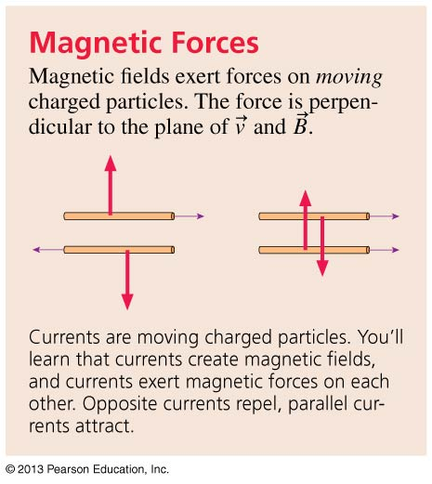
Chapter 32 Preview
Slide 32-5

Slide 5
Chapter 32 Preview
Slide 32-6

Slide 6
Chapter 32 Preview
Slide 32-7

Slide 7
Chapter 32 Preview
Slide 32-8

Slide 8
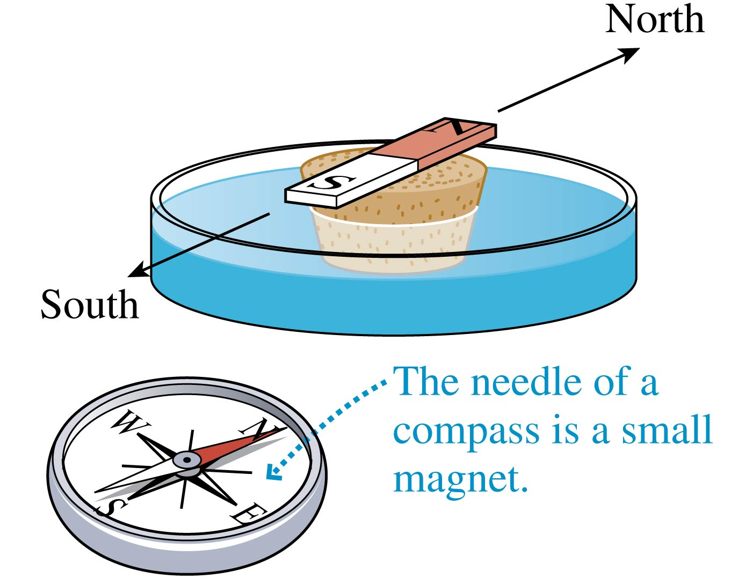
Discovering Magnetism: Experiment 1
Tape a bar magnet to a piece of cork and allow it to float in a dish of water.
It always turns to align itself in an approximate north-south direction.
The end of a magnet that points north is called the north-seeking pole, or simply the north pole.
The end of a magnet that points south is called the south pole.
Slide 32-19

Slide 9
Discovering Magnetism: Experiment 2
If the north pole of one magnet is brought near the north pole of another magnet, they repel each other.
Two south poles also repel each other, but the north pole of one magnet exerts an attractive force on the south pole of another magnet.
Slide 32-20

Slide 10
Discovering Magnetism: Experiment 3
The north pole of a bar magnet attracts one end of a compass needle and repels the other.
Apparently the compass needle itself is a little bar magnet with a north pole and a south pole.
Slide 32-21

Slide 11
Discovering Magnetism: Experiment 4
Cutting a bar magnet in half produces two weaker but still complete magnets, each with a north pole and a south pole.
No matter how small the magnets are cut, even down to microscopic sizes, each piece remains a complete magnet with two poles.
Slide 32-22

Slide 12
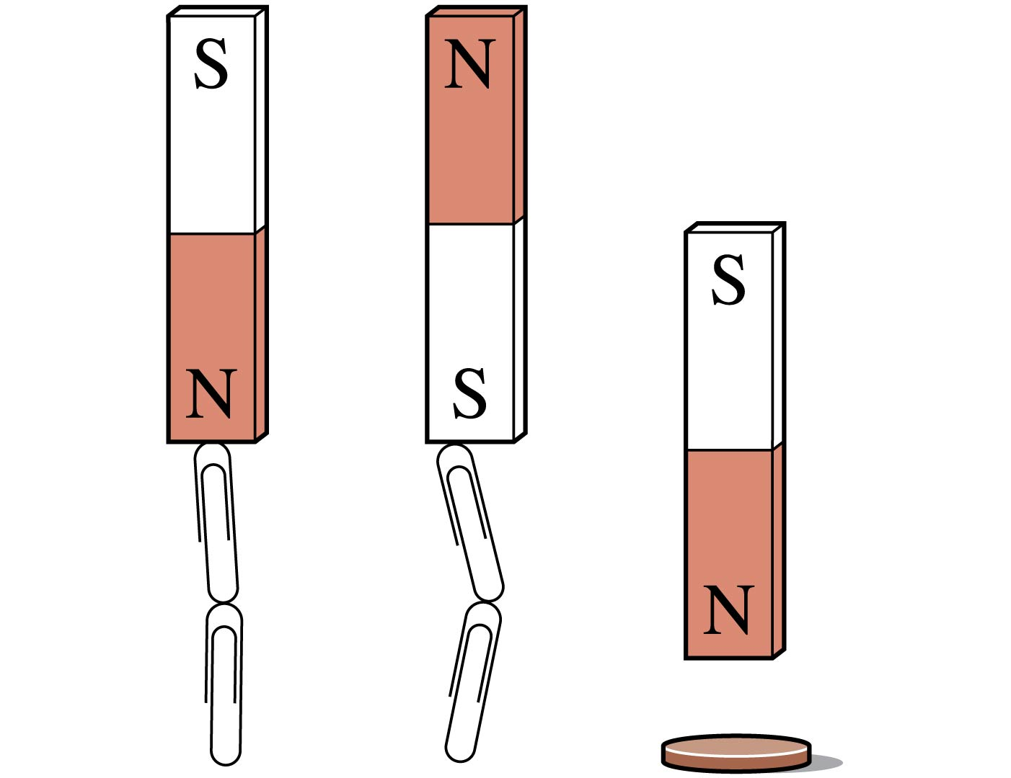
Discovering Magnetism: Experiment 5
Magnets can pick up some objects, such as paper clips, but not all.
If an object is attracted to one end of a magnet, it is also attracted to the other end.
Most materials, including copper (a penny), aluminum, glass, and plastic, experience no force from a magnet.
Slide 32-23

Slide 13
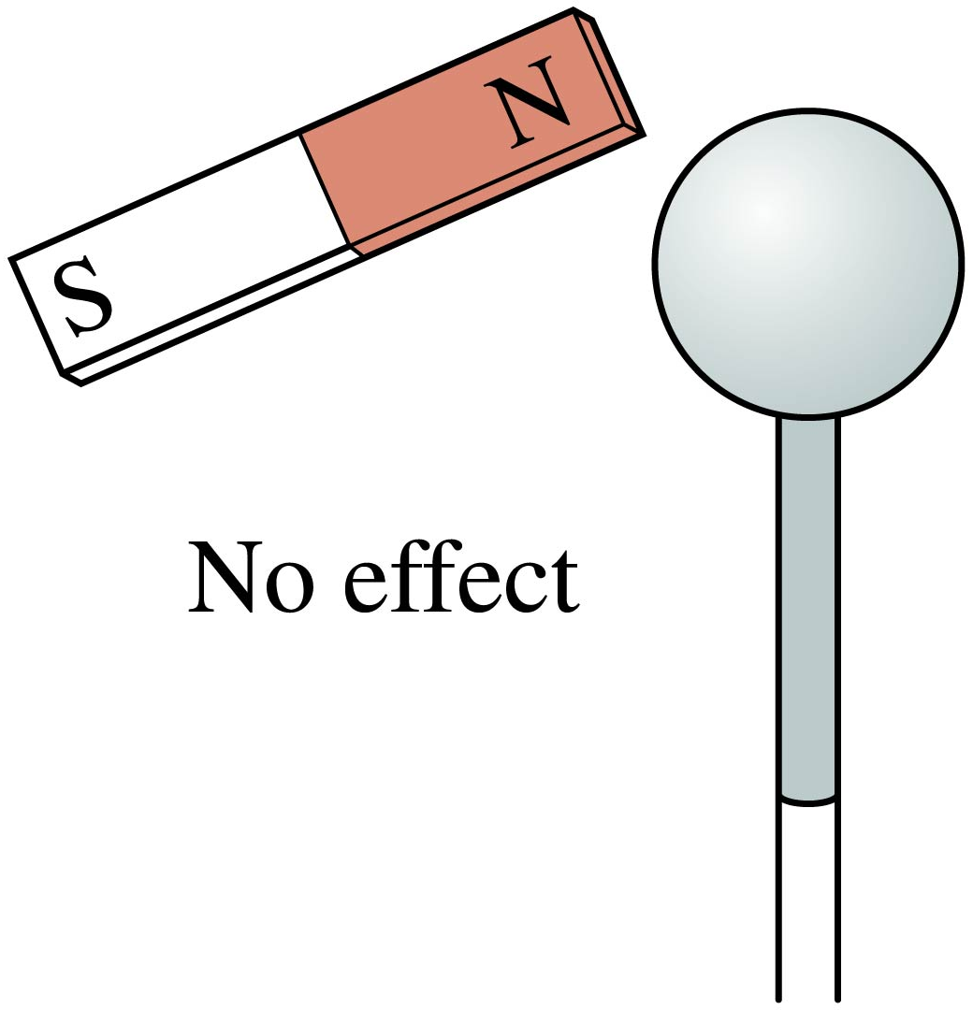
Discovering Magnetism: Experiment 6
A magnet does not affect an electroscope.
A charged rod exerts a weak attractive force on both ends of a magnet.
However, the force is the same as the force on a metal bar that isn’t a magnet, so it is simply a polarization force like the ones we studied in Chapter 25.
Other than polarization forces, charges have no effects on magnets.
Slide 32-24

Slide 14
What Do These Experiments Tell Us?
Magnetism is not the same as electricity.
Magnetism is a long range force.
All magnets have two poles, called north and south poles. Two like poles exert repulsive forces on each other; two opposite poles attract.
The poles of a bar magnet can be identified by using it as a compass. The north pole tends to rotate to point approximately north.
Materials that are attracted to a magnet are called magnetic materials. The most common magnetic material is iron.
Slide 32-25

Slide 15
QuickCheck 32.3
If a bar magnet is cut in half, you end up with
Slide 32-30
Notes:
15

Slide 16
QuickCheck 32.3
If a bar magnet is cut in half, you end up with
Slide 32-31
Notes:
16

Slide 17
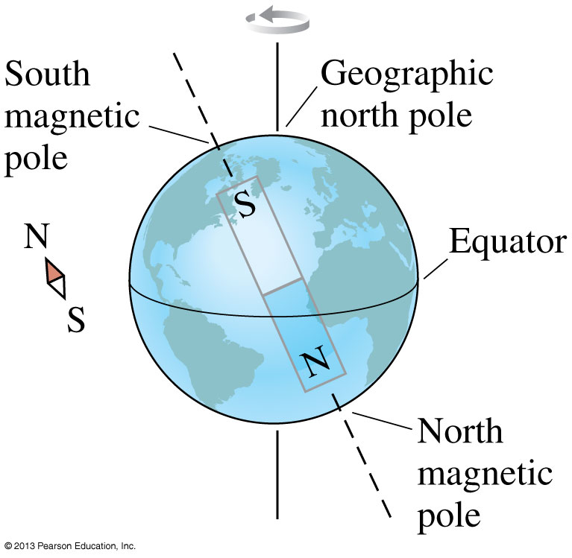
Compasses and Geomagnetism
Due to currents in the molten iron core, the earth itself acts as a large magnet.
The poles are slightly offset from the poles of the rotation axis.
The geographic north pole is actually a south magnetic pole!
Slide 32-32

Slide 18
Electric Current Causes a Magnetic Field
In 1819 Hans Christian Oersted discovered that an electric current in a wire causes a compass to turn.
Slide 32-33

Slide 19
Electric Current Causes a Magnetic Field
The right-hand rule determines the orientation of the compass needles to the direction of the current.
Slide 32-34

Slide 20
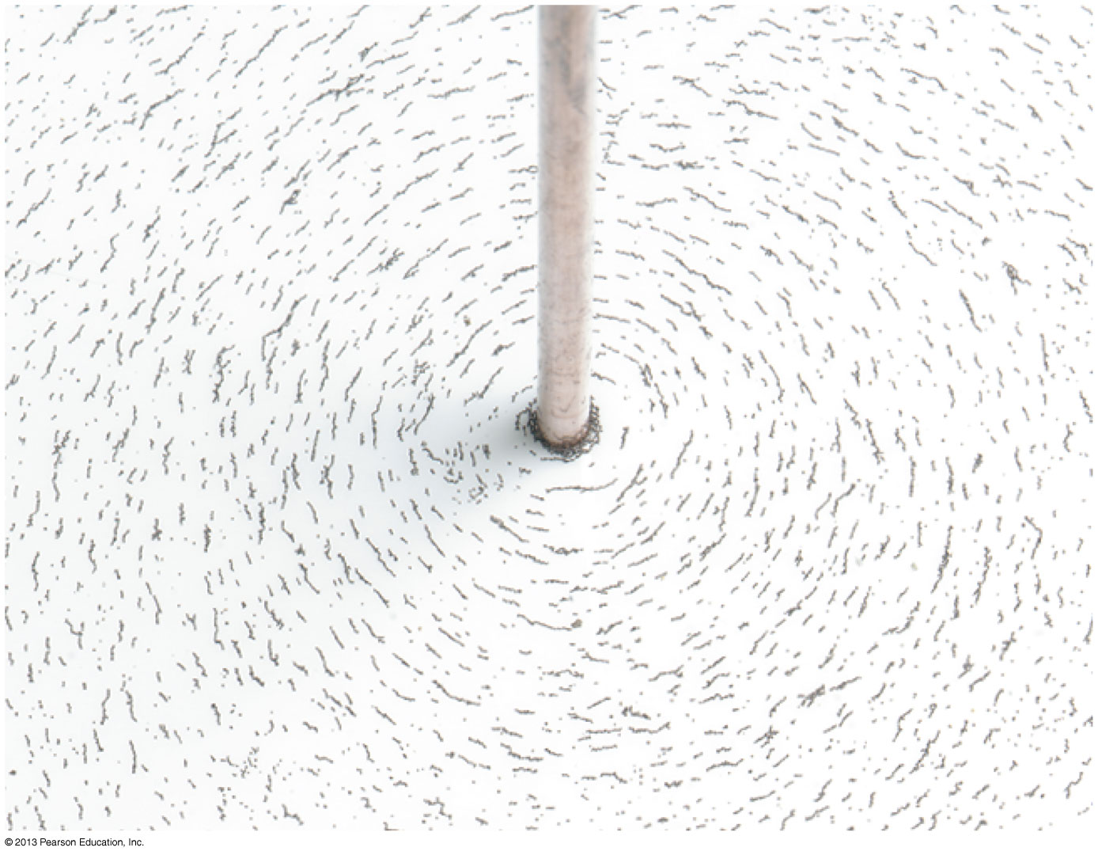
Electric Current Causes a Magnetic Field
The magnetic field is revealed by the pattern of iron filings around a current-carrying wire.
Slide 32-35

Slide 21
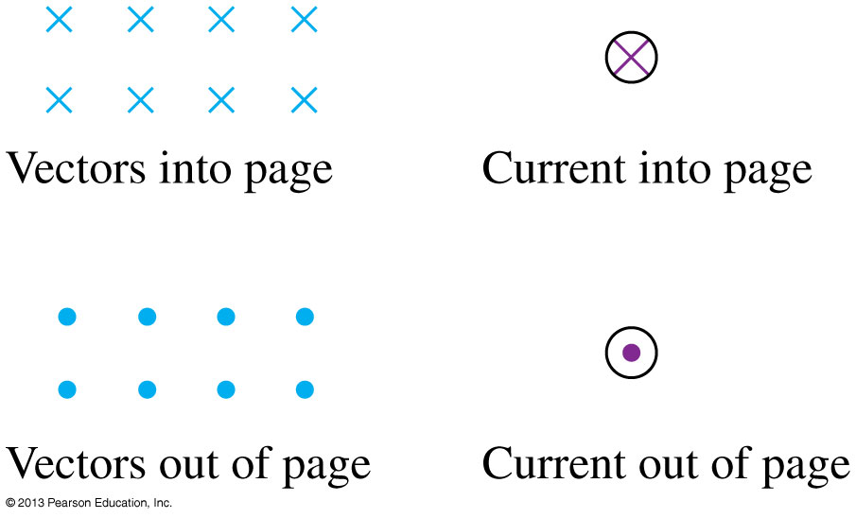
Notation for Vectors and Currents Perpendicular to the Page
Magnetism requires a three-dimensional perspective, but two-dimensional figures are easier to draw.
We will use the following notation:
Slide 32-36

Slide 22
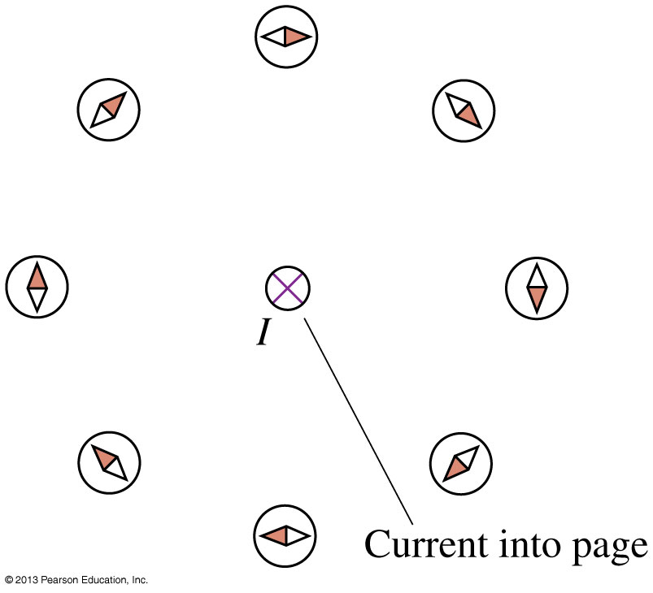
Electric Current Causes a Magnetic Field
The right-hand rule determines the orientation of the compass needles to the direction of the current.
Slide 32-37

Slide 23
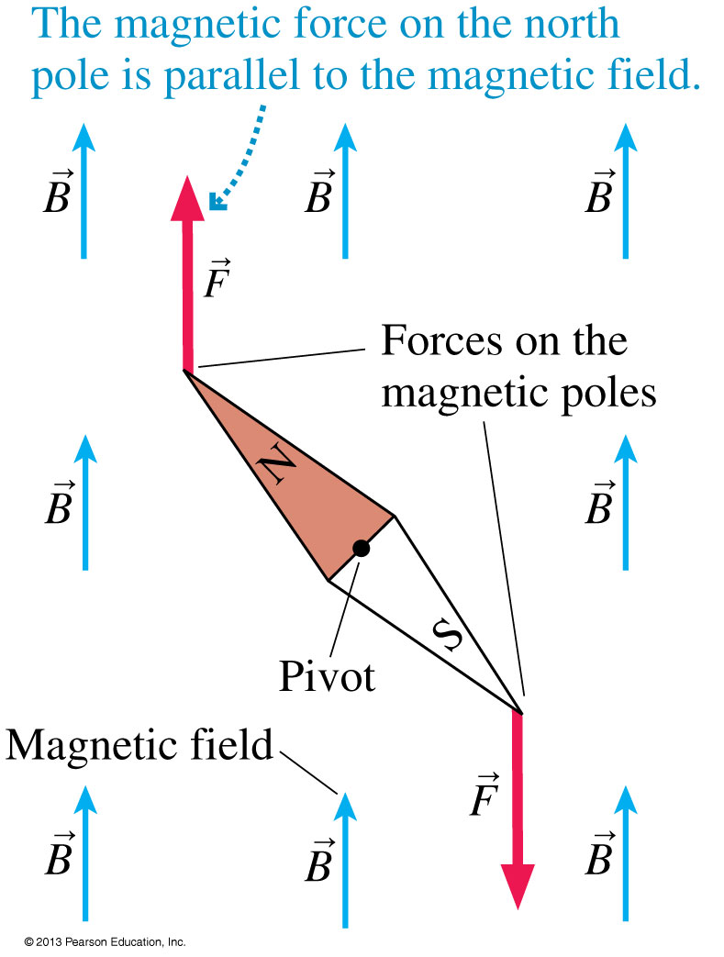
Magnetic Force on a Compass
The figure shows a compass needle in a magnetic field.
A magnetic force is exerted on each of the two poles of the compass, parallel to for the north pole and opposite for the south pole.
This pair of opposite forces exerts a torque on the needle, rotating the needle until it is parallel to the magnetic field at that point.
Slide 32-40

Slide 24
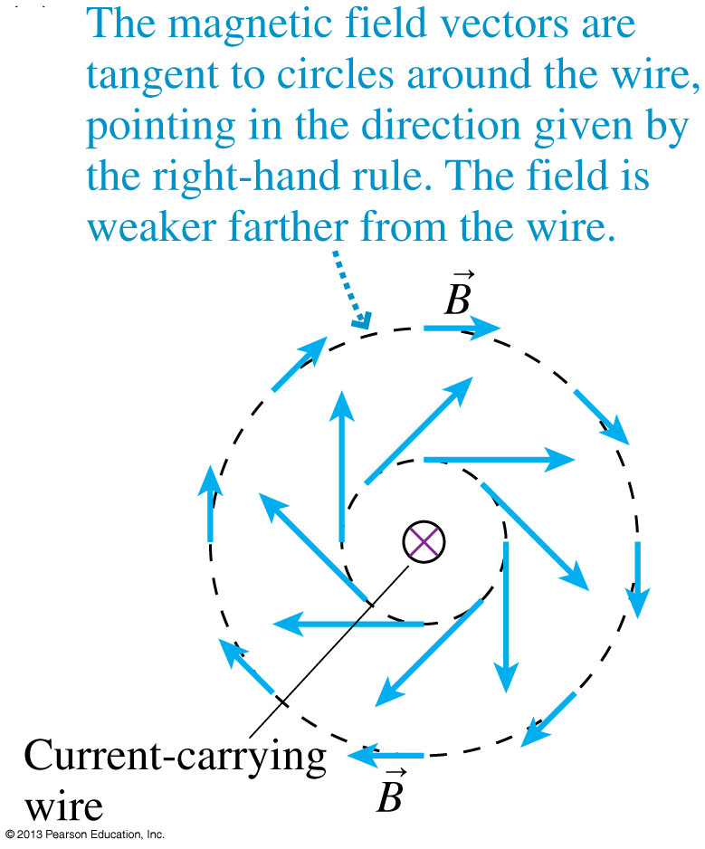
Electric Current Causes a Magnetic Field
Because compass needles align with the magnetic field, the magnetic field at each point must be tangent to a circle around the wire.
The figure shows the magnetic field by drawing field vectors.
Notice that the field is weaker (shorter vectors) at greater distances from the wire.
Slide 32-41

Slide 25
Electric Current Causes a Magnetic Field
Magnetic field lines are imaginary lines drawn through a region of space so that:
A tangent to a field line is in the direction of the magnetic field.
The field lines are closer together where the magnetic field strength is larger.
Slide 32-42

Slide 26
Tactics: Right-Hand Rule for Fields
Slide 32-43

Slide 27
The Source of the Magnetic Field: Moving Charges
The magnetic field of a charged particle q moving with velocity v is given by the Biot-Savart law:
Slide 32-44

Slide 28
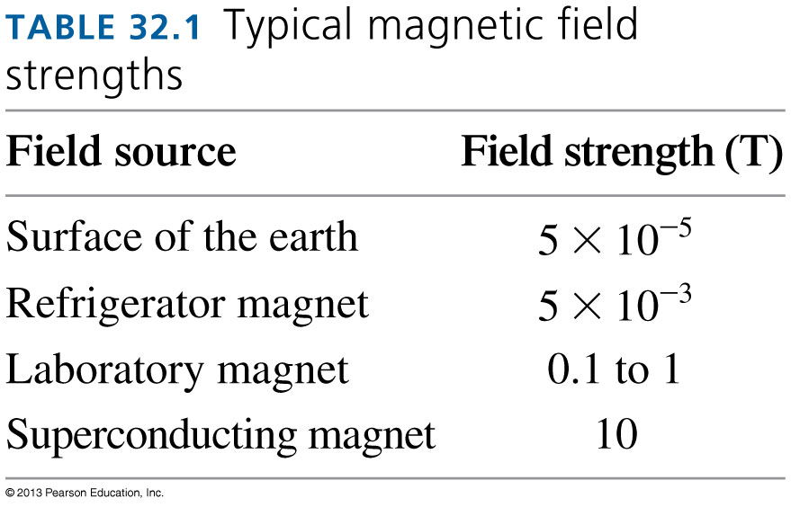
The Magnetic Field
The constant μ₀ in the Biot-Savart law is called the permeability constant:
μ₀ = 4π × 10⁻⁷ T m/A = 1.257 × 10⁻⁶ T m/A
The SI unit of magnetic field strength is the tesla, abbreviated as T:
1 tesla = 1 T = 1 N/A m
Slide 32-45

Slide 29
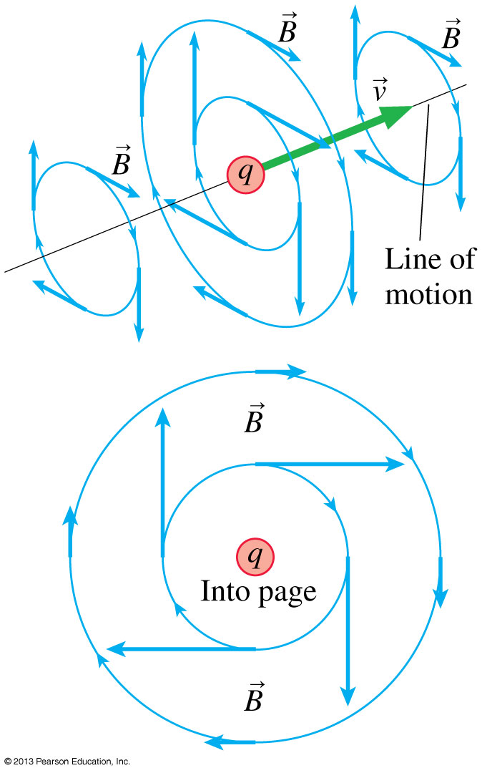
Magnetic Field of a Moving Positive Charge
The right-hand rule for finding the direction of due to a moving positive charge is similar to the rule used for a current carrying wire.
Note that the component of parallel to the line of motion is zero.
Slide 32-46

Slide 30
Example 32.1 The Magnetic Field of a Proton
Slide 32-47

Slide 31
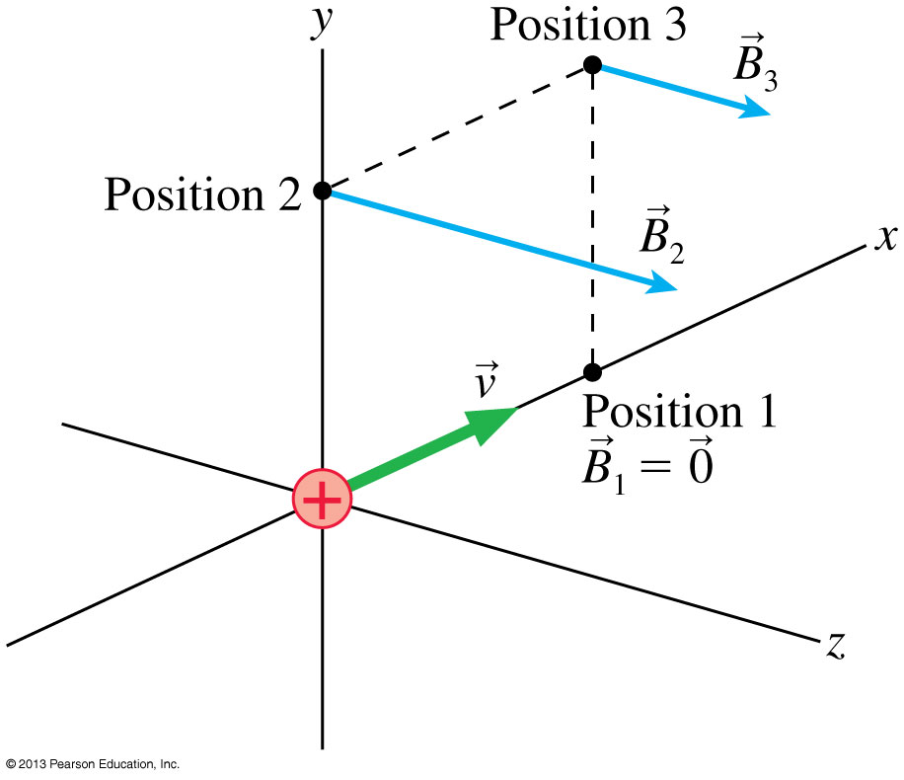
Example 32.1 The Magnetic Field of a Proton
Slide 32-48

Slide 32
Example 32.1 The Magnetic Field of a Proton
Slide 32-49

Slide 33
Example 32.1 The Magnetic Field of a Proton
Slide 32-50

Slide 34
Superposition of Magnetic Fields
Magnetic fields, like electric fields, have been found experimentally to obey the principle of superposition.
If there are n moving point charges, the net magnetic field is given by the vector sum:
The principle of superposition will be the basis for calculating the magnetic fields of several important current distributions.
Slide 32-51

Slide 35
The Cross Product
= (CD sin α, direction given by the right-hand rule)
Slide 32-52

Slide 36
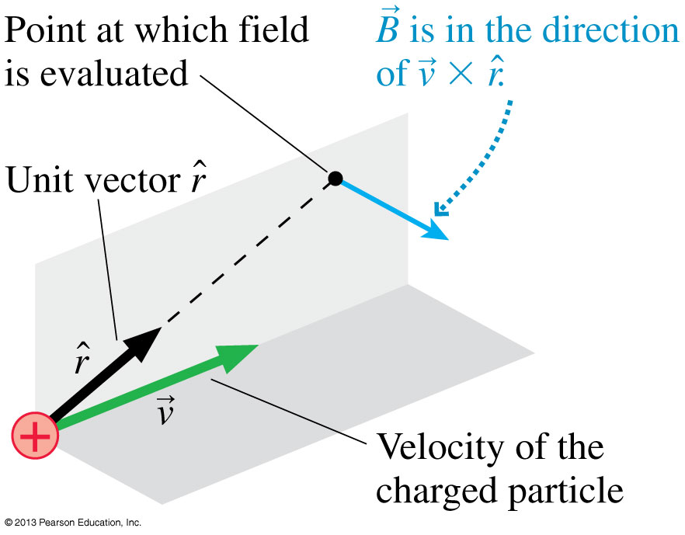
Magnetic Field of a Moving Charge
The magnetic field of a charged particle q moving with velocity is given by the Biot-Savart law:
Slide 32-53

Slide 37
Example 32.2 The Magnetic Field Direction of a Moving Electron
Slide 32-56

Slide 38
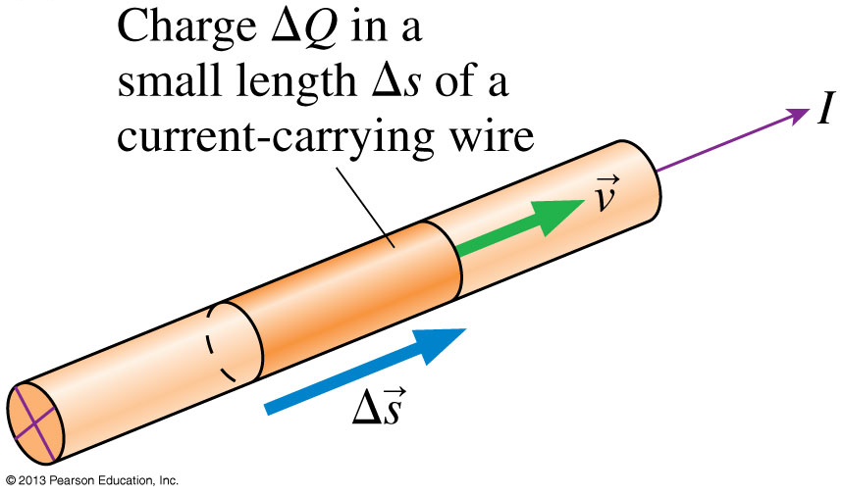
The Magnetic Field of a Current
The figure shows a current-carrying wire.
The wire as a whole is electrically neutral, but current I represents the motion of positive charge carriers through the wire.
Slide 32-57

Slide 39
The Magnetic Field of a Current
Slide 32-58

Slide 40
The Magnetic Field of a Current
The magnetic field of a long, straight wire carrying current I at a distance d from the wire is:
The magnetic field at the center of a coil of N turns and radius R, carrying a current I is:
Slide 32-59

Slide 41
Problem-Solving Strategy: The Magnetic Field of a Current
Slide 32-62

Slide 42
Problem-Solving Strategy: The Magnetic Field of a Current
Slide 32-63

Slide 43
Example 32.4 The Magnetic Field Strength Near a Heater Wire
Slide 32-64

Slide 44
Example 32.4 The Magnetic Field Strength Near a Heater Wire
Slide 32-65

Slide 45
Example 32.4 The Magnetic Field Strength Near a Heater Wire
Slide 32-66

Slide 46
Example 32.6 Matching the Earth’s Magnetic Field
Slide 32-67

Slide 47
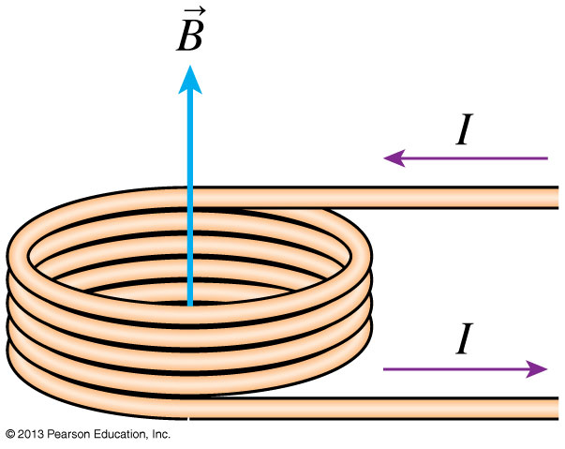
Example 32.6 Matching the Earth’s Magnetic Field
Slide 32-68

Slide 48
Example 32.6 Matching the Earth’s Magnetic Field
Slide 32-69

Slide 49
The Magnetic Field of a Current Loop
Slide 32-70

Slide 50
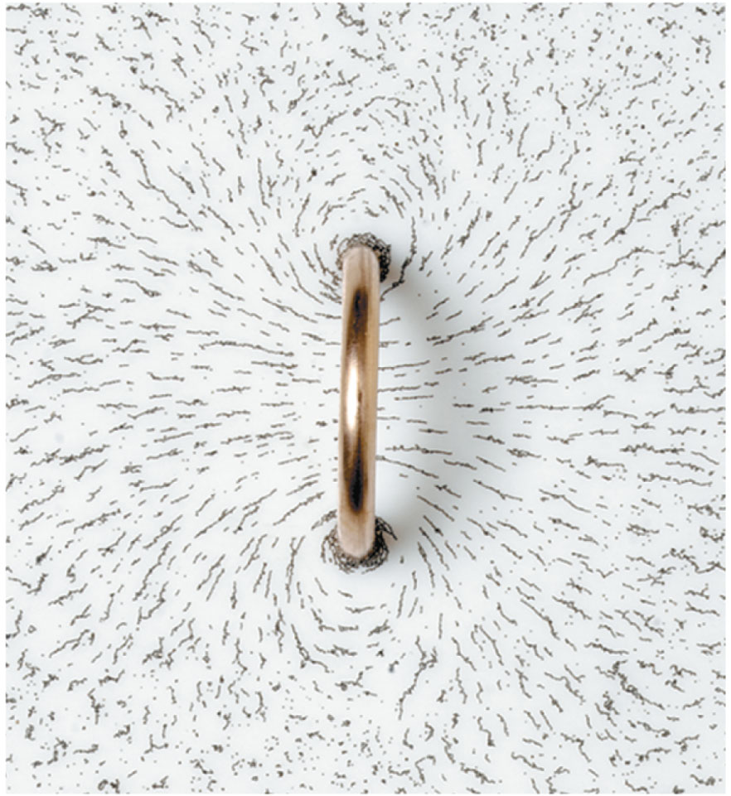
The Magnetic Field of a Current Loop
The magnetic field is revealed by the pattern of iron filings around a current-carrying loop of wire.
Slide 32-71

Slide 51
Tactics: Finding the Magnetic Field Direction of a Current Loop
Slide 32-74

Slide 52
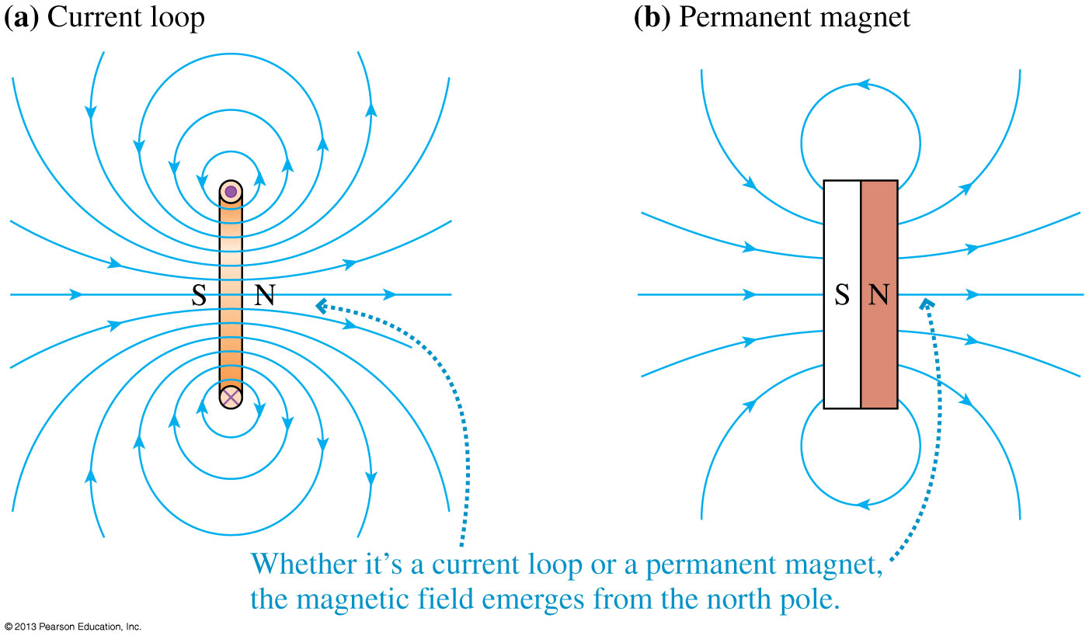
A Current Loop Is a Magnetic Dipole
Slide 32-75

Slide 53
The Magnetic Dipole Moment
The magnetic dipole moment of a current loop enclosing an area A is defined as:
Slide 32-78

Slide 54
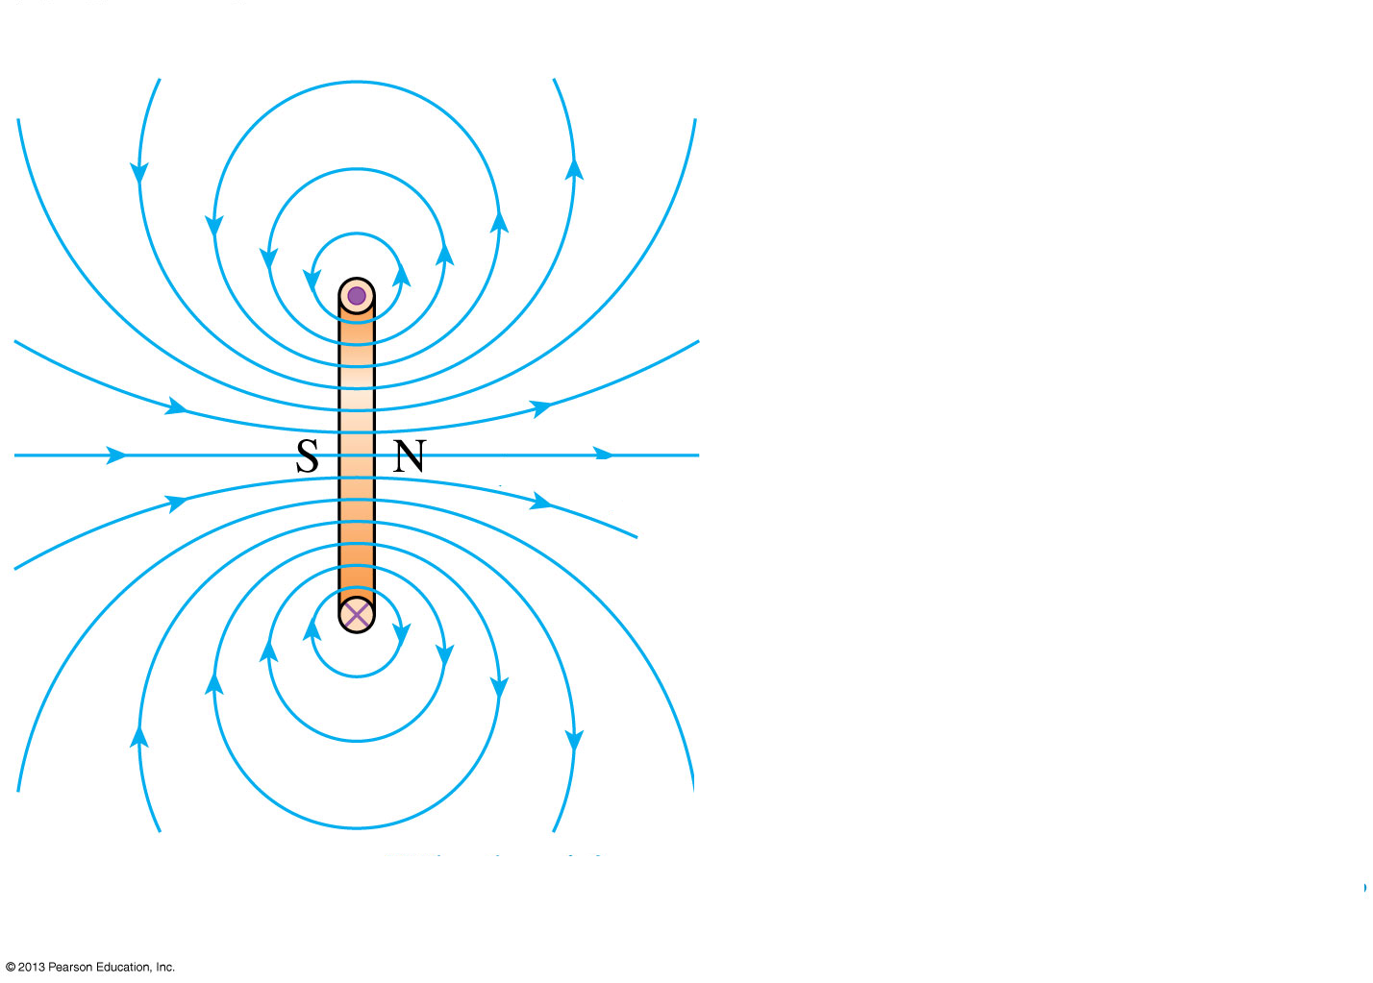
The Magnetic Dipole Moment
The SI units of the magnetic dipole moment are A m².
The on-axis field of a magnetic dipole is:
Slide 32-79

Slide 55
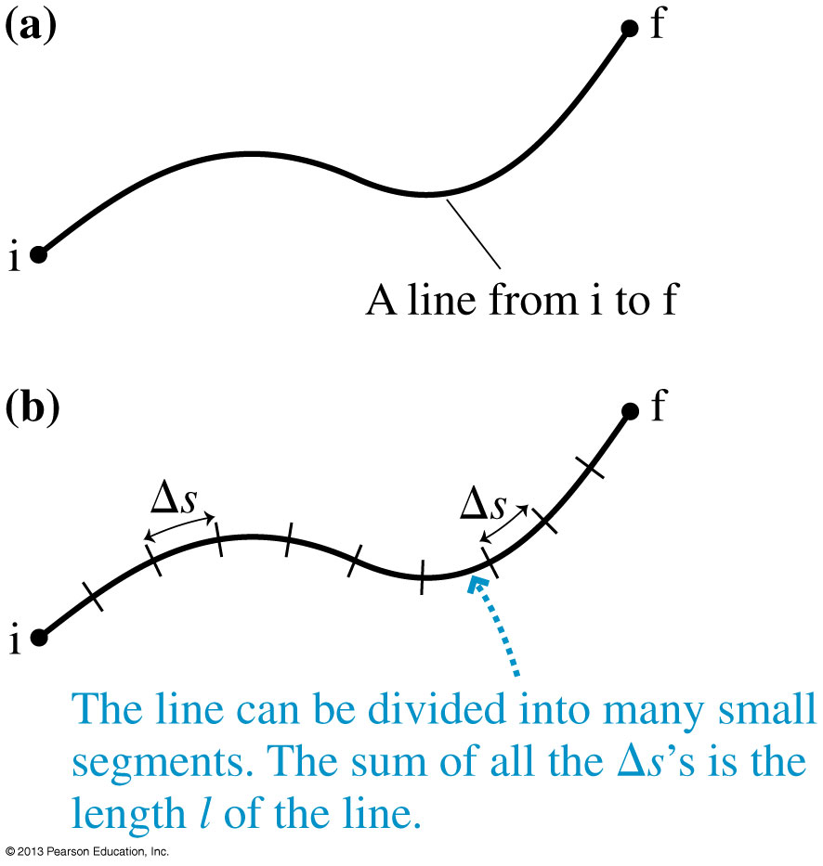
Line Integrals
Figure (a) shows a curved line from i to f.
The length l of this line can be found by doing a line integral:
Slide 32-82

Slide 56
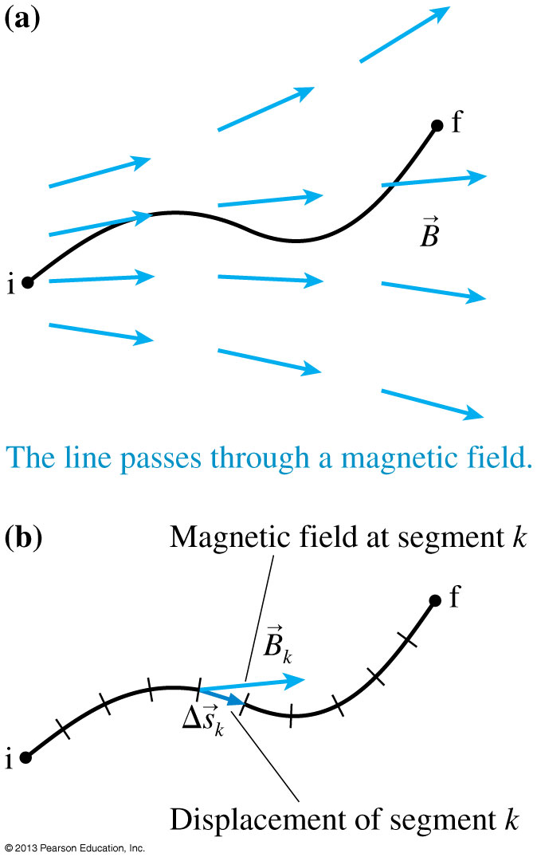
Line Integrals
Figure (a) shows a curved line which passes through a magnetic field .
We can find the line integral of from i to f as measured along this line, in this direction:
B
B
Slide 32-83

Slide 57
Tactics: Evaluating Line Integrals
Slide 32-84

Slide 58
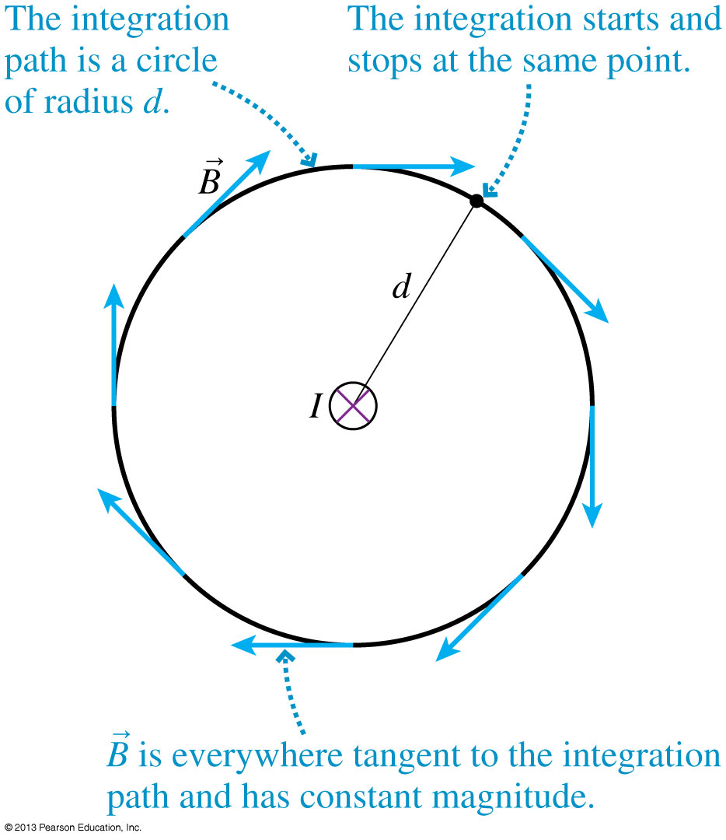
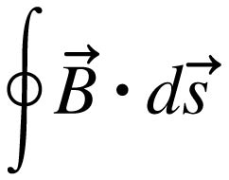
Ampère’s Law
Consider a line integral of evaluated along a circular path all the way around a wire carrying current I.
This is the line integral around a closed curve, which is denoted:
B
Slide 32-85

Slide 59
Ampère’s Law
B
Because is tangent to the circle and of constant magnitude at every point on the circle, we can write:
Here B = μ₀I/2πd, where I is the current through this loop, hence:
Slide 32-86

Slide 60
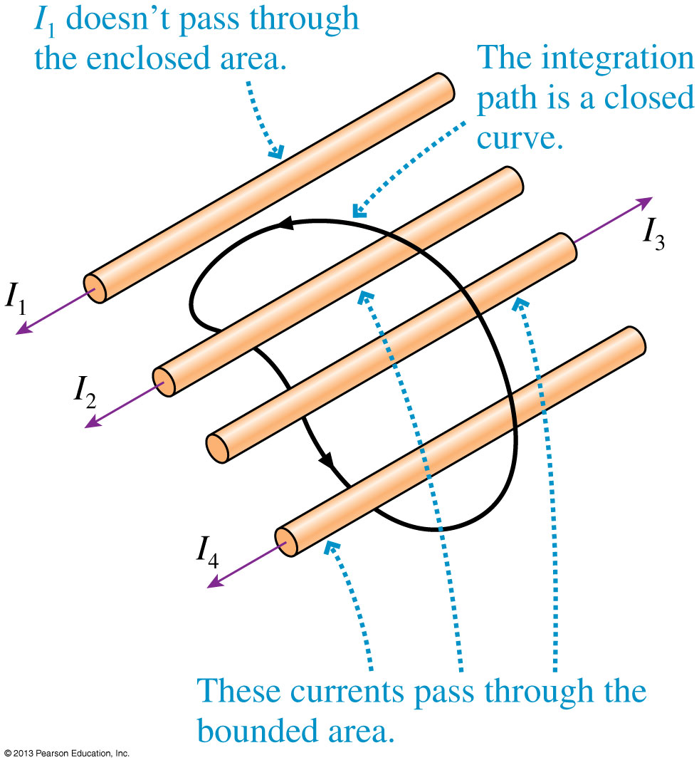
Ampère’s Law
Whenever total current I_{through} passes through an area bounded by a closed curve, the line integral of the magnetic field around the curve is given by Ampère’s law:
Slide 32-87

Slide 61
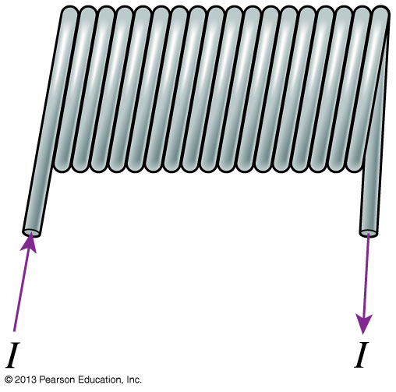
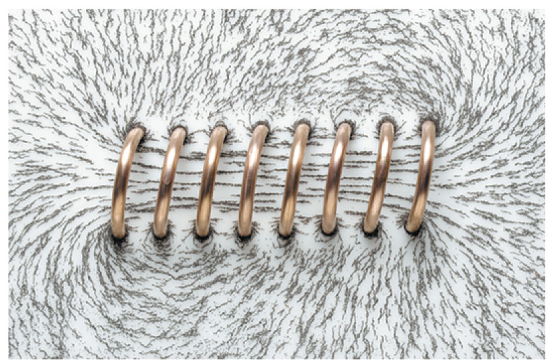
Solenoids
A uniform magnetic field can be generated with a solenoid.
A solenoid is a helical coil of wire with the same current I passing through each loop in the coil.
Solenoids may have hundreds or thousands of coils, often called turns, sometimes wrapped in several layers.
The magnetic field is strongest and most uniform inside the solenoid.
Slide 32-92

Slide 62
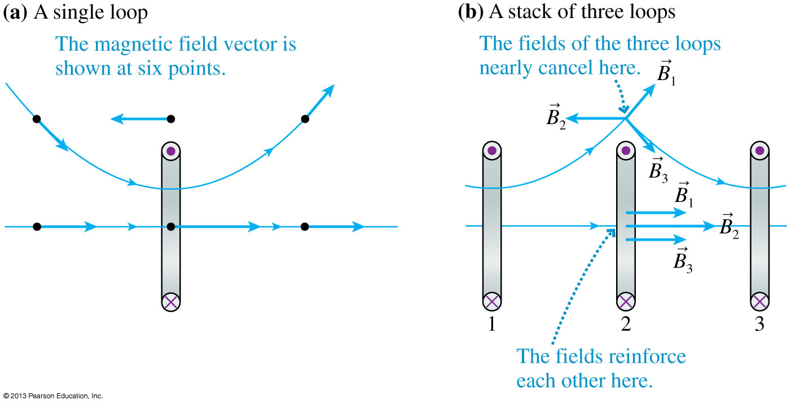
The Magnetic Field of a Solenoid
With many current loops along the same axis, the field in the center is strong and roughly parallel to the axis, whereas the field outside the loops is very close to zero.
Slide 32-93

Slide 63
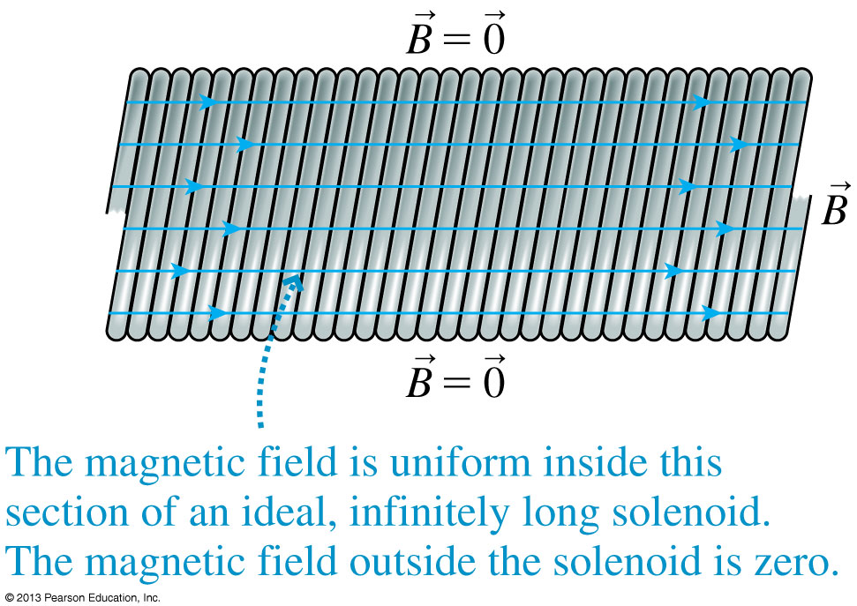
The Magnetic Field of a Solenoid
No real solenoid is ideal, but a very uniform magnetic field can be produced near the center of a tightly wound solenoid whose length is much larger than its diameter.
Slide 32-94

Slide 64
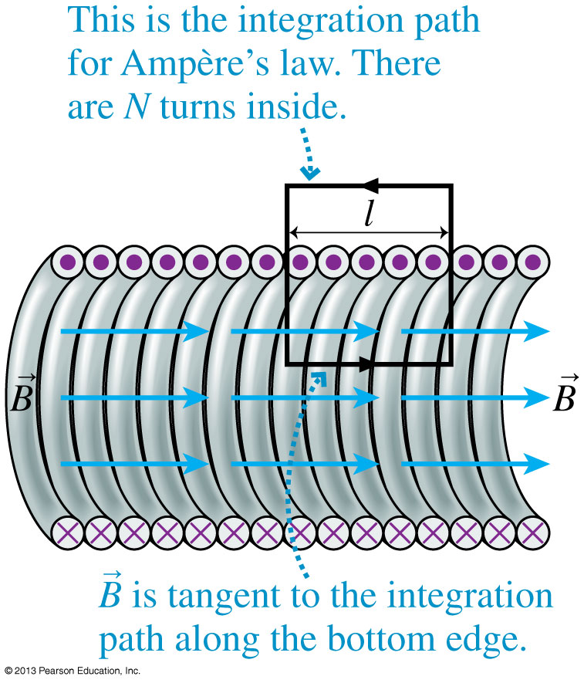
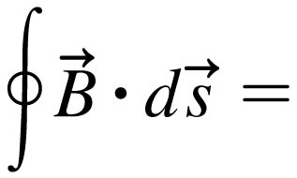
The Magnetic Field of a Solenoid
The figure shows a cross section through an infinitely long solenoid.
The integration path that we’ll use is a rectangle.
The current passing through this rectangle is I_{through} = NI.
Ampère’s Law is thus:
μ₀I_{through} = μ₀NI
Slide 32-95

Slide 65
The Magnetic Field of a Solenoid
Along the top, the line integral is zero since B = 0 outside the solenoid.
Along the sides, the line integral is zero since the field is perpendicular to the path.
Along the bottom, the line integral is simply Bl.
Solving for B inside the solenoid:
where n = N/l is the number of turns per unit length.
Slide 32-96

Slide 66
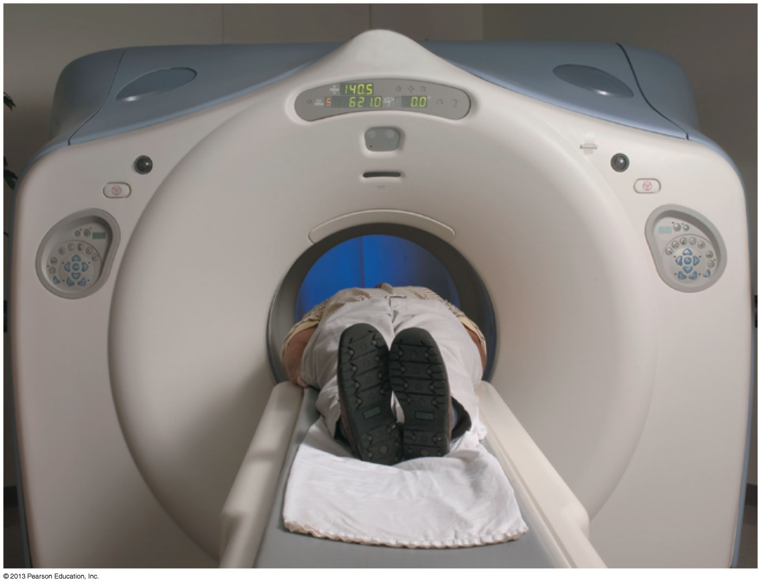
Generating an MRI Magnetic Field
This patient is undergoing magnetic resonance imaging (MRI). The large cylinder surrounding the patient contains a solenoid that is wound with superconducting wire to generate a strong uniform magnetic field.
Slide 32-101

Slide 67
Example 32.9 Generating an MRI Magnetic Field
Slide 32-102

Slide 68
Example 32.9 Generating an MRI Magnetic Field
Slide 32-103

Slide 69
Example 32.9 Generating an MRI Magnetic Field
Slide 32-104

Slide 70
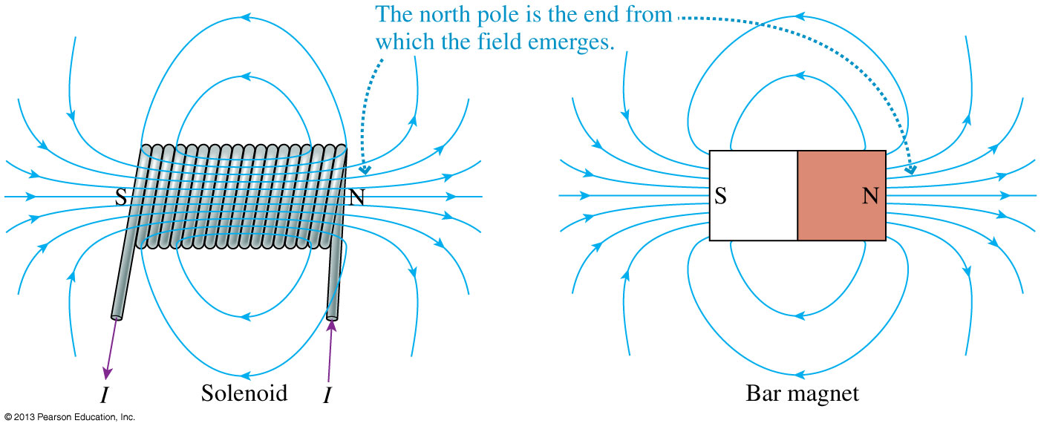
The Magnetic Field Outside a Solenoid
The magnetic field outside a solenoid looks like that of a bar magnet.
Thus a solenoid is an electromagnet, and you can use the right-hand rule to identify the north-pole end.
Slide 32-105

Slide 71
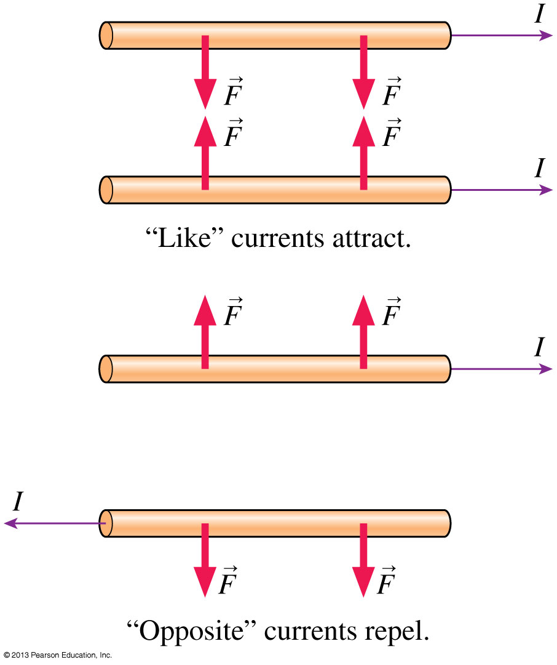
Ampère’s Experiment
After the discovery that electric current produces a magnetic field, Ampère set up two parallel wires that could carry large currents either in the same direction or in opposite directions.
Ampère’s experiment showed that a magnetic field exerts a force on a current.
Slide 32-106

Slide 72
The Magnetic Force on a Moving Charge
The magnetic force turns out to depend not only on the charge and the charge’s velocity, but also on how the velocity vector is oriented relative to the magnetic field.
Slide 32-107

Slide 73
The Magnetic Force on a Moving Charge
The magnetic force turns out to depend not only on the charge and the charge’s velocity, but also on how the velocity vector is oriented relative to the magnetic field.
Slide 32-108

Slide 74
The Magnetic Force on a Moving Charge
The magnetic force turns out to depend not only on the charge and the charge’s velocity, but also on how the velocity vector is oriented relative to the magnetic field.
Slide 32-109

Slide 75
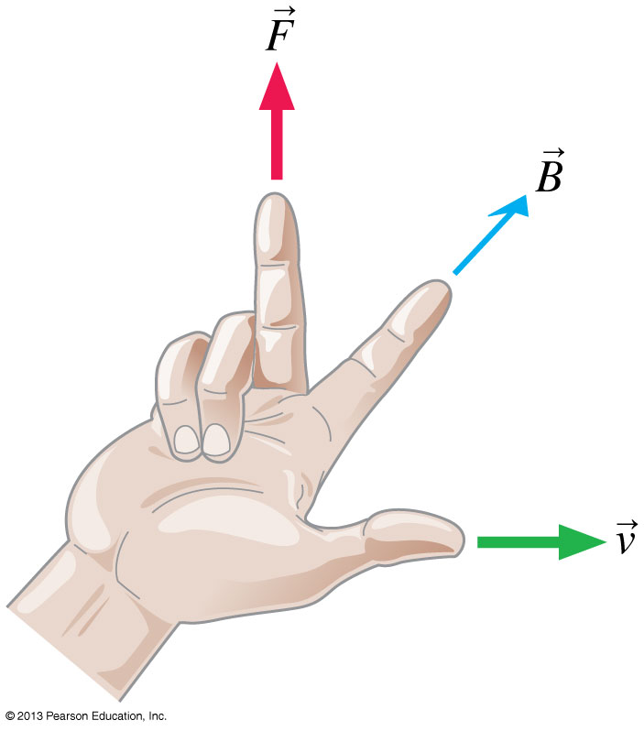
The Magnetic Force on a Moving Charge
The magnetic force on a charge q as it moves through a magnetic field B with velocity v is:
where α is the angle between v and B.
Slide 32-110

Slide 76
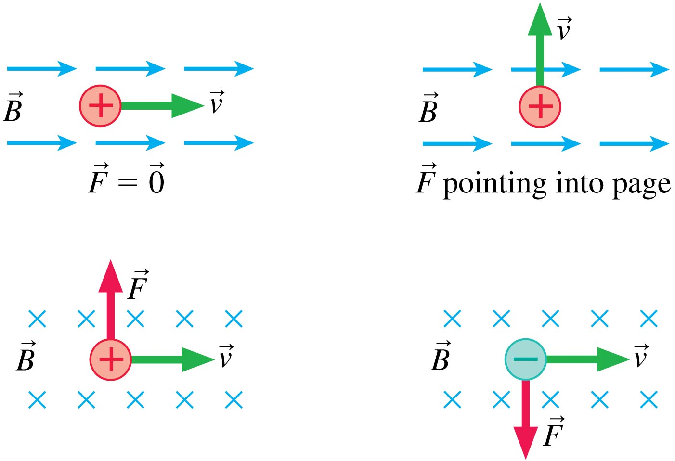
The Magnetic Force on a Moving Charge
Slide 32-111

Slide 77
Example 32.10 The Magnetic Force on an Electron
Slide 32-118

Slide 78
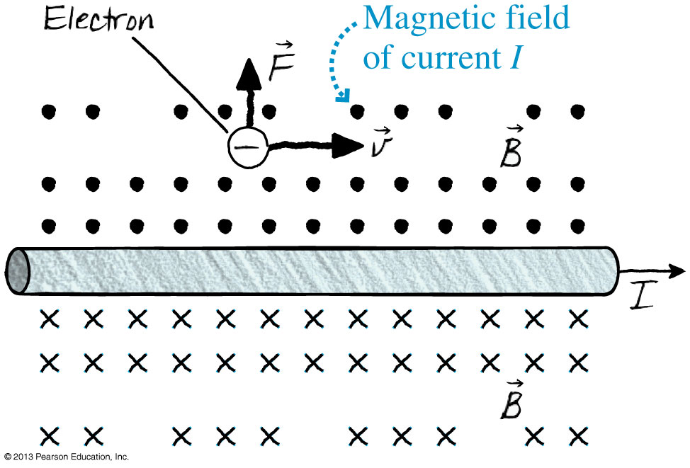
Example 32.10 The Magnetic Force on an Electron
Slide 32-119

Slide 79
Example 32.10 The Magnetic Force on an Electron
Slide 32-120

Slide 80
Example 32.10 The Magnetic Force on an Electron
Slide 32-121

Slide 81
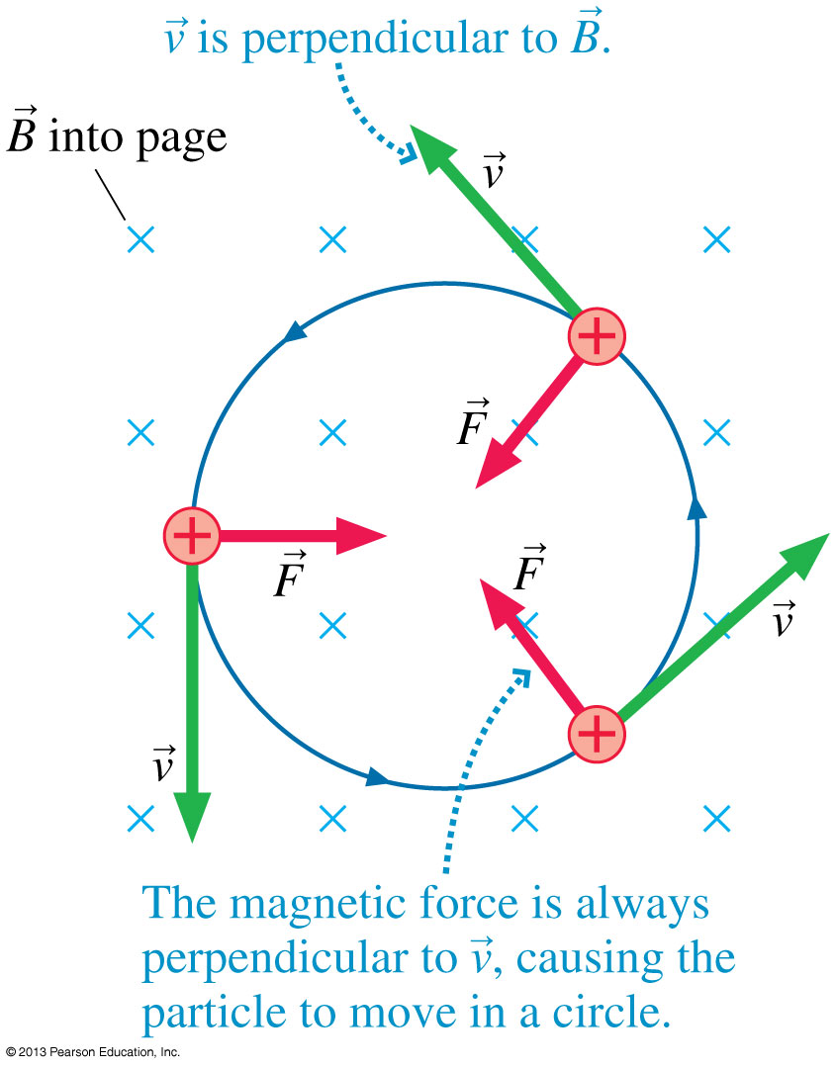
Cyclotron Motion
The figure shows a positive charge moving in a plane that is perpendicular to a uniform magnetic field.
Since is always perpendicular to , the charge undergoes uniform circular motion.
This motion is called the cyclotron motion of a charged particle in a magnetic field.
Slide 32-126

Slide 82
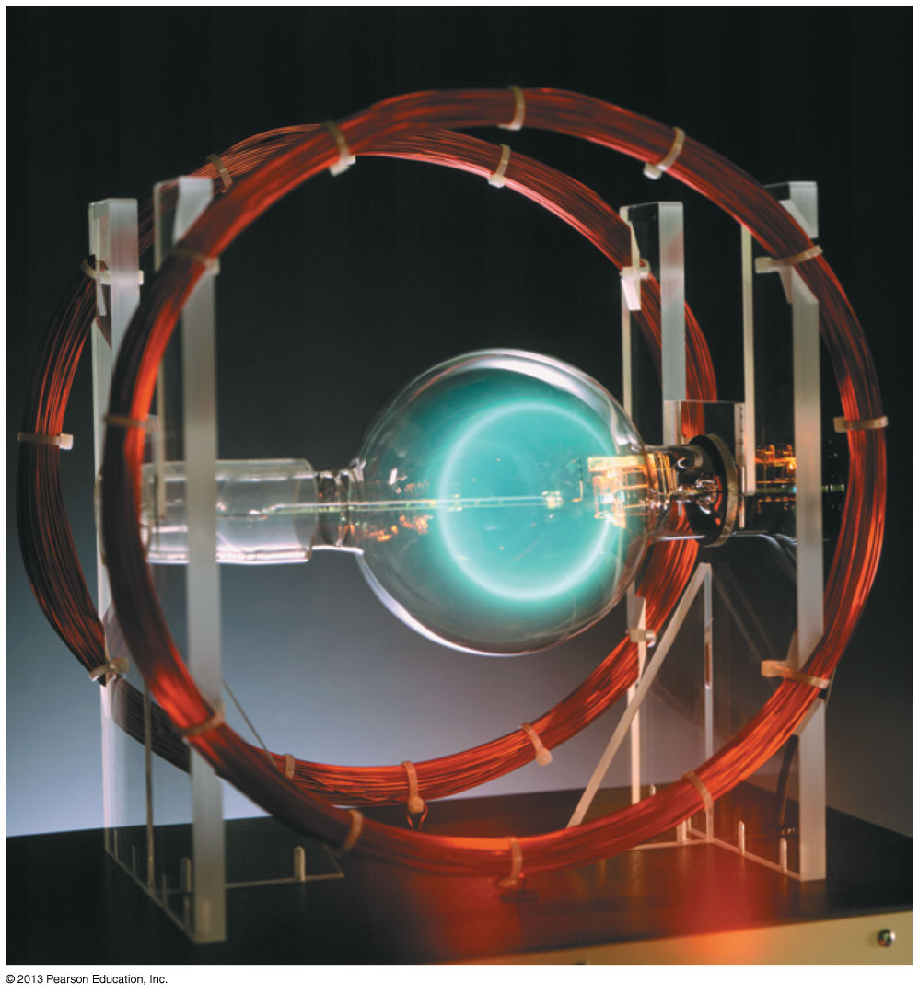
Cyclotron Motion
Electrons undergoing circular cyclotron motion in a magnetic field. You can see the electrons’ path because they collide with a low density gas that then emits light.
Slide 32-127

Slide 83
Cyclotron Motion
Consider a particle with mass m and charge q moving with a speed v in a plane that is perpendicular to a uniform magnetic field of strength B.
Newton’s second law for circular motion, which you learned in Chapter 8, is:
The radius of the cyclotron orbit is:
Recall that the frequency of revolution of circular motion is f = v/2πr, so the cyclotron frequency is:
Slide 32-128

Slide 84
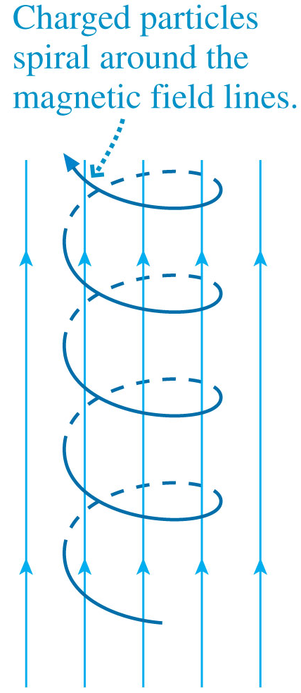
Cyclotron Motion
The figure shows a more general situation in which the charged particle’s velocity is not exactly perpendicular to .
The component of parallel to is not affected by the field, so the charged particle spirals around the magnetic field lines in a helical trajectory.
The radius of the helix is determined by v⊥, the component of perpendicular to .
Slide 32-129

Slide 85
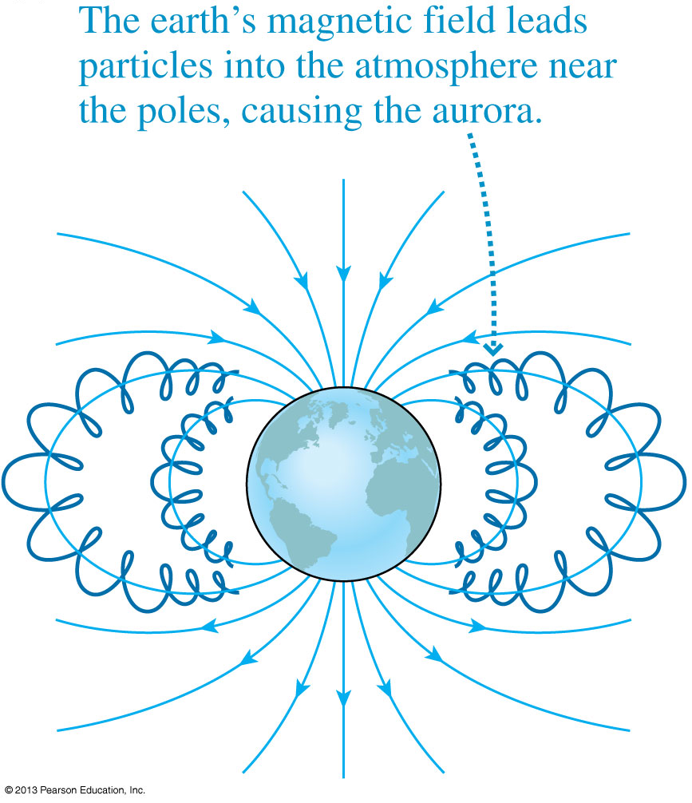
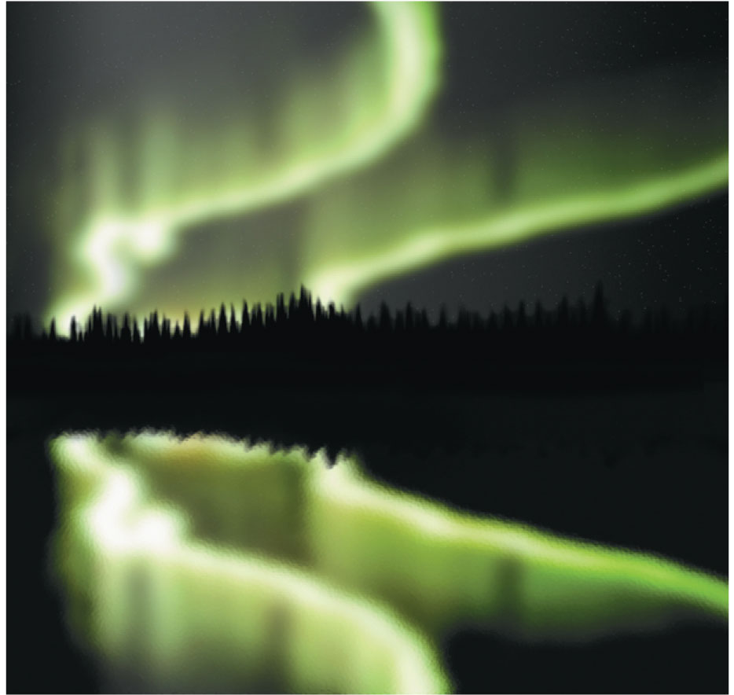
Aurora
Slide 32-130

Slide 86
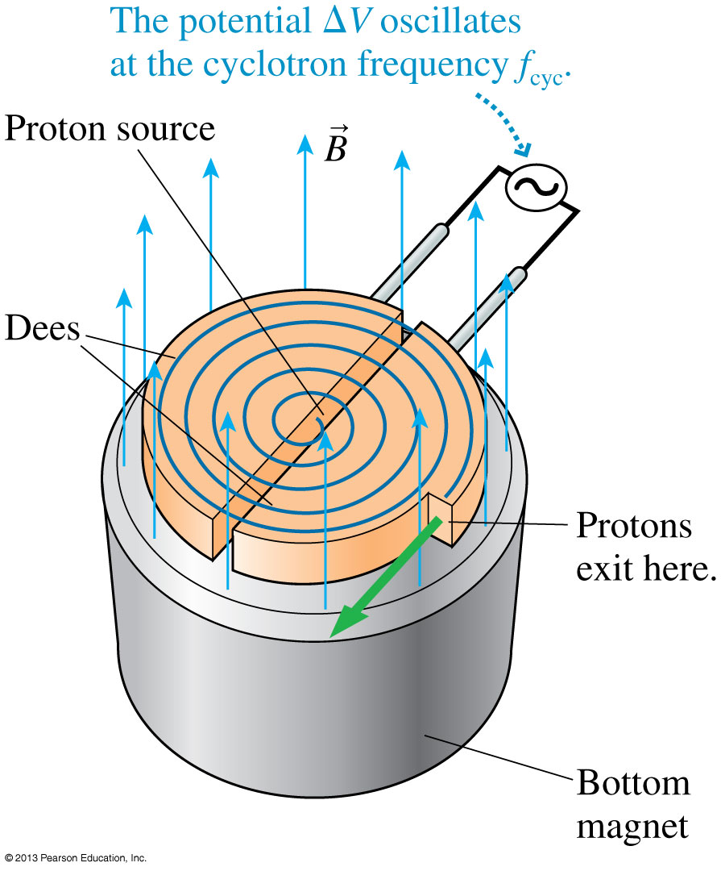
The Cyclotron
The first practical particle accelerator, invented in the 1930s, was the cyclotron.
Cyclotrons remain important for many applications of nuclear physics, such as the creation of radioisotopes for medicine.
Slide 32-131

Slide 87
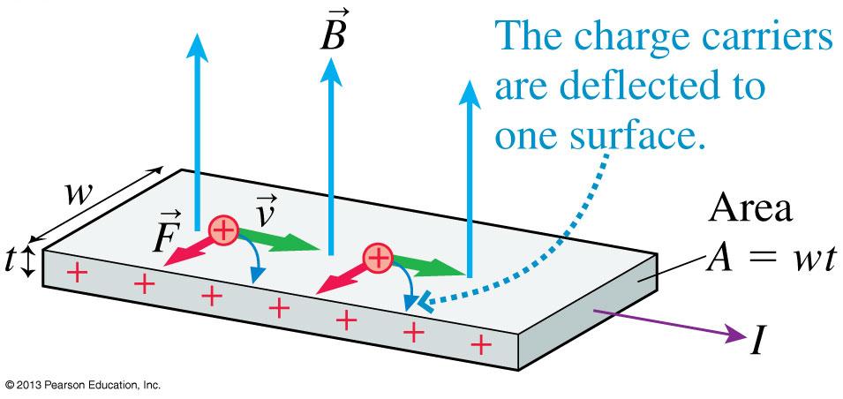
The Hall Effect
Consider a magnetic field perpendicular to a flat, current-carrying conductor.
As the charge carriers move at the drift speed v_{d}, they will experience a magnetic force F_{B} = ev_{d}B perpendicular to both and the current I.
Slide 32-132

Slide 88
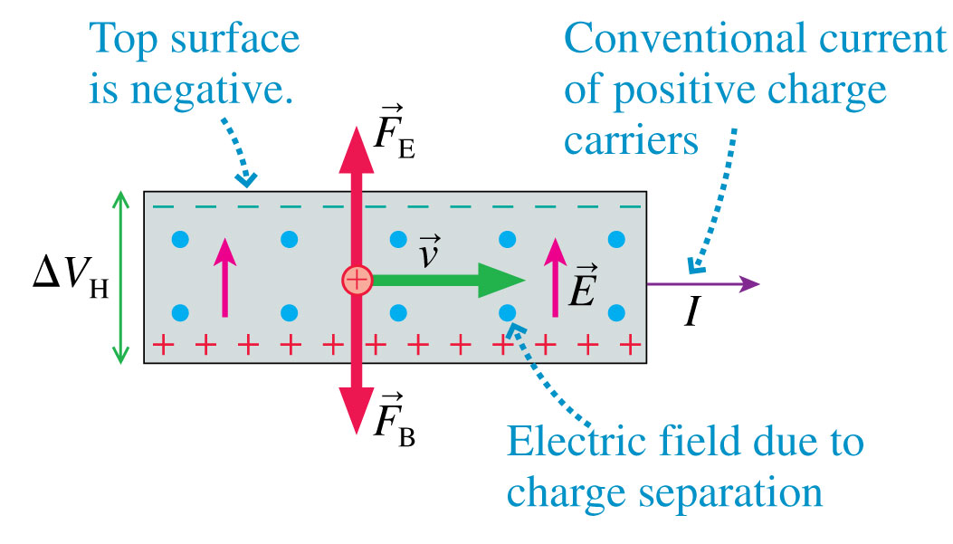
The Hall Effect
If the charge carriers are positive, the magnetic force pushes these positive charges down, creating an excess positive charge on the bottom surface, and leaving negative charge on the top.
This creates a measureable Hall voltage ΔV_{H} which is higher on the bottom surface .
Slide 32-133

Slide 89
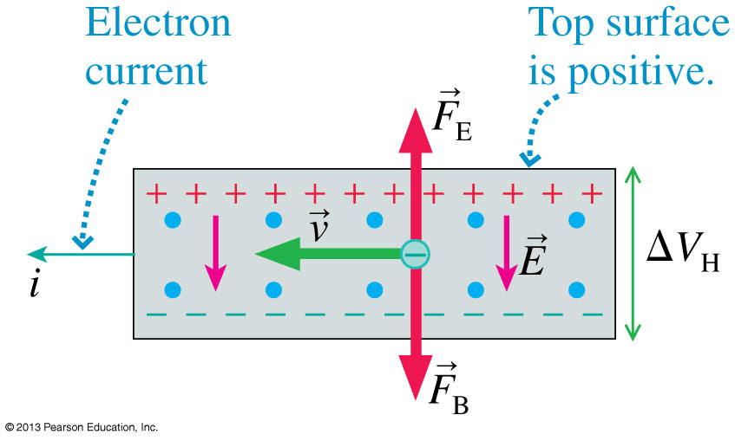
The Hall Effect
If the charge carriers are negative, the magnetic force pushes these positive charges down, creating an excess negative charge on the bottom surface, and leaving positive charge on the top.
This creates a measureable Hall voltage ΔV_{H} which is higher on the top surface.
Slide 32-134

Slide 90
The Hall Effect
When charges are separated by a magnetic field in a rectangular conductor of thickness t and width w, it creates an electric field E = ΔV_{H}/w inside the conductor.
The steady-state condition is when the electric force balances the magnetic force, F_{B} = F_{E}:
where v_{d} is the drift speed, which is v_{d} = I/(wtne).
From this we can find the Hall voltage:
where n is the charge-carrier density (charge carriers per m³).
Slide 32-135

Slide 91
Example 32.12 Measuring the Magnetic Field
Slide 32-136

Slide 92
Example 32.12 Measuring the Magnetic Field
Slide 32-137

Slide 93
Example 32.12 Measuring the Magnetic Field
Slide 32-138

Slide 94
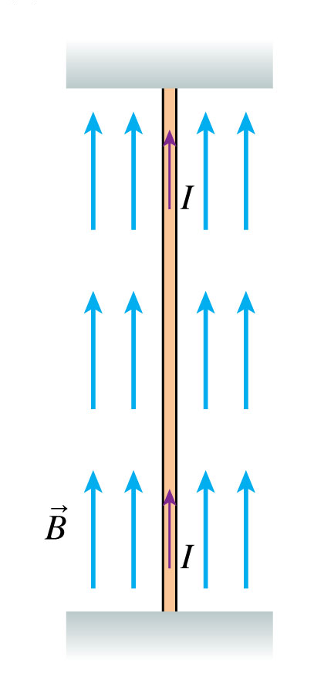
Magnetic Forces on Current-Carrying Wires
There’s no force on a current-carrying wire parallel to a magnetic field.
Slide 32-139

Slide 95
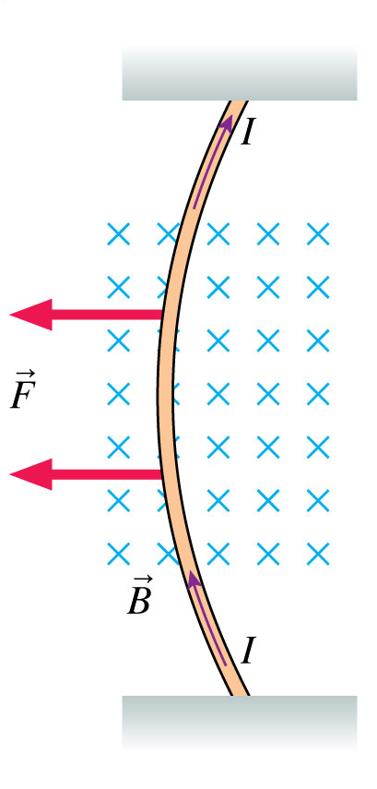
Magnetic Forces on Current-Carrying Wires
A current perpendicular to the field experiences a force in the direction of the right-hand rule.
If a wire of length l contains a current I = q/Δt, it means a charge q must move along its length in a time Δt = l/v.
Thus we have Il = qv.
Since = q × , the magnetic force on a current-carrying wire is:
Slide 32-140

Slide 96
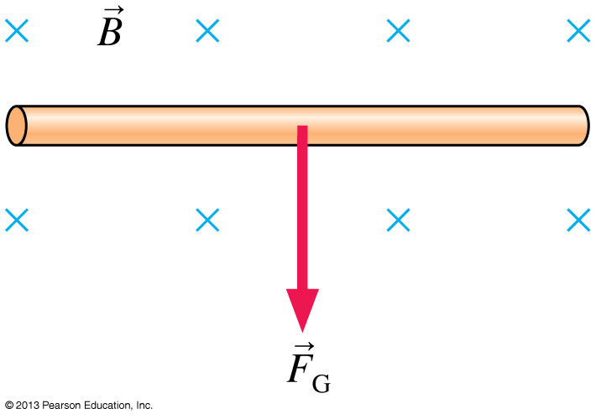
Example 32.13 Magnetic Levitation
Slide 32-143

Slide 97
Example 32.13 Magnetic Levitation
Slide 32-144

Slide 98
Example 32.13 Magnetic Levitation
Slide 32-145

Slide 99
Example 32.13 Magnetic Levitation
Slide 32-146

Slide 100
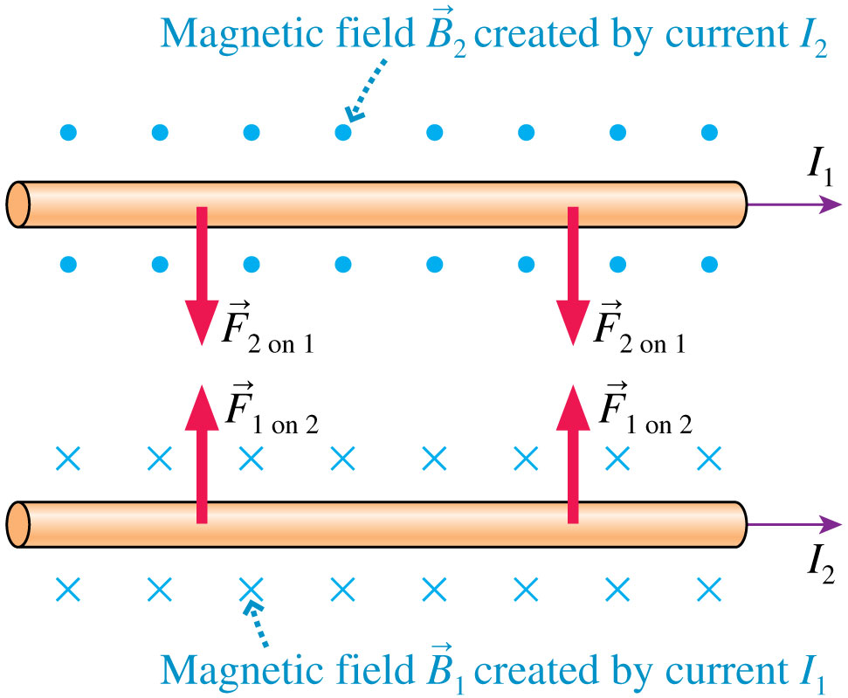
Magnetic Forces Between Parallel Current-Carrying Wires: Current in Same Direction
Slide 32-147

Slide 101
Magnetic Forces Between Parallel Current-Carrying Wires: Current in Opposite Directions
Slide 32-148

Slide 102
Forces on Current Loops
The two figures show alternative but equivalent ways to view magnetic forces between two current loops.
Parallel currents attract, opposite currents repel.
Opposite poles attract, like poles repel.
Slide 32-149

Slide 103
A Uniform Magnetic Field Exerts a Torque on a Square Current Loop
_{front} and _{back} are opposite to each other and cancel.
Both _{top} and _{bottom} exert a force of magnitude F = IlB around a moment arm d = ½lsinθ.
Slide 32-150

Slide 104
A Uniform Magnetic Field Exerts a Torque on a Square Current Loop
The total torque is:
τ = 2Fd = (Il²)Bsinθ = μBsinθ
where μ = Il² = IA is the loop’s magnetic dipole moment.
Although derived for a square loop, the result is valid for a loop of any shape:
Slide 32-151

Slide 105
A Simple Electric Motor
Slide 32-154

Slide 106
Atomic Magnets
A plausible explanation for the magnetic properties of materials is the orbital motion of the atomic electrons.
The figure shows a simple, classical model of an atom in which a negative electron orbits a positive nucleus.
In this picture of the atom, the electron’s motion is that of a current loop!
An orbiting electron acts as a tiny magnetic dipole, with a north pole and a south pole.
Slide 32-155

Slide 107
The Electron Spin
An electron’s inherent magnetic moment is often called the electron spin because, in a classical picture, a spinning ball of charge would have a magnetic moment.
While it may not be spinning in a literal sense, an electron really is a microscopic magnet.
Slide 32-156

Slide 108
Magnetic Properties of Matter
For most elements, the magnetic moments of the atoms are randomly arranged when the atoms join together to form a solid.
As the figure shows, this random arrangement produces a solid whose net magnetic moment is very close to zero.
Slide 32-157

Slide 109
Ferromagnetism
In iron, and a few other substances, the atomic magnetic moments tend to all line up in the same direction, as shown in the figure.
Materials that behave in this fashion are called ferromagnetic, with the prefix ferro meaning “iron-like.”
Slide 32-158

Slide 110
Ferromagnetism
A typical piece of iron is divided into small regions, typically less than 100 μm in size, called magnetic domains.
The magnetic moments of all the iron atoms within each domain are perfectly aligned, so each individual domain is a strong magnet.
However, the various magnetic domains that form a larger solid are randomly arranged.
Slide 32-159

Slide 111
Induced Magnetic Dipoles
If a ferromagnetic substance is subjected to an external magnetic field, the external field exerts a torque on the magnetic dipole of each domain.
The torque causes many of the domains to rotate and become aligned with the external field.
Slide 32-160

Slide 112
Induced Magnetic Dipoles
The induced magnetic dipole always has an opposite pole facing the solenoid.
Consequently the magnetic force between the poles pulls the ferromagnetic object to the electromagnet.
Slide 32-161

Slide 113
Induced Magnetism
Now we can explain how a magnet attracts and picks up ferromagnetic objects:
Electrons are microscopic magnets due to their spin.
A ferromagnetic material in which the spins are aligned is organized into magnetic domains.
The individual domains align with an external magnetic field to produce an induced magnetic dipole moment for the entire object.
Slide 32-162

Slide 114
Induced Magnetism
An object’s magnetic dipole may not return to zero when the external field is removed because some domains remain “frozen” in the alignment they had in the external field.
Thus a ferromagnetic object that has been in an external field may be left with a net magnetic dipole moment after the field is removed.
In other words, the object has become a permanent magnet.
Slide 32-163

Slide 115
Chapter 32 Summary Slides
Slide 32-164

Slide 116
General Principles
Slide 32-165

Slide 117
General Principles
Slide 32-166

Slide 118
General Principles
Slide 32-167

